Slide 1
网络化群集系统博弈动力学与平衡点研究
聊城大学矩阵半张量积理论与应用研究中心 2024 年暑期研修班
朱昱莹
天津工业大学 人工智能学院
2024.08.15
Notes:
首先，感谢李海涛老师的邀请，感谢聊城大学各位老师的热情帮助和招待！

Slide 2
大 纲
研究背景、现状
多社团网络演化博弈与平衡点分析
迭代博弈与零行列式策略
线性阈值博弈收敛性与平衡点
工作展望

Slide 3
合作者
天津工业大学
夏承遗教授
张志鹏博士
南开大学
陈增强教授

Slide 4
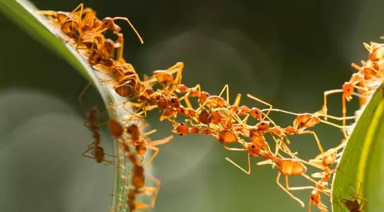
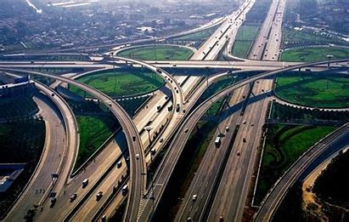
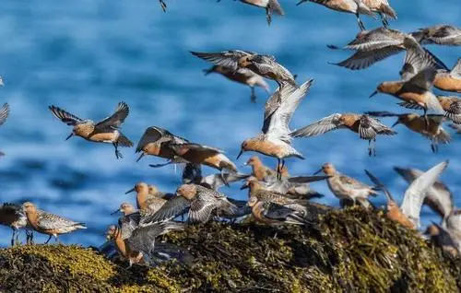
大规模的、由简单智能体所构成的群体
人群；
机器人群体；
动物群体；
车流…

Slide 5
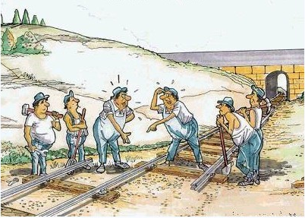
群体行为与协作
群属性（核心）：1+1>2
“群”：由大量的简单个体聚集而成的，虽然每个成员仅扮演简单的角色，但整体会呈现复杂的群体行为。
蚂蚁成群结队搜寻食物
蜜蜂合作筑巢
飞鸟成群
每只鸟都试图找到另一只一起飞翔
为了减少阻力，最终形成一个鸟群

Slide 6
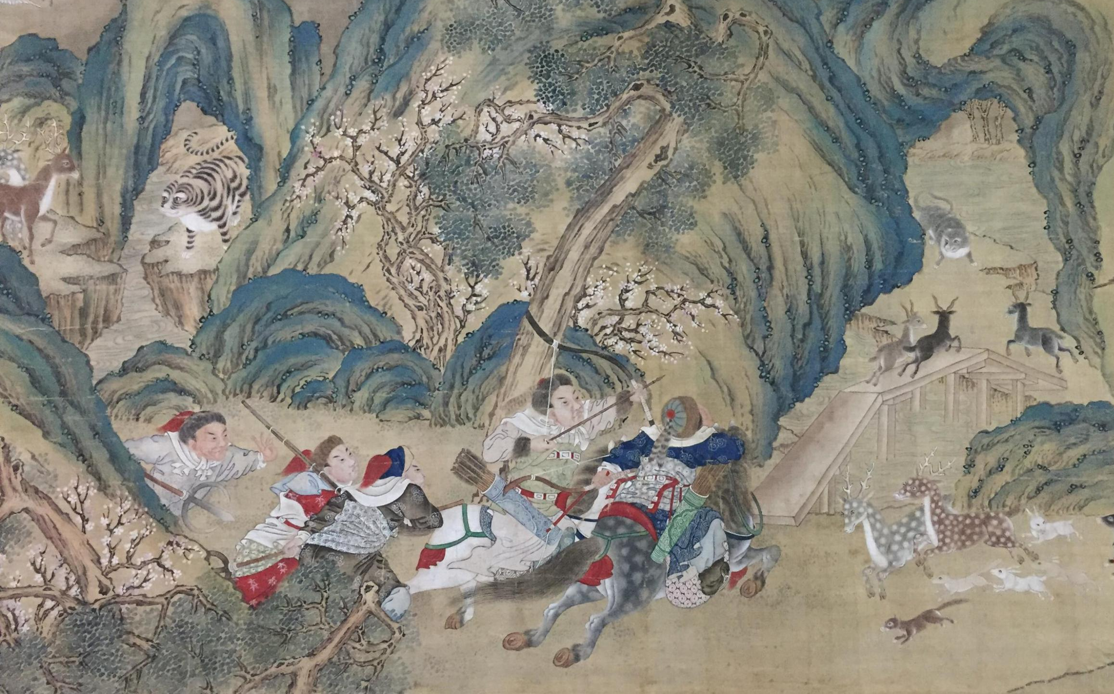
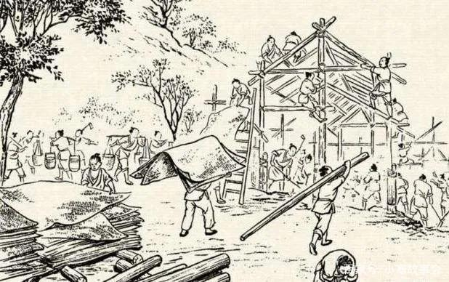
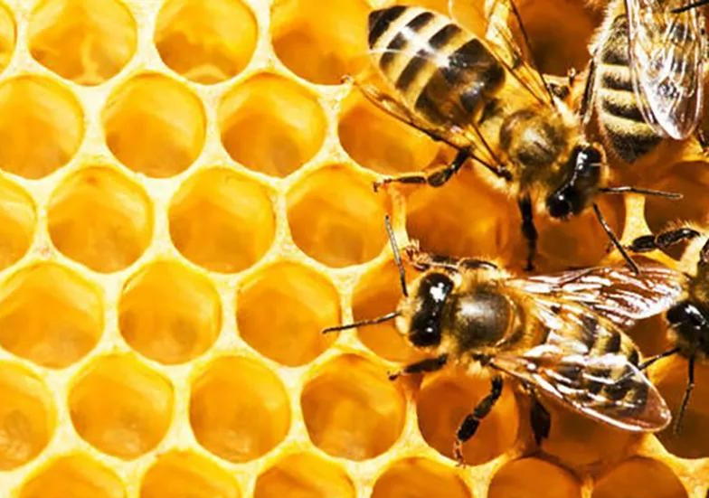
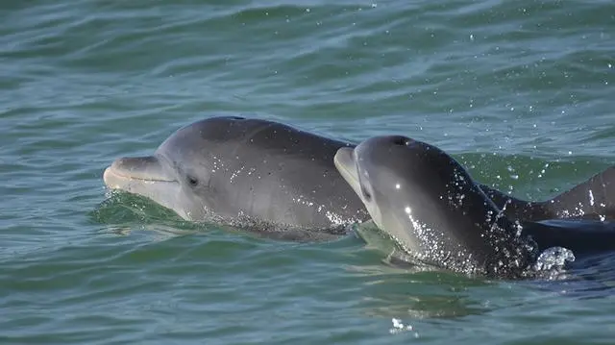
同一物种内
幸运！英男子游泳被鲨鱼袭击，海豚主动救援！
海葵与寄居蟹
不同物种间
[1] Nowak M A. May R M, Sigmund K. The arithmetics of mutual help, Scientific American.1995
[2] E.Pennisi, On the origin of cooperation, Science.2009.
合作行为广泛存在！

Slide 7
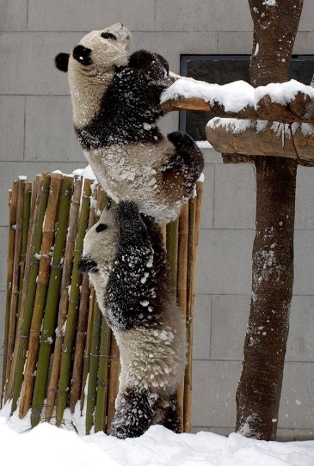
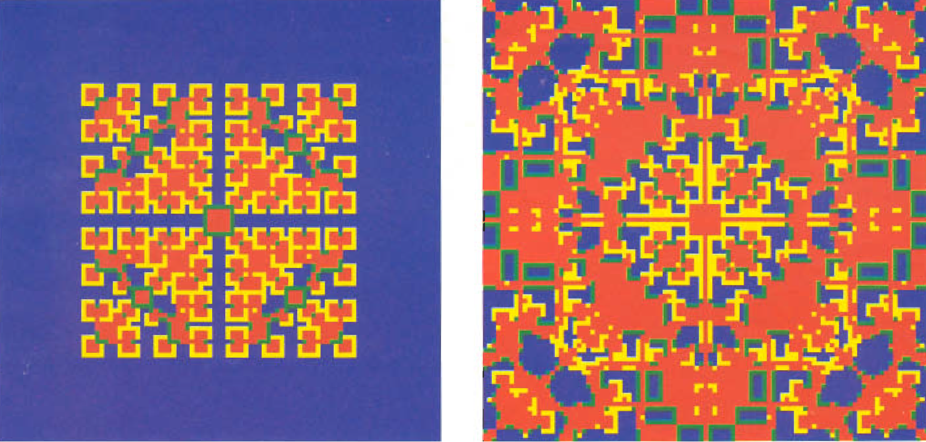
为什么蚂蚁和蜜蜂具有如此高度的牺牲精神？这种无私的利他行为是不是违背了自私基因的原理呢？如何解释这类社会化合作现象？
亲缘选择理论
直接互惠
“tit-for-tat”
“win-stay, lose-shift”
群组互惠
间接互惠
网络互惠
Notes:
群组互惠：对于一个群组内部，成功的个体会大量繁殖，当群组达到一定规模后，就会一分为二，为了保证所有群组数量的稳定，就有一些劣势群组面临消失。就像大公司会吞并小公司。自私的个体能获取更多资源，但由自私个体组成的群体没有生存优势，在进化中被消灭。而利他的个体虽然获得资源少，但利他个体促进合作，合作能使群体更有生存优势，由此该群体存活和发展概率更高。
网络互惠：早在1992年，Nowak和May 研究了二维方格上的囚徒困境博弈以及合作策略在二维方格上的演化。

Slide 8
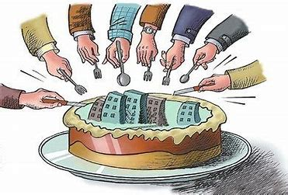
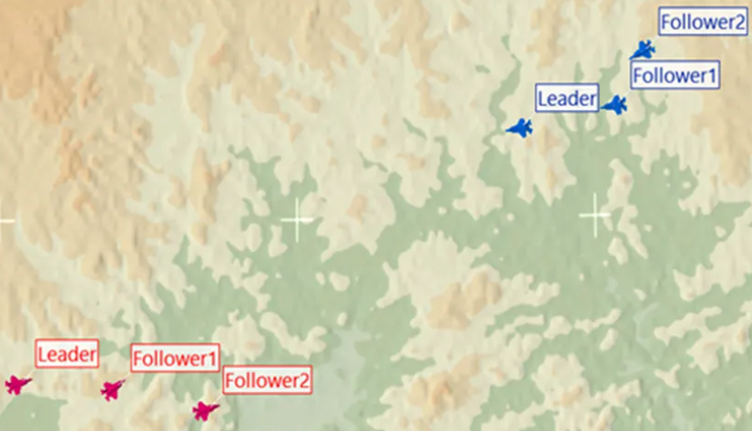
探究群体合作具有现实意义！
智能体最大化自身回报
异构无人机集群红蓝对抗

Slide 9
2005年，在庆祝创刊125周年之际，Science公布了125个最具挑战性的科学问题。如何理解合作的涌现被Science列为本世纪最难的125个科学问题之一

Slide 10
16年之后的2021年，随着科学的不断突破，许多问题得到一定程度的解答，一些问题也更加深入，上海交通大学携手Science杂志发布了“新125个科学问题”——《125个科学问题：探索与发现》

Slide 11
着重研究在动态演化中，理性或有限理性的个体在重复博弈过程中，通过自适应的学习来最大化自身收益。
决策过程
演化稳定状态
收益函数
$$P=f(s,t)$$
个体策略
收益
$$S=\left\{A, B, C…\right\}$$
演化稳定策略 (Smith & Price)
将不同的物种看成不同的策略，物种间的竞争用博弈来描述，最终在优胜劣汰自然规则的作用下存活的物种（策略）就是演化稳定策略 $x$
$u(x, x)≥u(y,x)$; $u\left(x, y\right)>u(y,y)$
博弈过程
初始状态
Notes:
如何建模

Slide 12
演化博弈论——多学科融合的理论
Evolutionary game theory, 不再将人模型化为超级理性的博弈方，认为人类通常是通过试错的方法达到博弈均衡的，与生物演化具有共性，即有限理性；所选择的均衡是达到均衡的均衡过程的函数，因而历史、制度因素以及均衡过程的某些细节都会对博弈的多重均衡的选择产生影响。
[3] Weibull, J. W. (1995) Evolutionary game theory, MIT Press
[4]Maynard Smith, J. (1982) Evolution and the Theory of Games", Cambridge University Press
[5]Axelrod R. (2006) The Evolution of Cooperation, Basic Books, New York.
Notes:
涉及到的具体的数学工具

Slide 13
影响博弈合作水平的因素
群体结构
Well-mixed
特定的拓扑：网络
博弈规则
博弈模型：PD/SD/PGG
策略更新机制
同步/异步
规则：RD, UI, Fermi, Moran, Myopic best-response
Notes:
在演化博弈理论框架下，我们将考虑如下几个要素

Slide 14
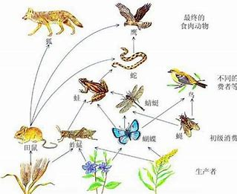
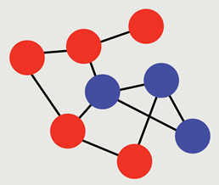
网络博弈
由众多复杂网络所构成的复杂系统广泛存在于自然界和现实的人类社会中
生物种群食物链、高度社会化的人类群体中复杂联系、生命体中的蛋白质和细胞网络、跨区域甚至跨越国界的交通运输网络
网络上的博弈
博弈过程
收益计算
收益比较与决策过程
Notes:
群体结构方面，一些复杂的博弈场景可被抽象成各种各样复杂网络的大规模群体，并时刻影响着人们的生活。

Slide 15
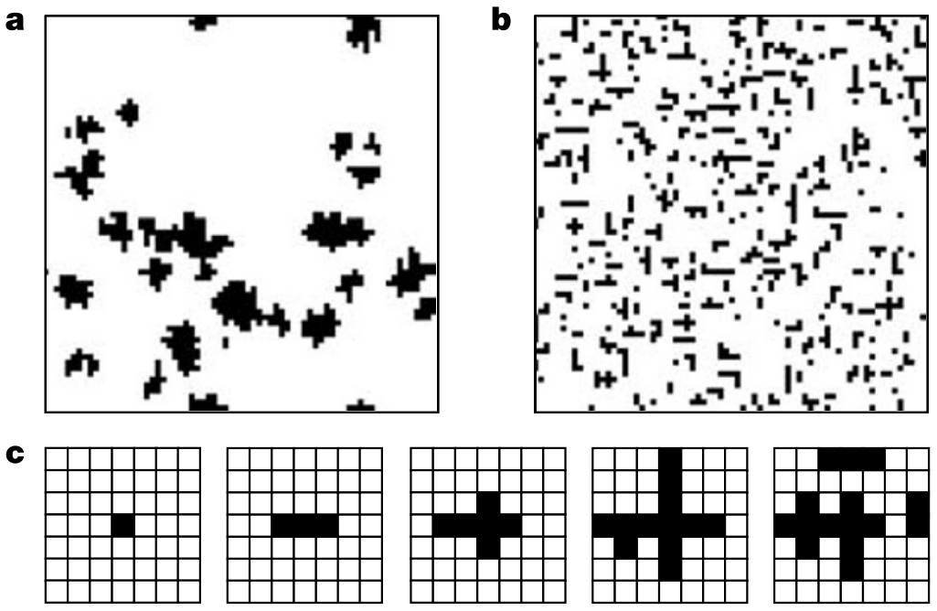
网络博弈
[6]Nowak, M., May, R. Evolutionary games and spatial chaos. Nature 359, 826–829 (1992)
早在1992年，Nowak和May 研究了二维方格上的囚徒困境博弈以及合作策略在二维方格上的演化。
合作在二维方格上得以促进！
t = 30 t = 217
t = 219 t = 221
2004 年，Hauert 和 Doebeli 使人们重新审视空间结构对于雪堆博弈所起到的作用：在二维正则格子上雪堆博弈的合作低于均匀混合群体中合作策略的比例。
合作行为反而被抑制！
[7]Hauert, C., Doebeli, M. Spatial structure often inhibits the evolution of cooperation in the snowdrift game. Nature 428, 643–646 (2004).

Slide 16
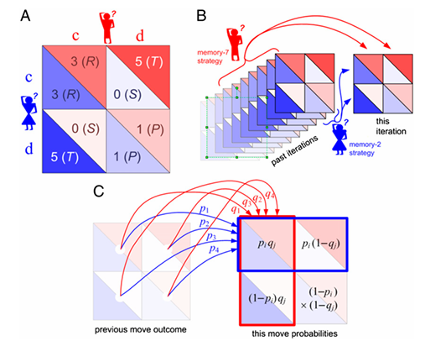
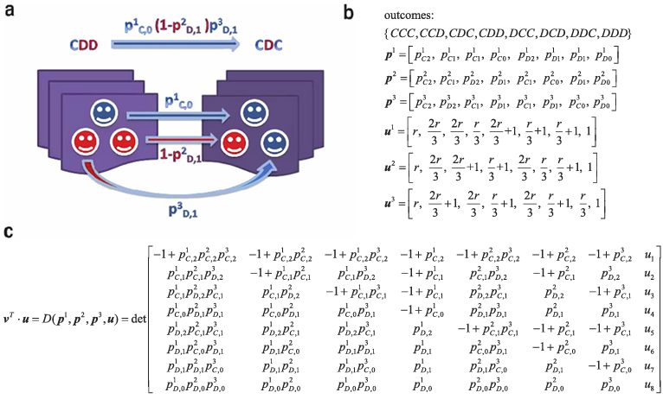
迭代博弈（零行列式角度）
Direct reciprocity: assume that there are repeated encounters between the same two individuals ^{[8]}.
[9]
[10]
[8] Nowak, M. A. (2006) Five Rules for the Evolution of Cooperation, Science.
[9] Press, W.H. and Dyson, F.J. (2012) Iterated Prisoner’s Dilemma contains strategies that dominate any evolutionary opponent, PNAS.
[10] Pan, L., Hao, D., Rong, Z. and Zhou, T. (2015) Zero-Determinant Strategies in Iterated Public Goods Game, Scientific Reports.

Slide 17
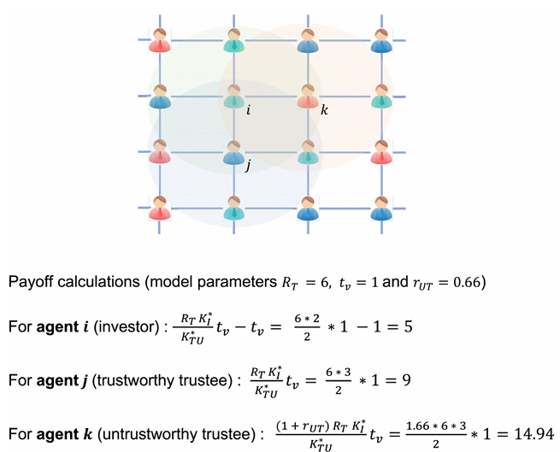
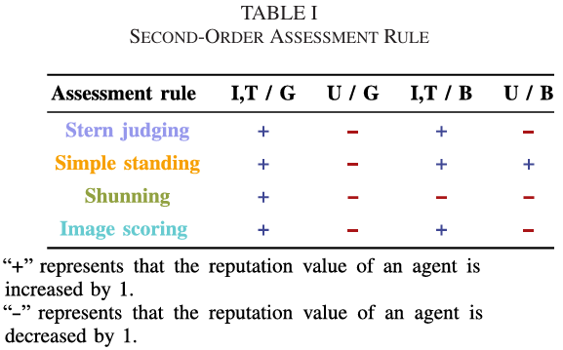
信任博弈
多人信任博弈^{[11]}
二阶声誉
[11] Li, X., Feng, M., Han, W., Xia, C. (2023) N-Player Trust Game With Second-Order Reputation Evaluation in the Networked Population, IEEE Systems Journal.
[12] Ren, T. and Zeng, X. (2023) Reputation-based Interaction Promotes Cooperation with Reinforcement Learning. IEEE Transactions on Evolutionary Computation.
[13] Xia, C., Wang, J., Perc, M. and Wang, Z. (2023) Reputation and reciprocity, Physics of Life Reviews.

Slide 18
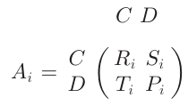
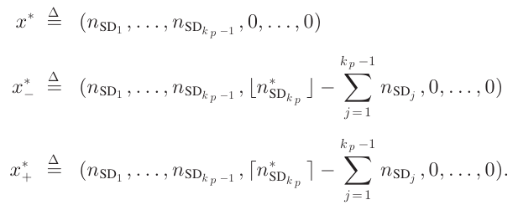
异质群体博弈
^{[14]}
[14] Ramazi, P. and Cao, M. (2018) Asynchronous Decision-Making Dynamics Under Best-Response Update Rule in Finite Heterogeneous Populations, IEEE Transactions on Automatic Control.
[15] Ramazi, P., Riehl, J. And Cao, M. (2016) Networks of conforming or nonconforming individuals tend to reach satisfactory decisions. PNAS

Slide 19
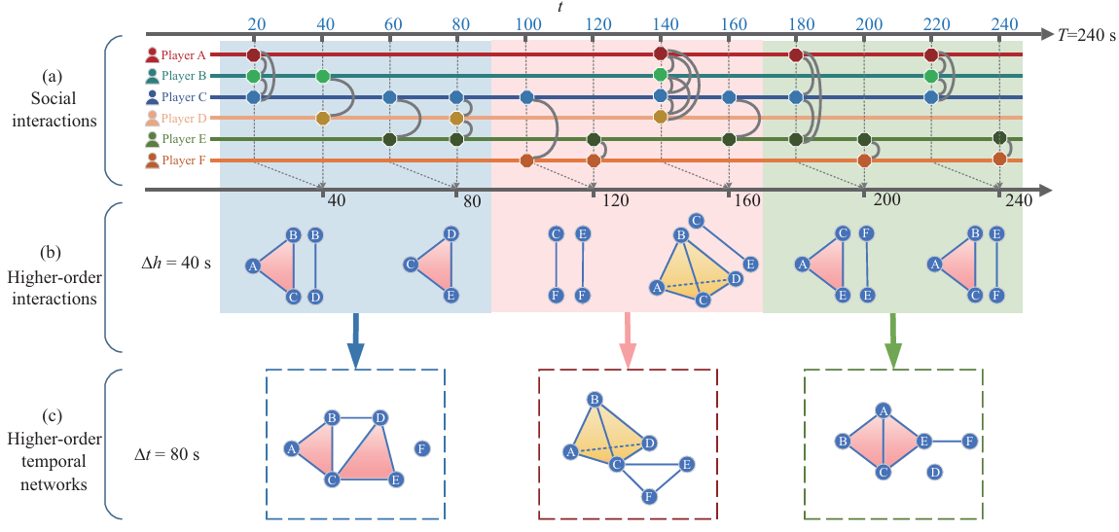
时序网络博弈
^{[16]}
[16]李阿明, 侯谷庾, 王龙. (2023)时序网络构建的理论和方法. 控制与决策.
[17] Xu, Y., Wang, J., Xia, C. and Wang, Z. (2023) Higher-order temporal interactions promote the cooperation in the multiplayer snowdrift game. Science China Information Sciences.
[18] Su, Q., McAvoy, A. and Plotkin, J. B . (2023) Strategy evolution on dynamic networks. Nature Computational Science.
Notes:
temporal effect of higher-order networks can facilitate the evolution of cooperation; higher-order topology can enhance the emergence of cooperation within a certain range of parameters; contribution of temporal burstiness and participants burstiness to cooperation is reversed

Slide 20
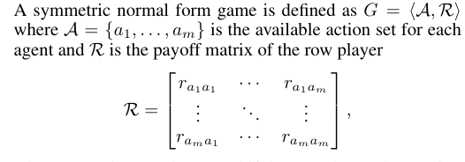
博弈与强化学习
Two-player Symmetric Game
Immediate reward
Learning rate

Slide 21
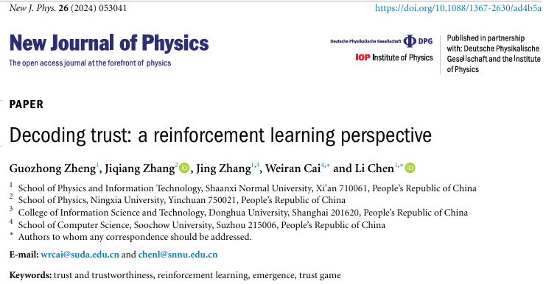
[19] Exploring cooperative evolution with tunablepayoff’s loners using reinforcement learning, Chaos, Solitons and Fractals, 2024.
[20] Reputation-based Interaction Promotes Cooperation with Reinforcement Learning, IEEE Transactions on Evolutionary Computation, 2023.
[21] Learning in Games: A Systematic Review, Science China Information Sciences, 2024.
[22] Modelling the Dynamics of Regret Minimization in Large Agent Populations: a Master Equation Approach, IJCAI, 2022.

Slide 22
汇报大纲
研究背景、现状
多社团网络演化博弈与平衡点分析
迭代博弈与零行列式策略
线性阈值博弈收敛性与平衡点
总结与展望

Slide 23
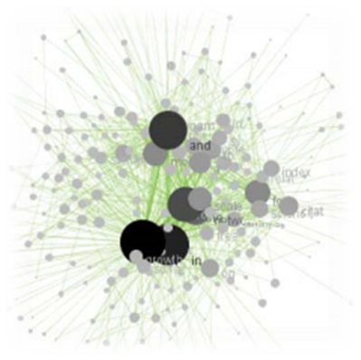
从均匀混合到社团网络
Successful strategies spread by natural selection.
How can natural selection lead to cooperation?
Well-mixed group
Structured populations
Evolutionary game theory (EGT) pioneered by John Maynard Smith provides a mathematical framework for describing the cooperative problem in large infinite populations.
Recently, there has been a growing interest in studying the evolutionary dynamics of structured populations where individuals are arranged on a network or graph.
Refs:
[1] William D Hamilton. The evolution of altruistic behavior [J]. American Saturalist, 1963, 97:354-356.
[2] Nowak M A, May R M, Sigmund K, The arithmetics of mutual help, Scientific American, 1995.

Slide 24
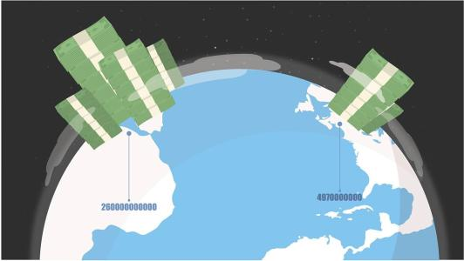
Birds migrate as season changes. Studies with respect to the migration habits is of great significances.
Studies on several typical economic models, e.g., the prisoner's dilemma (PD), public good game (PGG).
Biology
Social
science
EGT
Economics
Social dilemmas are situations in which the optimal decision of an individual contrasts with the optimal decision for the group.
Allows further understanding on the appearance and the prevalence of HIV or cancer, hence new approaches to treat diseases can be explored.
Medical
science

Slide 25
Population structure can be described by a network
Nodes in network represent the individual agents
The state of the agents in this network correspond to the strategy
Network theory has provided important insights into the dynamics of interactions in a structured population.

Slide 26
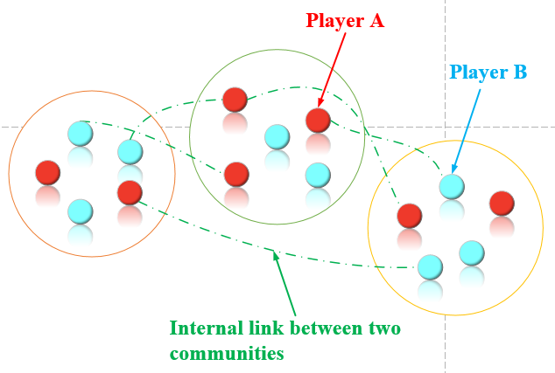
社团结构群体描述
Now we consider a symmetrical $2×2 \text{game} \text{with} \text{two} \text{pure} \text{strategies} \text{A} \text{and} \text{B}\text{.}$
 | A | B
Payoff of A | a | b
Payoff of B | c | d
PD game with dominating A or B: a > c, b > d; a < c, b < d.
SD game with coexisting A and B: a < c, b > d.
Coordination game with bistable A and B: a > c, b < d.

Slide 27
连接概率矩阵
Elements $w_{ij}$ of the matrix W must be real numbers in the closed interval [0, 1].
The interaction probability within the same community is larger than that between communities, i.e., $w_{ii}>w_{ij} ,$for all $j≠i.$

Slide 28
收益计算
In the two-strategy game, the payoffs of strategies A and B in community i are denoted by
And the n-dimensional column vectors are respectively

Slide 29
演化方程
In community i, replicator equation, which describes the dynamics of strategies A and B, is given by
The average payoff is $\overline{P_{i}}=x_{i}P_{Ai}+y_{i}P_{Bi}$, substituting $x_{i}+y_{i}=1$ into the replicator equation above, we get

Slide 30
雅可比矩阵
The elements in the Jacobian matrix of the above differential equation are

Slide 31
扩展至 n-community 系统
Assume that the state of the i-th community $x_{i}$merely has two options: $x_{i}=1$ or $x_{i}=0,$ hence there are totally $2^{n}$ formations for $\vec{x}$. The non-diagonal elements in the Jacobian matrix $J^{m}$ are zero and the diagonal elements for $J^{m}$ are
Then, discuss the stability of the boundary equilibrium points according to the following scenarios: a>c, b>d; a<c, b<d; a<c, b>d; a>c, b<d.

Slide 32
The n-community system
The two typical border equilibria: $(0,0,…,0)$ and $\left(1,1,…,1\right)$ are important. Supposing that there are $n$ ($n>2$) communities in the system, the Jacobian matrixes for the two equilibria are respectively

Slide 33
The n-community system
Case 1: When a>c, b>d
Except for the stable point $\left(1,1,…,1\right)$, the rest of the $2^{n}−2$ equilibria are all unstable.
Case 2: When a<c, b<d
Only $(0,0,…,0)$ is stable among the $2^{n}$ types of border equilibriums.

Slide 34
示 例
Supposing that there are totally 8 communities in this whole population. The interacting matrix W is

Slide 35
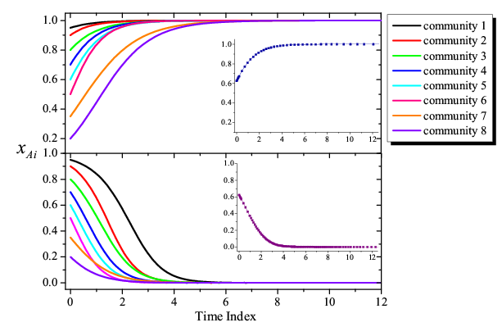
示 例
System dynamics when there are totally eight communities in the whole population. Vertical axis $x_{Ai}$ is the fraction of A-players in community i (i=1, 2, …, 8).
Upper figure: A dominates ($λ=−0.5,k=1.5$ )
Lower figure: B dominates ($λ=0.5,k=−1.5$ )
Small panels: the evolution process of the whole system.

Slide 36
Examples
Case 3: When a<c, b>d
We are sure that points $(0,0,…,0)$ and $\left(1,1,…,1\right)$ are all unstable.
Case 4: When a>c, b<d
Both of the border equilibria $(0,0,…,0)$ and $\left(1,1,…,1\right)$ are stable states.
与均匀混合群体中协调博弈结果一致！

Slide 37
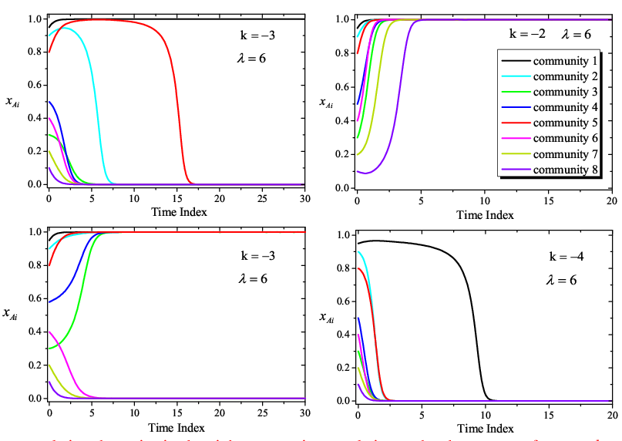
Examples for a>c, b<d
Similar to the coordination game in well-mixed population, both of the border equilibria $(0,0,…,0)$ and $\left(1,1,…,1\right)$ are stable.

Slide 38
内部平衡点稳定性分析
Then we study the stability of the inner equilibrium $\vec{x^{∗}}$ . For convenience, use $J_{1}$ to denote the Jacobian matrix of the replicator equation:
得到如下定理:
Theorem: If there is an interior equilibrium $\vec{x^{∗}}$ . The relevant Jacobian matrix of equation , $J_{1}$ and $J_{2}$, satisfy the following relationship:
We can obtain the Jacobian matrix of $J_{2}$ by calculating $J_{1}$.

Slide 39
内部平衡点稳定性分析
Where . Substitute $x=x^{∗}$ to $J_{2}$, we get
And according to theorem above, $J_{1}$ is calculated by

Slide 40
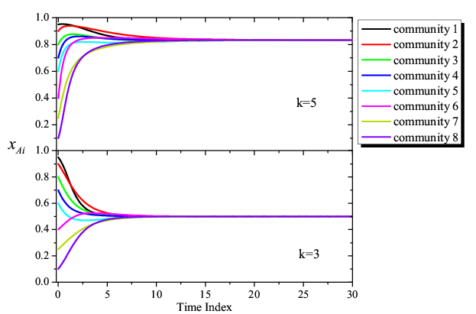
内部平衡点稳定性分析
When a<c, b>d, the condition for Jacobian matrix $J_{1}$having n negative eigenvalues equals to the status of all eigenvalues for the interacting matrix W are positive. Consequently, the inner equilibrium $\vec{x^{∗}}$ is stable if W has n positive eigenvalues.
Under the initial condition of ${\vec{x}}_{0}=(0.95, 0.9, 0.8, 0.7, 0.6, 0.4, 0.25, 0.1),$the system evolves to the stable interior equilibrium eventually.

Slide 41
The full n-dimension spaces of the boundary points
We extend the explorations to the entire n-dimension spaces of the boundary points where at least one community converges to the full-A or full-B state. And we analyze the stability of the equilibrium point $\vec{x^{o}}=(x_{1},x_{2}, …,x_{n})$ according to following points:
At least one community converge to the full-A state, but no community converge to the full-B state, for example, the state of community i is $x_{i}=1$
At least one community converge to the full-B state, and there is no community converge to full-A. Here we consider the most simple case: the state of community i is $x_{i}=0$.

Slide 42
The full n-dimension spaces of the boundary points
In the first case I, when $x_{i}=1,$the elements of the corresponding Jacobian matrix${ J}^{o}$will be $J_{ij}=0,$ for all $0≤j≤n$ and $j≠i$, the Jacobian matrix could be written as follows

Slide 43
The full n-dimension spaces of the boundary points
More generally, for the border point $(x_{1},…, 1,…,{1,…,x}_{n})$ where two communities evolve into full-A state, so we have the corresponding Jacobian matrix

Slide 44
The full n-dimension spaces of the boundary points
To sum up, we notice that no matter how many communities are in the full-A state,
must be one of the n eigenvalues of ${ J}^{o}.$ When a<c, b<d, then $λ+k<0,$
k<0, the eigenvalue satisfy
All of the border equilibrium points $\vec{x^{o}}$ in case I are unstable on condition that a<c, b<d.
All of the equilibria in scenario II (there may exist more than one community whose state is full B-players ) are unstable provided that a>c, b>d.

Slide 45
多策略网络系统
Here we suppose that there are totally $m≥2$ strategy choices for each of the individual. State of community i could be characterized by the m-dimensional vector $X_{i}{=(x_{i}^{1},x_{i}^{2}, …,x_{i}^{m})}^{T}$, where $x_{i}^{j}$ denotes the fraction of the j-player in community i and $\sum_{j=1}^{m}{x_{i}^{j}=1}$ for each community. The payoff matrix of the game is
The element $a_{ij}$ denotes the payoff of strategy i when it playing against strategy j. Then we adopt the column vector to represent the payoff of different strategies in community i, and

Slide 46
收益计算（多策略）
We now calculate the payoffs for the agents in community i by
Column vector is used for denoting the fraction of strategy j ($j≤m$) in the whole population.

Slide 47
多策略演化方程
On the basis of the replicator dynamics, we obtain m replicator equations of the i-th community:
where$\overline{{ P}_{i}}$ is the average payoff of community i, and .

Slide 48
雅可比矩阵（多策略）
According to the m replicator equations, the relevant Jacobian matrix J can be denoted by,
Elements in the Jacobian matrix J are respectively,

Slide 49
边界平衡点（多策略）
In an arbitrary community, the sum of the fraction of various strategies equals to 1, that is, $\sum_{j=1}^{m}{x_{i}^{j}=1}$. Note that all possible boundary equilibrium points are respectively $\left(1,0,…,0\right), \left(0,1,…,0\right)$, …,$\left(0,0,…,1\right)$.
Before we deduce the sufficient condition for equilibrium point $(x_{i}^{1},x_{i}^{2}, …,x_{i}^{m})$=$\left(1,0,…,0\right)$ to be stable in community i, we pay attention the Jacobian matrix $J^{1}$ where the elements are

Slide 50
边界平衡点（多策略）
Obviously, eigenvalues for the Jacobian matrix $J^{1}$ take the following form
where$2≤u≤m.$Further, the eigenvalues can be simplified into

Slide 51
边界平衡点（多策略）
Theorem：

Slide 52
内部平衡点
We are able to obtain the inner equilibrium $X_{i}^{∗}=\left(x_{i}^{1},x_{i}^{2}, …,x_{i}^{m}\right)$ of community i, by solving the following equation panels
The entries in the Jacobian matrix $J^{∗}$ for the inner point $X_{i}^{∗}$ can be denoted by

Slide 53
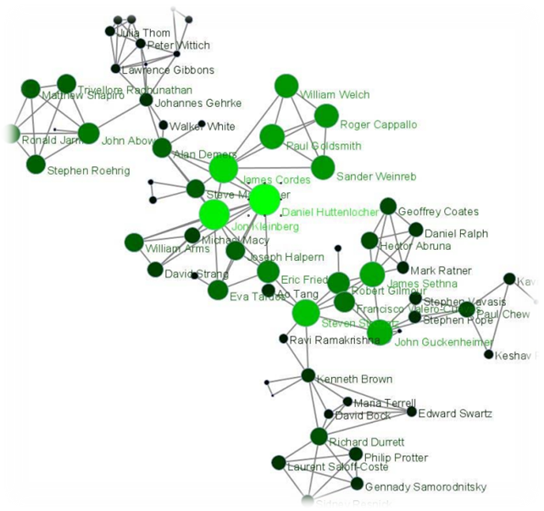
内部平衡点
Theorem：
Larger interacting weight $w_{ii}$ usually give rise to a positive eigenvalue, which will do harm to the stability of the inner equilibrium.
In community i, the inner equilibrium is harder to be reached if strategies${ x}^{1}, { x}^{2}$, …, ${ x}^{m}$ are more likely to acquire higher payoff when playing against themselves (i.e., larger payoff $a_{uu}$).

Slide 54
结 论
策略主导型博弈下 (A 或 B 占主导, 如 PDG)， 背叛（合作）是唯一纳什均衡。
共存型博弈条件下(如SDG),系统随时间演化至内部平衡点（与无结构网络上结果类似）。
协调型博弈中,不同的子社团会分别到达 full-A 或者 full-B 的状态（双稳态） 。
多社团多策略的情形下, 得到某一策略在整个社团网络中占主导的参数条件。

Slide 55
大 纲
研究背景、现状
多社团网络演化博弈与平衡点分析
迭代博弈与零行列式策略
线性阈值博弈收敛性与平衡点
工作展望

Slide 56
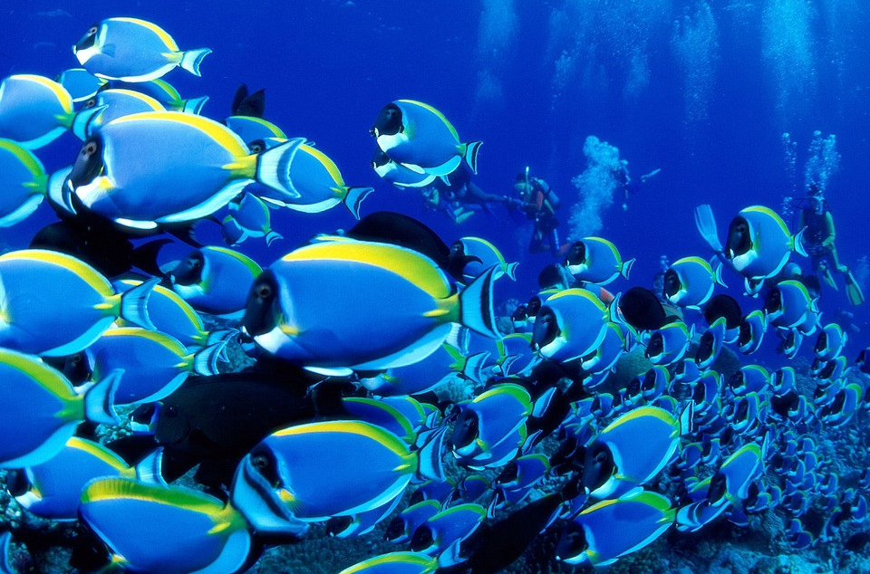
重复交互(repeated interactions)
Birds or fish in the same flock migrating to winter quarters during the periods of the migration.
Students in the same class meet each other during the semester.
Tenants in the same apartment meet each other during the rental period.
Medical personnel and patients in the area of isolation.

Slide 57
迭代博弈
Repeated encounters between the same two individuals:
in every round, each player has a choice between cooperation and defection. If I cooperate now, you may cooperate later. Hence, it might pay off to cooperate.
Axelrod ^{[1]}: “winning strategy” was the simplest of all, tit-for-tat.
This strategy always starts with a cooperation, then it does whatever the other player has done in the previous round: a cooperation for a cooperation, a defection for a defection.
[1] R. Axelrod. The Evolution of Cooperation (Basic Books, New York, 1984).

Slide 58
迭代博弈
But soon an Achilles heel of the world champion was revealed:
If there are erroneous moves caused by “trembling hands” or “fuzzy minds”, then the performance of tit-for-tat declines^{[2-3]} .
Tit-for-tat cannot correct mistakes, because an accidental defection leads to a long sequence of retaliation.
Tit-for-tat was replaced by generous-tit-for-tat ^{[4]}, a strategy that cooperates whenever you cooperate, but sometimes cooperates although you have defected [with probability 1 − (c/b)].
Tit-for-tat was replaced by win-stay, lose-shift, which is the even simpler idea of repeating your previous move when ever you are doing well, but changing otherwise^{[5]}.
[2] D. Fudenberg, E. Maskin, Am. Econ. Rev. 80, 274 (1990).
[3] R. Selten, P. Hammerstein, Behav. Brain Sci. 7, 115 (1984).
[4] M. A. Nowak, K. Sigmund, Nature 355, 250 (1992).
[5] M. A. Nowak, K. Sigmund, Nature 364, 56 (1993).
Notes:
但很快，这位世界冠军的致命弱点就暴露了出来

Slide 59
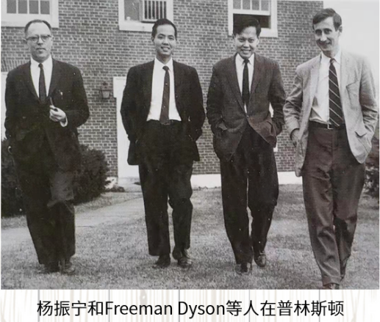
ZD策略
Notes:
他们发现存在一种策略, 可以单方面地令自己和对手的收益满足一个线性关系式 ，他们将这类策略命名为零行列式策略 (zero-determinant strategies, 简称 ZD 策略) . 这一发现颠覆了人们对单个策略控制能力的认识, 因此备受关注 。

Slide 60
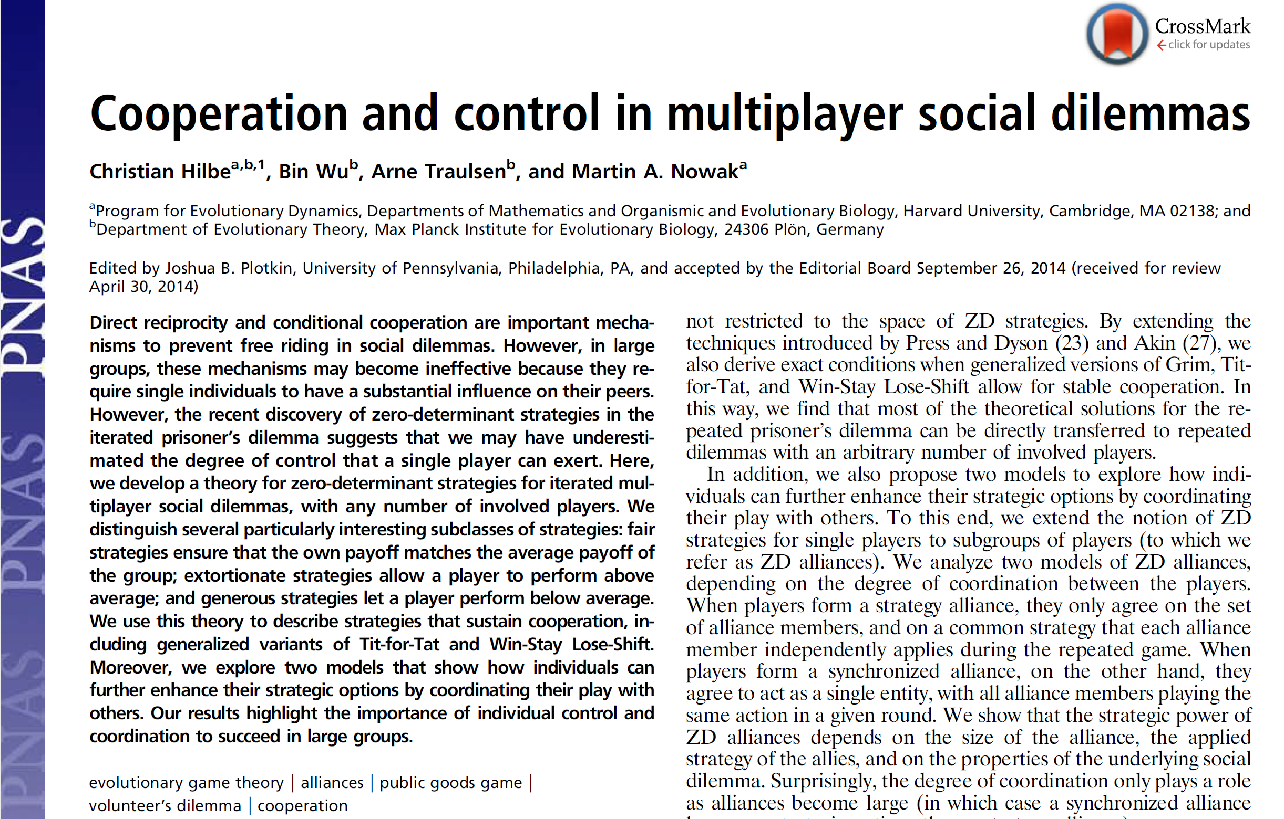
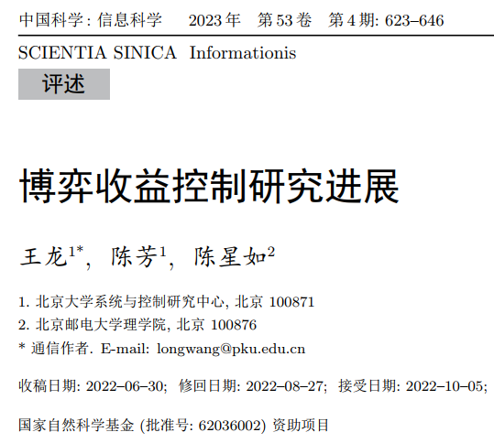
Literatures

Slide 61
多人迭代博弈
针对多人交互构成的社会困境建模：
每一轮博弈中所产生的收益:
多人社会困境具有如下性质:
个体更倾向于与合作的群组成员进行交互，$a_{j+1}≥a_{j}$, $b_{j+1}≥b_{j}$ for $0≤j<n−1$.
2) 背叛者将获得比合作者更多的收益，$b_{j+1}>a_{j}$ for $0≤j<n−1$.
3) 相互合作优于相互背叛, $a_{n−1}>b_{0}$.
Notes:
前面的工作多数都是基于成对迭代博弈的结果，我们这里考虑多人或群组（PGG）博弈环境下的ZD策略。

Slide 62
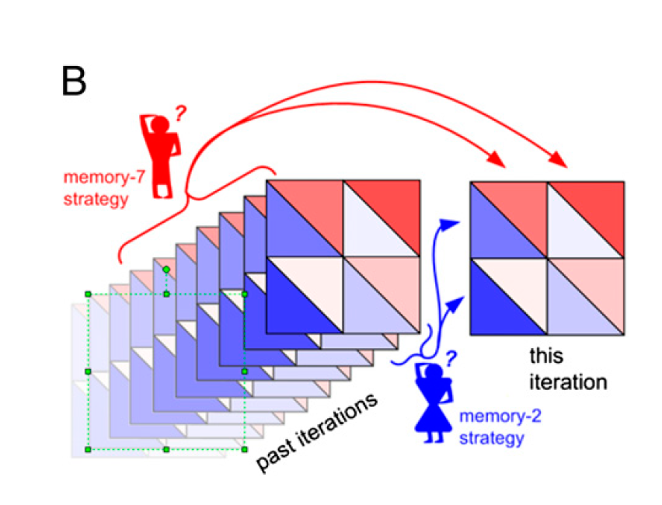
多人迭代博弈基本构成：
1) Baseline game: Consider in each stage game, every player may choose cooperation (C) or defection (D), in which j of the other group members cooperate, a cooperator receives the payoff $a_{j}$ and a defector receives $b_{j}$.
2) Repeated games: group members face the same dilemma situation over multiple rounds.
3) Memory-one strategies: players only consider the outcome of the last round：
---a rule that tells the player what to do in the first round, and
---a rule for what to do in all subsequent rounds, depending on the previous round’s outcome.

Slide 63
Memory-one 策略
其余 n-1 个体
当前个体
Memory-one
……
c/d
ZD策略定义: 策略 $p$ (memory-one strategy) 是ZD策略：在给定$常数 l, s,$以及 $φ≠0$ 的条件下，如果作为策略的向量 $p$ 满足：
(1)

Slide 64
ZD可行域
ZD策略能够使得单一个体在参与多人迭代博弈的过程中，可以固定所有其他玩家的总收益，或者说是以单边方式对其同伴进行敲诈勒索。
Lemma 1. (Necessary Conditions for Enforceable Payoff Relations) :
Any enforceable payoff relation $(l,s)$satisfies $−\frac{1}{n−1}≤s≤1$, and if $s<1$, then $b_{0}≤l≤a_{n−1}$. Moreover, the parameter $φ≠0$ needs to be chosen such that $φ>0$.
Lemma 2. (Enforceable Payoff Relations) :
Consider a payoff relation $(l,s)$for player $i$, then $(l,s)$is enforceable for a given social dilemma if and only if either $s=1$ or
$\max_{0≤j≤n−1}{\{b_{j}−\frac{j}{n−1}\frac{b_{j}−a_{j−1}}{1−s}\}≤l≤}$ $\min_{0≤j≤n−1}{\{a_{j}+\frac{n−j−1}{n−1}\frac{b_{j+1}−a_{j}}{1−s}\}}$.
[6] C. Hilbe, B. Wu, A. Traulsen, and M. Nowak, “Cooperation and control in multiplayer social dilemmas.” Proc Natl Acad Sci USA, vol. 111, no. 46, pp. 16425–16430, Nov. 2014.

Slide 65
ZD可行域下的线性收益关系
线性收益关系：The multi-player-version of ZD stipulates that a single agent $i$can control the linear relation between the own payoff $π_{i}$ and the co-players‘ mean payoff $π_{−i}=\sum_{j≠i}{\frac{π_{j}}{n−1}}$
(2)
收益线性关系变形：Agent $i$ can enforce a payoff margin $π_{i}−l,$ which is $\frac{1}{s}$-fold of the co-players' payoff surplus. Here, $l$ is the baseline payoff, which is given by$l=π_{i}{=π}_{−i}$. $s$is the slope of the linear relation, since it controls (i.e., enlarges or reduces) the payoff gap between$i$and average of the co-players. The payoff relation can be rewritten as
(3)

Slide 66
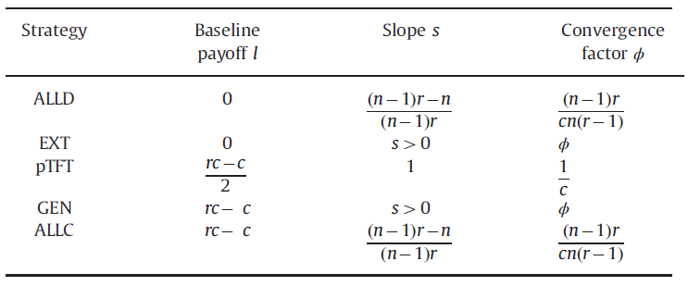
几种典型的ZD策略
在可行域内将ZD分为三种类型: 1) generous $i$, $π_{i}{<π}_{−i}$; 2) fair $i$, $π_{i}{=π}_{−i}$; 3) extortionate $i$, $π_{i}{>π}_{−i} .$ Corresponding diagrams for the three cases (with $s>0$) for the repeated public goods games are
[7] C. Hilbe, B. Wu, A. Traulsen, and M. Nowak, “Evolutionary performance of zero-determinant strategies in multiplayer games,” J. Theor. Biol., vol. 374, pp. 115–124, Jun. 2015.

Slide 67
ZD同盟
Every B-agent with ZD parameters $(s_{B}$, $l_{B}$) can unilaterally control the linear average payoff of the other $n_{A}$ As and that of the remaining ${n−n}_{A}−1$ Bs,
(4)
where$π_{A}$ and $π_{B}$ are the payoffs of A and B. On the other hand, the A-agent can enforce the following linear payoff relation,
(5)
Notes:
任意1个B-agent （4）
任意1个A-agent （5）

Slide 68
ZD同盟
Agents in each ally collectively agree on a common decision, i.e., ZD strategy A or B. By (4) and (5), payoff relations between the alliances are
(6)
the A-alliance:
the B-alliance:

Slide 69
Nash Equilibrium Points
For iterated n-agent games with strategy set $𝒮=\left\{A,B\right\}$，where A and B are two arbitrary ZD strategies, x_{i}=1(or x_{i}=0) is used to denote the state of the ith agent playing strategy A (or B). Define X=(x₁, x₂ , … , x_{n}) and the vector X_{-i}=(x₁, …, x_{i-1} , x_{i+1} ,…, x_{n}). The strategy profile X ^{e}=($x_{1}^{e}$, $x_{2}^{e}$ , … , $x_{n}^{e}$) is an NE, if for any i and x_{i}∈{0,1}:
In the NE state, the agents cannot acquire higher payoffs by unilaterally changing their strategies,
where B-players cannot achieve the higher payoff via changing to A, meanwhile, A-players cannot obtain the more payoff by switching to B.

Slide 70
Model: Dynamics of Iterated Multiplayer Games (IMG) Systems
Updating rule. Agents play the IMG and accumulate payoffs over all game rounds. All agents update strategies according to the asynchronous best-response dynamics, where the updates are assumed to be persistent under following activation assumption.
Persistent asynchronous activation process: Agents make decisions independently and asynchronously at discrete time step t = 0, 1, 2, … Correspondingly, a sequence of activated agents is given by ${{(i}^{t}\text{)}}_{t=0}^{∞}$, where $i^{t}$ is the activated agent at time t. Persistent activation refers to that, at any time t, a random agent j can be reactivated at a finite future time t i.e., $j=i^{t^{′}}$.

Slide 71
Update rule: Best-response dynamics
In the n-player IMG, there are n_{A} agents playing the strategy A and n − n_{A} agents playing the strategy B, whose payoffs are π^{A}(n_{A}) and π^{B}(n_{A}), respectively. At time t, an agent i is activated and will be updated according to
(9)
where x_{i}(t) = 1 (or 0) is the state A (or B) of i at time t.

Slide 72
Convergence of the IMG system
Theorem 1: Under the asynchronous best-response dynamics (10), the IMG system will converge to an equilibrium in finite time.
Proof: Define the function $H\left(t\right)=\sum_{i=1}^{n}{H_{i}(t)}$, where
(11)
If there is no strategy switch at time t+1, i.e., $n_{A}(t+1)$ $=n_{A}\left(t\right)$, we have H(t+1)=H(t). Then, we just study how the function H(t) changes along the strategy switches:
an agent i switches from A to B, i.e., $x_{i}$(t)=1, $x_{i}$(t+1)=0, $n_{A}$(t+1)=$n_{A}$(t)-1;
an agent i switches from B to A, i.e., $x_{i}$(t)=0, $x_{i}$(t+1)=1, $n_{A}$(t+1)=$n_{A}$(t)+1
Notes:
收敛点存在性：有限时间内一定收敛。

Slide 73
a) an agent i switches from A to B, i.e., $x_{i}$(t)=1, $x_{i}$(t+1)=0, $n_{A}$(t+1)=$n_{A}$(t)-1, we can obtain that
b) an agent i switches from B to A, i.e., $x_{i}$(t)=0, $x_{i}$(t+1)=1, $n_{A}$(t+1)=$n_{A}$(t)+1
The strategy switch of an agent (from A to B or from B to A) will lead to the value of the function H(t) increases.

Slide 74
Convergence Time
Theorem 2: Under the dynamics (10), the IMG systems will converge to an equilibrium after at most n strategy switches.
Proof: Upper bound for H(t) is max{H(t)}=n. Lower bound for H(t) is min{H(t)}= -n.
Hence, given an initial time t = 0 and an equilibrium t=t*, we have:
H(t) increases by at least 2 for every time of the strategy switch, thus the system will reach an equilibrium within no more than n times of the strategy switches.
Notes:
收敛的速度：至多n步就会收敛。

Slide 75
Equilibrium States of IMG Systems
The IMG systems may have multiple NEs. Suppose that set Θ covers all possible system states. Define the NE set
Θ^{e}={$X_{1}^{e}$, $X_{2}^{e}$, $…\text{,} { X}_{m}^{e}$},
in which all system states $X_{i}^{e}$, i=1, 2,…,m are at the Nash equilibrium. All the non-NEs fall into the set Θ^{ne}= Θ\ Θ^{e}.
Examples for NE states:
State X(n_{A}(t)) that corresponds to the upper bound for H(t), i.e., max{H(t)}=n, is NE, where
$\left.π^{A}(n_{A} (t))>π^{B}(n_{A}(t)−1\right)$, $\left.π^{B}(n_{A} (t))>π^{A}(n_{A}\left(t\right)+1\right)$
State X(n_{A}(t)) that corresponds to the lower bound for H(t), i.e., min{H(t)}=-n, is non-NE, where
$\left.π^{A}\left(n_{A} \left(t\right)\right)<π^{B}(n_{A}(t)−1\right)$, $\left.π^{B}\left(n_{A} \left(t\right)\right)<π^{A}(n_{A}\left(t\right)+1\right)$

Slide 76
Lemma 1: Given a finite, well-mixed population, if X(t₀) ∈ Θ^{e} at time t₀ > 0, under the best-response dynamics (10)
Proof: At time t₀, suppose that the system state is NE, denoted by X(t₀)=Xe(n_{A})∈Θ^{e}. We can deduce that $\left.π^{A}(n_{A})≥π^{B}(n_{A}−1\right)$, $\left.π^{B}(n_{A})≥π^{A}(n_{A}+1\right).$ There are two cases:
strategy for i is A:x_{i}(t₁)=1, system state is NE, hence $\left.π^{A}(n_{A})≥π^{B}(n_{A}−1\right)$, $\left.π^{A}(n_{A}+1−x_{i}(t_{1}))≥π^{B}(n_{A}−x_{i}(t_{1})\right)$, i does not switch strategy.
strategy for i is B:x_{i}(t₁)=0, in the same way, i will keep the current strategy B.
The NE state is invariant.

Slide 77
Lemma 2: All non-NEs of the IMG are non-equilibrium under the best-response dynamics (10).
Proof: Suppose that the IMG is in the non-NE state X(t₀)= X^{ne}($n_{A}^{ne}$)$∈Θ^{ne}$, where there are $n_{A}^{ne}$ A-agents. So either $π^{A}$($n_{A}^{ne}$) $<π^{B}$ ($n_{A}^{ne}−1$) or $π^{B}$ ($n_{A}^{ne}$)< $π^{A}$($n_{A}^{ne}+1$) . If $π^{A}$($n_{A}^{ne}$) $<π^{B}$ ($n_{A}^{ne}−1$) :
If the strategy of agent i is A, x_{i}(t₁)=1, then x_{i}(t₁+1)=0, i switches to strategy B;
strategy of i is B, x_{i}(t₁)=0, in the same way, if i remains unchanged, x_{i}(t₁+1)=0 (an invalid update). According to the persistent activation assumption, there is a finite future time $\tilde{t}$ at which an A is activated. Then, the case returns to a).
That is, in all of the non-NEs, there always exist some agents who switch strategies when being activated.

Slide 78
Convergence of IMG to Nash Equilibrium
Summarizing Lemmas 6 and 7, the states belonging to set Θ^{e} are equilibria; while states belong to Θ^{ne} are non-equilibria.
Theorem 3: Under the asynchronous best-response dynamics, the IMG systems will converge to NE state in finite time, that is, there is a finite time τ
where X*∈ Θ^{e}.
Notes:
IMG收敛存在性

Slide 79
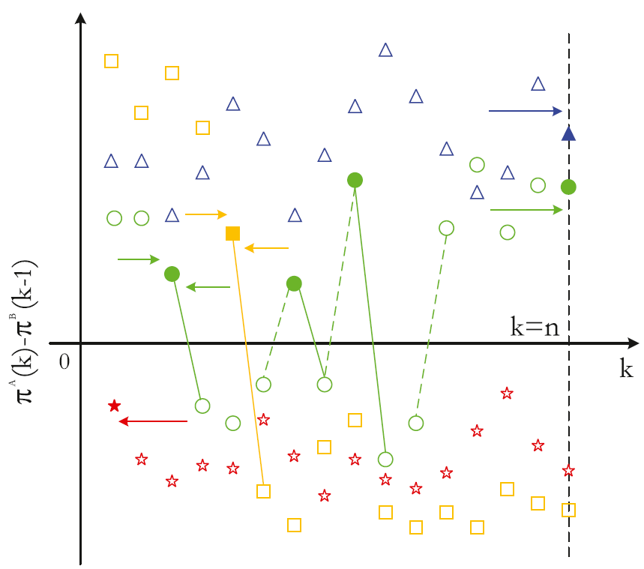
Nash Equilibrium of IMG Systems
In general, there are four cases of the evolutionary outcomes:
single NE of full-A, which is the global attractor [see Fig. 2, case i)];
single NE of full-B, which is the global attractor [see Fig. 2, case ii)];
unique interior NE Xe(n_{A}), which is the global attractor [see Fig. 2, case iii)] ;
multiple NE points [Fig. 2, case iv)].
Fig.2: Examples of game outcomes. Open marks are non-NE,
and closed ones are NE. Case i): blue triangles; case ii): red stars; case iii): orange squares; and case iv): green circles.

Slide 80
Nash Equilibrium of IMG Systems
Discussions of the two border equilibria full-A and full-B
Full-A:
When $s_{A}=1,s_{B}≠1$, full-A is NE on the condition that $l_{A}≥l_{B}$;
When $s_{B}=1,s_{A}≠1$, full-A is NE.
Full-B:
When $s_{A}=1,s_{B}≠1$, full-B is NE;
When $s_{B}=1,s_{A}≠1$, full-B is NE on the condition that $l_{B}≥l_{A}$.

Slide 81
Nash Equilibrium of IMG Systems
For some special parameter settings, define $s_{τ}=1−\frac{1}{n−1}$,
Proposition 1: Under one of the three conditions l_{A} = l_{B}, s_{A} = 1, and s_{B} = 1, where the ZD relation is fair, all interior points X(n_{A}) (1 ≤ n_{A} ≤ n − 1) are NEs.
Proposition 2: (Interior NE): For IMG described by s_{A} = s_{B} = s, all interior equilibrium points are NE when
a) $s_{τ}$<s<1 and l_{A} > l_{B};
b)$−\frac{1}{n−1}≤s≤s_{τ}$ and l_{A} < l_{B} .
Proposition 3: (Boundary NE): For IMG with s_{A} = s_{B} = s,
a) if $−\frac{1}{n−1}≤$s$≤s_{τ}$ and l_{A} > l_{B}, full-B is NE;
b) if $s_{τ}≤s<1$ and l_{A} > l_{B} , full-A is NE;
c) if $−\frac{1}{n−1}≤$s$≤s_{τ}$ and l_{A} < l_{B}, full-A is NE;
d) if $s_{τ}≤s<1$ and l_{A} <l_{B} , full-B is NE.

Slide 82
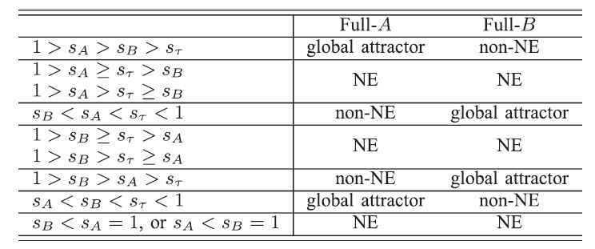
Nash Equilibrium of IMG Systems
The relationship between NE and ${(s}_{A}−s_{B})(l_{A}−l_{B}$), there are two cases:
a) Boundary Equilibria ${(s}_{A}−s_{B})(l_{A}−l_{B}$)>0

Slide 83
Nash Equilibrium of IMG Systems
b) Boundary NE ${(s}_{A}−s_{B})(l_{A}−l_{B}$)<0

Slide 84
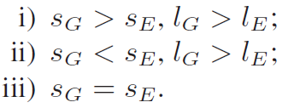
Nash Equilibrium of IPGG
An example in IPGG, where the game is played between G and E:
Case i): the system will evolve to boundary NE points given ${(s}_{G}−s_{E})(l_{G}−l_{E}$)>0. If $s_{G}>s_{E}>$ $s_{τ}$ , full-G is a global attractor.
Case ii): there exist interior NE points if $s_{G}<s_{τ}$.
Case iii): $s_{G}−s_{E}=s$, there are n − 1 interior NEs.
Here the threshold s_{τ} characterizes how generous or extortionate the agents need to be that can lead to a stable NE.
Our conclusion of IPGG conforms to the previous results in ^{[6]}, where the ZDs that are boundary NE points in IPGG tend to have the properties:
be generous (l_{G} = rc − c), but not be too generous (s_{G} ≥ s_{τ} );
be extortionate (l_{E} = 0), and earn the extortionate share s_{E} ≤ s_{τ} .
[6] C. Hilbe, B.Wu, A. Traulsen, and M. A. Nowak. Cooperation and control in multiplayer social dilemmas. Proc. Nat. Acad. Sci. USA, vol. 111, no. 46, pp. 16425–16430, Nov. 2014.

Slide 85
小 结
For gaming system restricted to a binary strategy set within the space of ZDs，we have
The asynchronous best-response dynamics can drive the system to arrive at the NE in finite time.
An upper bound of the convergence time has been obtained, which is exactly equal to the population size.
By analyzing the NE points, our results reveal that there exists a threshold ZD slope s_{τ} , above which strategies with higher baseline payoff prevail, while below which strategies with lower baseline payoff dominate.

Slide 86
迭代公共物品博弈与敲诈/勒索、慷慨与公平策略
系统演化动力学方程：Competitions between different ZD strategies under the deterministic evolutionary dynamics are formulated by continuous-time differential equations. There are two ZD strategies denoted by X and Y,
(1)
$P_{X}$ and $P_{Y}$: payoffs of ZDs X and Y, for X, Y$∈\{Generous(G),Extortionate(E),pTFT\}$.
收益计算：Suppose that a sample of n agents are randomly selected from a well-mixed population to contest the IPGGs with the long-term strategies X and Y . Given an arbitrary agent, the probability that there are m agents play strategy X among the n − 1 co-players is
(2)

Slide 87
Evolutionary scenario 1: competition between G and E
The system dynamics takes on two different cases, which are summarized in Theorem 1.
Theorem 1: Evolutionary outcomes for the iterated public goods games contested by strategies G and E are:
1) if (1-s)(n-1)>1, the system converges to the equilibrium of full-E;
2) if (1-s)(n-1)<1, the system converges to the equilibrium of full-G.
(a) Evolve to full-E with (1 − s)(n − 1) > 1;
(b) Evolve to full-G with (1 − s)(n − 1) < 1.
Notes:
Well-mixed群体中，一定可以收敛到E或G

Slide 88
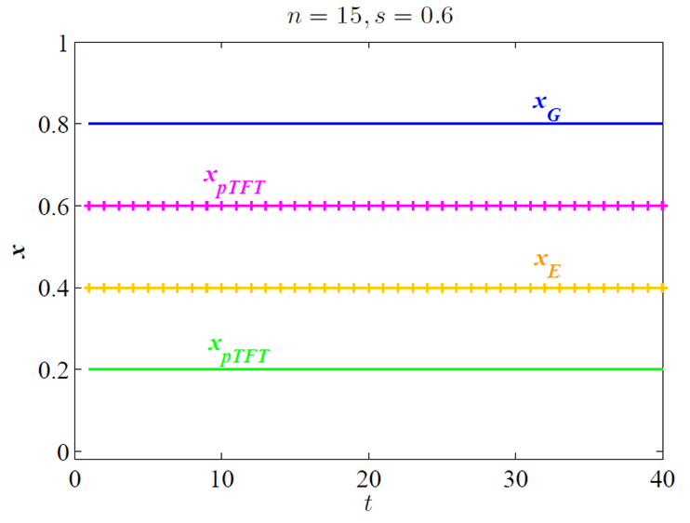
Evolutionary scenario 2: Prospects of ZDs Facing pTFT
When playing against a random ZD strategy (denoted by B), the pTFT can unilaterally enforce the linear payoff relationship of $P_{\text{pTFT}}=P_{B}=l_{B}$. Thus, the dynamics equations always take the form of ${\dot{x}}_{pTFT}=0$, which yields a continuum of equilibria. For example, in the figure below, when involving the pTFT strategy, the system will be fixed to the initial state, independent of the opponent's situation.

Slide 89
网络化的ZD策略博弈
The iterated multiplayer games take place on a series of “k-regular” networks of size N, where every node is linked to exactly k neighbors. G(V, E) is the underlying graph, in which the vertices V={1,2,…,N} are occupied by game-playing agents and the edges E denotes the interactions between neighboring agents. In the context of networked games, agents participate in the iterated multiplayer games organized by neighbors and themselves.
Lemma 3. Network G(V, E) can converge to the consistent state either full-A or full-B.
Proof: With the help of Definition 11.1 in the following Ref.
[1] C. Grinstead and J. Snell, Introduction to probability. American Mathematical Society, 1997.
Notes:
在规则网格中，基于模仿动力学系统一定能够到达full-A或full-B.

Slide 90
网络化的ZD策略博弈
Now we can calculate the probabilities for the network to converge to one of the two consistent states, that is, the fixation probability for strategy A or B taking over the whole network. Iteration step of the multiplayer networked games are streamlined in the following parts.
Step i) Strategy initialization. All nodes can choose either the ZD strategies A or B. In each round of the multiplayer games, agents decide whether to cooperate or to defect directed by the ZDs that they have adopted.
Step ii) The multiplayer games. For a focal agent, he or she plays repeatedly with the neighborhood, with the interactions being described by the multiplayer games.
Notes:
上述步骤从数值上保证网络达到full-A 或full-B状态，并且能用对近似计算网络ZD策略博弈的固定概率。

Slide 91
网络化的ZD策略博弈
Step iii) Payoff calculations. Payoff of an agent will be averaged over the accumulated score of the iterated plays. By playing the ZD strategy, after ﬁnitely many rounds, a focal node can enforce a linear relation between the own payoff and the average payoff of the neighbors [1].
Step iv) Strategy updating. At a given time, an agent i is selected proportional to his or her fitness (payoff), a random neighbor of i updates by imitating the strategy of i .
……
Step v) Network equilibrium. Repeat the evolutionary process above. The network will reach one of the consistent decisions of full-A and full-B (Lemma 3).
…
…

Slide 92
网络化的ZD策略博弈
Then, calculate the fixation probability of the collective behavior dynamics in networked populations with the aid of pair approximation method. Herein, several important quantities should be defined. At the agent level, $p_{A}$ and $p_{B}$ are used to represent the proportions of A and B agents in the network. For the edge pairs AA, AB, BA, BB, corresponding proportions are $p_{AA}$, $p_{AB}$, $p_{BA}$, $p_{BB}$. Given an agent who plays ZD strategy A, $q_{B/A}$ refers to the conditional probability when the A-agent has a B-neighbor.
(3)
[2] H. Ohtsuki, C. Hauert, E. Lieberman, and M. Nowak. A simple rule for the evolution of cooperation on graphs and social networks. Nature, vol. 441, pp. 502–505, Feb. 2006.
Notes:
用对近似的方法从理论上计算规定概率。

Slide 93
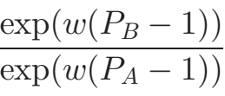
固定概率计算
$φ_{i}$ is the probability for the network to converge to the full-A equilibrium, on condition that there are$i$A-agents in the network’s initial state, which takes the following form of
(4)
which is determined by the ratio $χ_{m}$

Slide 94
Networked Games with Dominant G (or E)
For the game dynamics between ZD strategies G and E in the regular networks comprising N agents, the networked decision-making dynamics follow the iterated public goods games, where each agent has binary choices: G ( $l_{G}= rc − c$, $s_{G} = s$) and E ($l_{E}=0$,$s_{E} = s$).
Theorem 2: The agent-based collective decision-making behaviors on network G(V, E), where each agent has binary strategies E and G, have following properties:
1) dominant strategy E for the network’s decision-making behaviors, if $(1 − s)k > 1$;
2) dominant strategy G for the network’s decision-making behaviors, if $(1 − s)k < 1$.

Slide 95
Networked Games with Dominant G (or E)
Evolutionary outcomes for networked games with dominant E ($\left(1 − s\right)k> 1$).
The payoffs of PGG: $c = 1; r = 2$in (a) and $r = 4$in (b).
Selection intensities: $w = 0.01$

Slide 96
Networked Games with Dominant G (or E)
Evolutionary outcomes for networked games with dominant G ($\left(1 − s\right)k< 1$).
The payoffs of PGG: $c = 1; r = 2$in (a) and $r = 4$in (b).
Selection intensities: $w = 0.01$

Slide 97
Evolutionary prospects for G and E when playing against pTFT
Vertical axis: ﬁxation probabilities for equilibrium either full-G or full-E, which are respectively in direct proportion to initial numbers of G and E. Different network topologies are considered here: $k = 8$in (a); $k = 15$in (b). Synergy coefficients PGG are $c = 1, r = 1.5, 2, 3, 4, 5$. Selection intensities: $w = 0.01$.

Slide 98
小 结
Three representative “zero-determinant” (ZD) are studied here: proportional Tit-for-Tat (pTFT ), extortioners (E) , generous agents (G) .
Solution of the system dynamics gives the effectiveness of the parameter settings on the equilibrium stability, in which equilibrium either full-G or full-E can be stable.
Theoretical analysis has been extended to the networked games. For games between G and E, there are two equilibria, larger slope of the ZD linear relation helps to ﬁx the equilibrium of full-G, while the network topology of more neighbors is conducive to the ﬁxation of full-E.

Slide 99
大 纲
研究背景、现状
多社团网络演化博弈与平衡点分析
迭代博弈与零行列式策略
线性阈值（异质）博弈收敛性与平衡点
工作展望

Slide 100
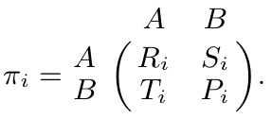
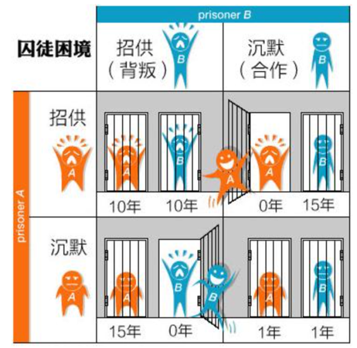
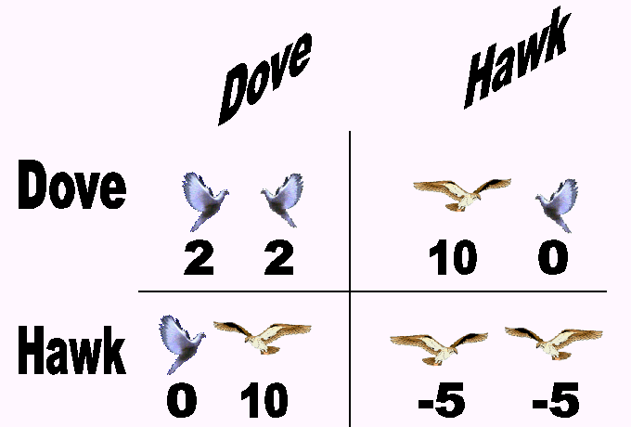
异质群体 (heterogeneous populations)
囚徒困境博弈
雪堆博弈（又称鹰鸽博弈）

Slide 101
异质群体(heterogeneous populations)-networks
网络博弈的收益计算，如果 i 是合作者，那么
网络博弈的收益计算，如果 i 是背叛者，则

Slide 102
最优响应动态
根据最优响应动态 (myopic best-response dynamics)
整理节点 i 下一步选择合作的情况：$\left.R_{i}n_{i}^{A}(t)+S_{i}n_{i}^{B}(t)>T_{i}n_{i}^{A}(t)+P_{i}n_{i}^{B}(t\right)$ 可得：
令$δ_{i}=R_{i}−T_{i}+P_{i}−S_{i}$，$γ_{i}=P_{i}−S_{i}$，可得

Slide 103
协调/反协调
根据 $δ_{i}$ 取值的正负，有以下两种情况：
协调
反协调
简明起见，一般令 $τ_{i}=γ_{i}$/$δ_{i}$

Slide 104
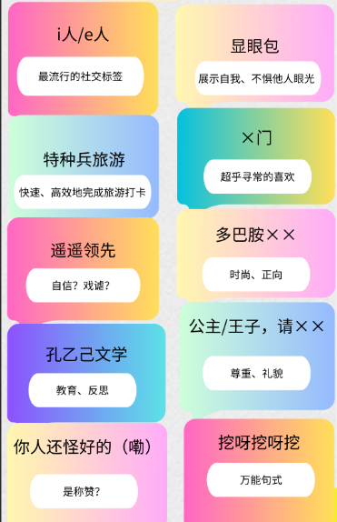
协调/反协调
协调博弈模型—Coordinating game model
从众效应(Bandwagon Effect)，是指当个体受到群体的影响（引导或施加的压力），会怀疑并改变自己的观点、判断和行为，朝着与群体大多数人一致的方向变化，以和他人保持一致。也就是通常人们所说的“随大流”。

Slide 105
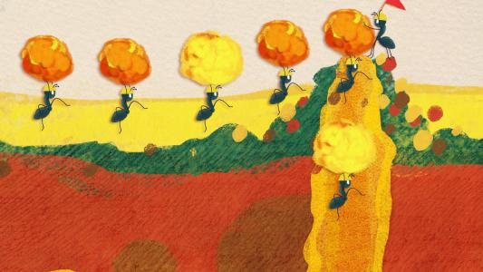
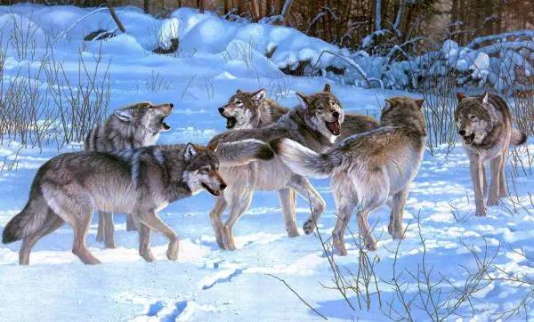
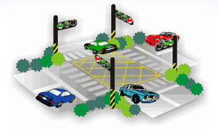
协调/反协调
反协调博弈模型—Anticoordinating game model
John Maynard Smith
进化是一场所有生命都参与的博弈。所有的动物参加，所有的植物也参加，所有的细菌同样如此。动物不能如此选择它们的策略，因为它们本身就是策略。
[1] John Maynard Smith, Evolution and the Theory of Games, Cambridge: Cambridge University Press, 1982.
Notes:
博弈论能够解释生物体如何采用不同的策略在暴虐的生态环境下生存并繁衍后代继续斗争。你无需将任何理性或思维能力归于生物体——它们的策略仅仅是他们的特性和习性的综合。成为一棵矮树还是一棵高树好呢?成为一个超级快的四足动物还是一个很慢但聪明的两足动物，哪一个更好呢?

Slide 106
The linear threshold model（线性阈值模型）
[2] Granovetter, Mark (1978). Threshold models of collective behavior. American Journal of Sociology, 1420–1443.
[3] Nowzari, Cameron, Preciado, Victor M., & Pappas, George J. (2021). Analysis and control of epidemics: A survey of spreading processes on complex networks. IEEE Control Systems, 36(1), 26–46.

Slide 107
协调/反协调
“The analysis is done in terms of the cumulative distribution function of thresholds and generalizes the ideas of the linear-threshold model introduced by Granovetter in 1978 to the case of anticoordinating”.
Strategic complements: Coordinating agents have an incentive for action 1 when such action is played by a fraction of the remaining players above a certain threshold.
Strategic substitutes: Anticoordinating agents have an incentive for action 1 when such action is played by a fraction of the remaining players below a certain threshold.
[4] Vanelli, M. (2019). On network games with coordinating and anti-coordinating agents. Master’s thesis, Politecnico di Torino. https://webthesis.biblio.polito.it/11996
[5] Vanelli M , Arditti L , Como G , et al (2020). On games with coordinating and anti-coordinating agents. IFAC-PapersOnLine.

Slide 108
加权网络情形
给定加权网络 ，其中
No self-loop w_{ii} = 0 and symmetrical w_{ij} = w_{ji}
此时，节点权重可以表示为：

Slide 109
加权网络情形
时刻 t，个体 i 的收益计算如下：
此时，个体的状态更新仍采取最优响应动态。

Slide 110
加权网络情形
此时，个体的状态更新仍采取最优响应动态，从 t 到 t + 1时刻，有：
同样，令$δ_{i}=R_{i}−T_{i}+P_{i}−S_{i}$，$γ_{i}=P_{i}−S_{i}$。

Slide 111
加权网络情形
Proposition 1* Evolutionary dynamics on weighted network
can be characterized by the coordinating and anticoordinating decision-making dynamics, respectively:
i) if agent i is activated at t and R_{i} − T_{i} + P_{i} − S_{i} > 0, agent i is coordinating and update strategy according to

Slide 112
加权网络情形
Proposition 1* Evolutionary dynamics on weighted network
can be characterized by the coordinating and anticoordinating decision-making dynamics, respectively:
ii) if agent i is activated at t and R_{i} − T_{i} + P_{i} − S_{i} < 0, agent i is anticoordinating and update strategy according to

Slide 113
收敛性讨论
以 anticoordinating network 为例
首先，研究阈值对于收敛时间的影响，建立如下函数：
Strategy A
Strategy B
其中，
显然函数$Φ(t)$有上界： $Φ(t)≤\sum_{i=1}^{n}{(1−τ)d_{i}}$

Slide 114
收敛定理
证明思路：建立策略切换（$A→B$ & $B→A$）与函数$Φ(t)$ 变化之间的关系。

Slide 115
收敛时间
[6] Ramazi, P., Riehl, J., & Cao, M. (2016). Networks of conforming or nonconforming individuals tend to reach satisfactory decisions. Proceedings of the National Academy of Sciences of the United States of America, 113 (46), 12985-12990.
Notes:
在此基础上给出具体的收敛时间；并分别就三种情况与如下文献中的收敛时间结果进行对比，我们得到的收敛时间上界会比文献中的上界更小。显然，如果网络规模更大，阈值中等，我们的结果会有更显著的改进

Slide 116
收敛时间比较
得到的收敛时间上界：$n+3\left|ε\right|$
与参考文献中的情况进行比较： $6\left|ε\right|$
显然有：$6\left|ε\right|−(n+3\left|ε\right|)≥\left|ε\right|$
给定关系：$\sum_{i=1}^{n}{d_{i}≥\sum_{i=1}^{n}{1=n}} 和\sum_{i=1}^{n}{d_{i}=2\left|ε\right|}$

Slide 117
加权网络结论
Theorem 1* Pure coordinating/anticoordinating asynchronous best-response game dynamics on weighted network is generalized ordinal potential game, which converges to equilibrium in finite time.
Corollary 1* Heterogeneous-threshold coordinating/anticoordinating agents who update according to the asynchronous best-response rule will converge to Nash equilibrium state in finite time.
Corollary 2* Weighted networks under coordinating or anticoordinating decision-making dynamics will converge to Nash equilibrium state after no more than
strategy switches.

Slide 118
加权网络（协调/反协调混合）
Hybrid game dynamics on weighted networks
协调、反协调混合导致无法收敛的结果！

Slide 119
基于收益奖励的机制
从个体层面对收益进行调整。考虑针对个体所施加的奖励机制，假如网络中的所有个体，如果其采取策略A，就会收到奖励 r > 0，那么就有相应的收益矩阵：
奖励对应的阈值增长

Slide 120
基于收益惩罚的机制
另一方面，还可以考虑使用惩罚方案来控制反协调网络状态的演化。在这种情况下，每个网络个体在采取 A 策略时均会受到惩罚 α > 0：
惩罚对应的阈值降低

Slide 121
收益激励形式（惩罚/奖励）
Lemma 1 The threshold of anticoordinating games
1) increases if the agents are rewarded (p = r > 0) for playing strategy A;
2) decreases if the agents are punished (p = α < 0) for playing strategy A.

Slide 122
网络平衡点讨论
Corollary 2. With the best-response dynamics, equilibrium strategy profile is
The maximum anticoordinating equilibrium means that neighboring agents have opposite strategies:

Slide 123
收益激励下网络平衡点
Proposition 1 With the threshold change Δτ,
the maximum anticoordinating equilibrium $x_{h}^{∗}$ is invariant.
2) if Δτ > 0, the equilibrium where all B-agents have the A-neighbors:
$x_{B}^{∗}={\{(x}_{1},x_{2},…,x_{n})|n_{i}^{A}=d_{i}$, for $i∈𝒱_{B} \}$
is invariant.
3) if Δτ < 0, the equilibrium where all A-agents have the B-neighbors:
$x_{A}^{∗}={\{(x}_{1},x_{2},…,x_{n})|n_{i}^{A}=0$, for $i∈𝒱_{A} \}$
is invariant.
阈值的改变是在施加收益激励影响之下的结果。
显然，也有一些特殊的平衡点在特定的阈值变化下是不变的。

Slide 124
平衡点存在性
Definition 4 A path (or chain) with the sequence of nodes $v_{1}$, $v_{2}$, $…v_{m}$satisfying: 1) m > 2; 2) $v_{1}≠$ $v_{2} ≠$,$…,≠v_{m−1}$; 3) $v_{1}$= $v_{m}$, is a cycle (or loop).
Lemma 3 Networks excluding cycles or including cycles ($v_{1}$, $v_{2}$, $…v_{m}$, $v_{1}=$ $v_{m}$satisfying m = 2z, z = 1, 2, ...) have the equilibrium${ x}_{h}^{∗}.$
(a)
(b)
含有 cycles 并且其具有奇数个节点时，网络不存在平衡点 $x_{h}^{∗}$

Slide 125
实例分析
考虑流行病在人群中传播期间的个人行为，在人群中，个体类型是健康的和生病的，行动代表所采取的预防措施的水平（例如0表示自我隔离，1表示正常活动），正常活动是人们所期望的，但可能会带来疾病传播风险。用收益去衡量疾病从生病的个体传播给健康人的风险。
[2]
[1]
在最小顶点覆盖这一问题上，有两个要点：覆盖率和成本，未被覆盖的顶点更倾向于和覆盖的节点成为邻居。
[7] Yang, Y., & Li, X. (2013). Towards a snowdrift game optimization to vertex cover of networks. IEEE Transactions on Cybernetics, 43 (3), 948-956.
[8] Eksin, C., Shamma, J. S., & Weitz, J. S. (2017). Disease dynamics in a stochastic network game: a little empathy goes a long way in averting outbreaks. Scientific reports, 7 , 44122.

Slide 126
收益激励
针对以下问题1
提出控制协议：

Slide 127
收益激励
控制协议（有限时间）：

Slide 128
例 子
目标：网络状态演化至${ x}_{h}^{∗}$
给定前提条件：博弈参数 $R−T+P−S= −\frac{3}{2}$, 网络总边数$\left|ε\right|=$15，初始AA边数$\left|ε_{AA}\right|=$4，初始阈值设定：$τ=\frac{2}{3}$

Slide 129
例 子

Slide 130
例 子

Slide 131
加权网络收益激励
协调、反协调混合导致无法收敛的结果！
Corollary 5* The incentive-based algorithm requires no more than
agents’ strategy switches to reach the convergence outcome.
[9] Y. Zhu, Z. Zhang, C. Xia*, X. Li, Z. Chen. Finite-time convergence of heterogeneous coordinating and anticoordinating game dynamics on weighted networks.（Automatica 在投，一审）

Slide 132
结 论
无权网络收敛性、收敛时间（与阈值、网络规模有关）
加权线性阈值网络收敛性、收敛时间
基于惩罚、奖励的控制机制与系统状态演化

Slide 133
未来工作展望
有向、时序网络的稳定性及平衡点分析
迭代博弈与网络相结合解析解
设计有针对性的收益激励控制协议
协调+非协调博弈在复杂网络上的共演化

Slide 134
相关成果
Y. Zhu, C. Xia*, Z. Chen*. Nash equilibrium in Iterated multiplayer games under asynchronous best-response dynamics. IEEE Trans on Automatic Control, 2023, 68(9): 5798-5805.
Y. Zhu, Z. Zhang, C. Xia*, Z. Chen. Equilibrium analysis and incentive-based control of the anticoordinating networked game dynamics. Automatica, 2023, 147(110707).
Y. Zhu, Z. Zhang, C. Xia*, X. Li, Z. Chen. Finite-time convergence of heterogeneous coordinating and anticoordinating game dynamics on weighted networks.（投 Automatica，一审）
Y. Zhu, C. Xia*, Z. Wang* and Z. Chen*. Networked decision-making dynamics based on fair, extortionate and generous strategies in iterated public goods games. IEEE Trans on Network Science and Engineering, 2022, 9(4): 2450-2462.
W. Li, Y. Zhu*, C. Xia*. Evolutionary dynamics of N-player sender-receiver game in networks with community structure. Chaos, 2023, 33:103117.
L. Zhu, Y. Zhu*, C. Xia. Evolutionary dynamics of memory-one extortion and generosity on scale-free simplices. EPL, 2024,146:51002.
Y. Zhu, J. Zhang, J. Han, Z. Chen. Evolutionary Game Dynamics Based on Local Intervention in Multi-Agent Systems, IEEE Transactions on Circuits and Systems II: Express Briefs, 2021, 68(4): 1293-1297.
J. Zhang, Y. Zhu, Z. Chen. Evolutionary Game Dynamics of Multiagent Systems on Multiple Community Networks, IEEE Transactions on Systems, Man, and Cybernetics: Systems, 2020, 50(11): 4513-4529.

Slide 135
联系方式：
谢谢，欢迎批评指正！
zhyy@tiangong.edu.cn

