Slide 1
随机布尔控制网络的模型评估
陈红委
东华大学 信息科学与技术学院
邮箱：hongwei@dhu.edu.cn
2025年1月7日
* H. Chen, Z. Wang, B. Shen and J. Liang, Model Evaluation of the Stochastic Boolean Control Networks, IEEE Transactions on Automatic Control, doi: 10.1109/TAC.2021.3115473.

Slide 2
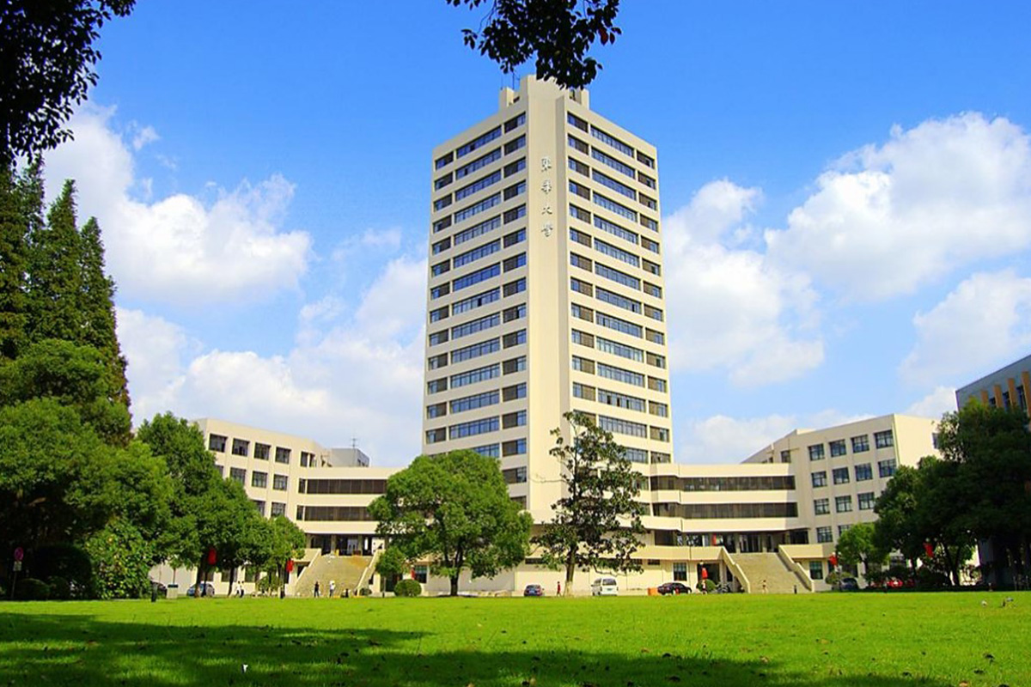
汇报提纲
研究背景
01
主要结果
02
数值模拟
03
结论
04

Slide 3
汇报提纲
研究背景
01
主要结果
02
数值模拟
03
结论
04
Notes:
下面是我将分基本情况，研究背景，学术成果和工作计划四个部分进行汇报。

Slide 4
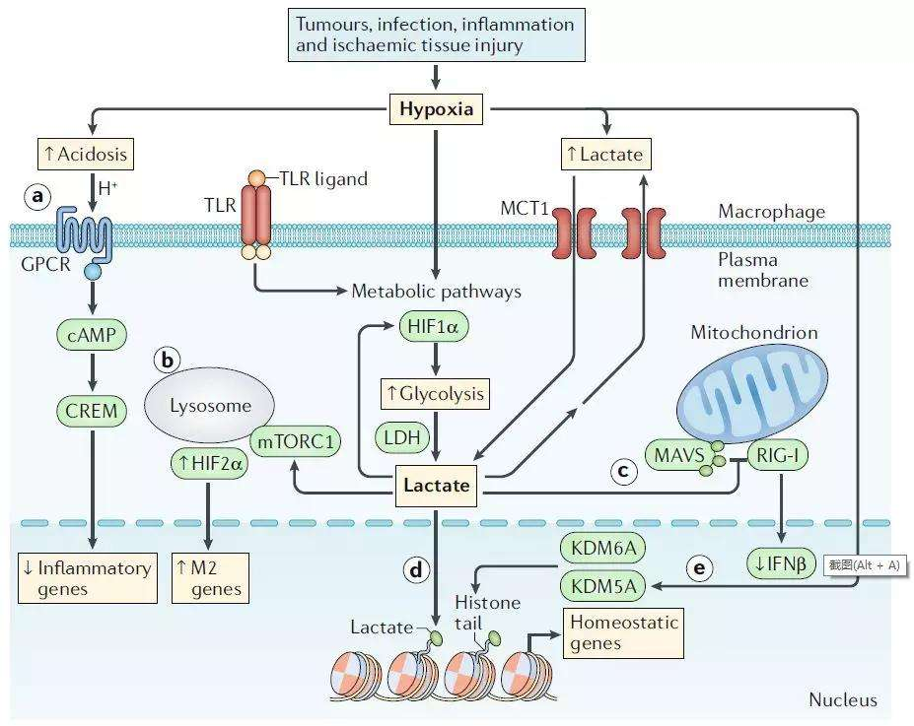
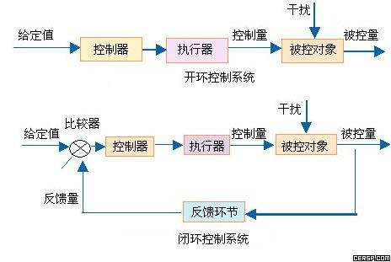
研究背景
系统生物学
基本问题：开发探索实验数据的基本模型，理解生物系统组件之间复杂的关系和相互作用
1948年，N. Wiener 指出：生物系统和控制系统可以用同样的科学方法进行研究
生物系统
控制系统
采用系统论的观点，可以将一个生物系统看成一个动力学系统，系统的状态由状态向量表示
生物系统还可以被描述成一个输入输出系统，由简单的连通组件构成，当收到外界刺激或调控时，可以提供一个响应或输出
利用控制论的概念和技术来研究实际生物系统具有很高的适用性
研究背景

Slide 5
研究背景
基因调控网络
基因调控网络不同于一般的网络结构，它具有一些生物学意义的特征
随机性
复杂性
网络动态性
基因调控在分子水平上呈现出多种因素复杂交互作用，这些因素都能增强或抑制特定基因的表达，即使是同一个细胞，多次试验的结果也会有很大的不同
实际基因调控网络中具有的基因数量非常巨大，这些基因又分布在不同的染色体上。因此，染色体的结构和多样的基因序列都将导致基因转录的复杂性
在基因调控网络中，反馈回路可以分为“正反馈”和“负反馈”。负反馈回路可能引起系统的单稳定性，正反馈回路可以引起系统的多冲稳定性
基因调控网络的建模问题已经成为系统生物学领域的重要课题之一
研究背景
Notes:
基因调控网络的系统生物学建模是当下比较热门的一个研究课题。基因调控网络不同于一般的网络结构，它具有一些生物学意义的特性，比如随机性、复杂性、时空特异性和网络动态性。这些特性给基因调控网络的建模带来了很大的困难，吸引了很多科研工作者的研究兴趣。

Slide 6
研究背景
布尔网络
系统理论
贝叶斯网络模型
生物网络
微分方程模型
系统生物学
布尔网络
基因调控网络
软件模拟
神经网络模型
合成生物
概率图模型
纳米技术
信息论模型
研究背景
Notes:
人们提出了很多数学模型来模拟实际基因调控网络的动力学行为，包括贝叶斯网络模型、微分方程模型、神经网络模型和布尔网络等。布尔网络因其在模拟调控机制特有的优势而备受关注。

Slide 7
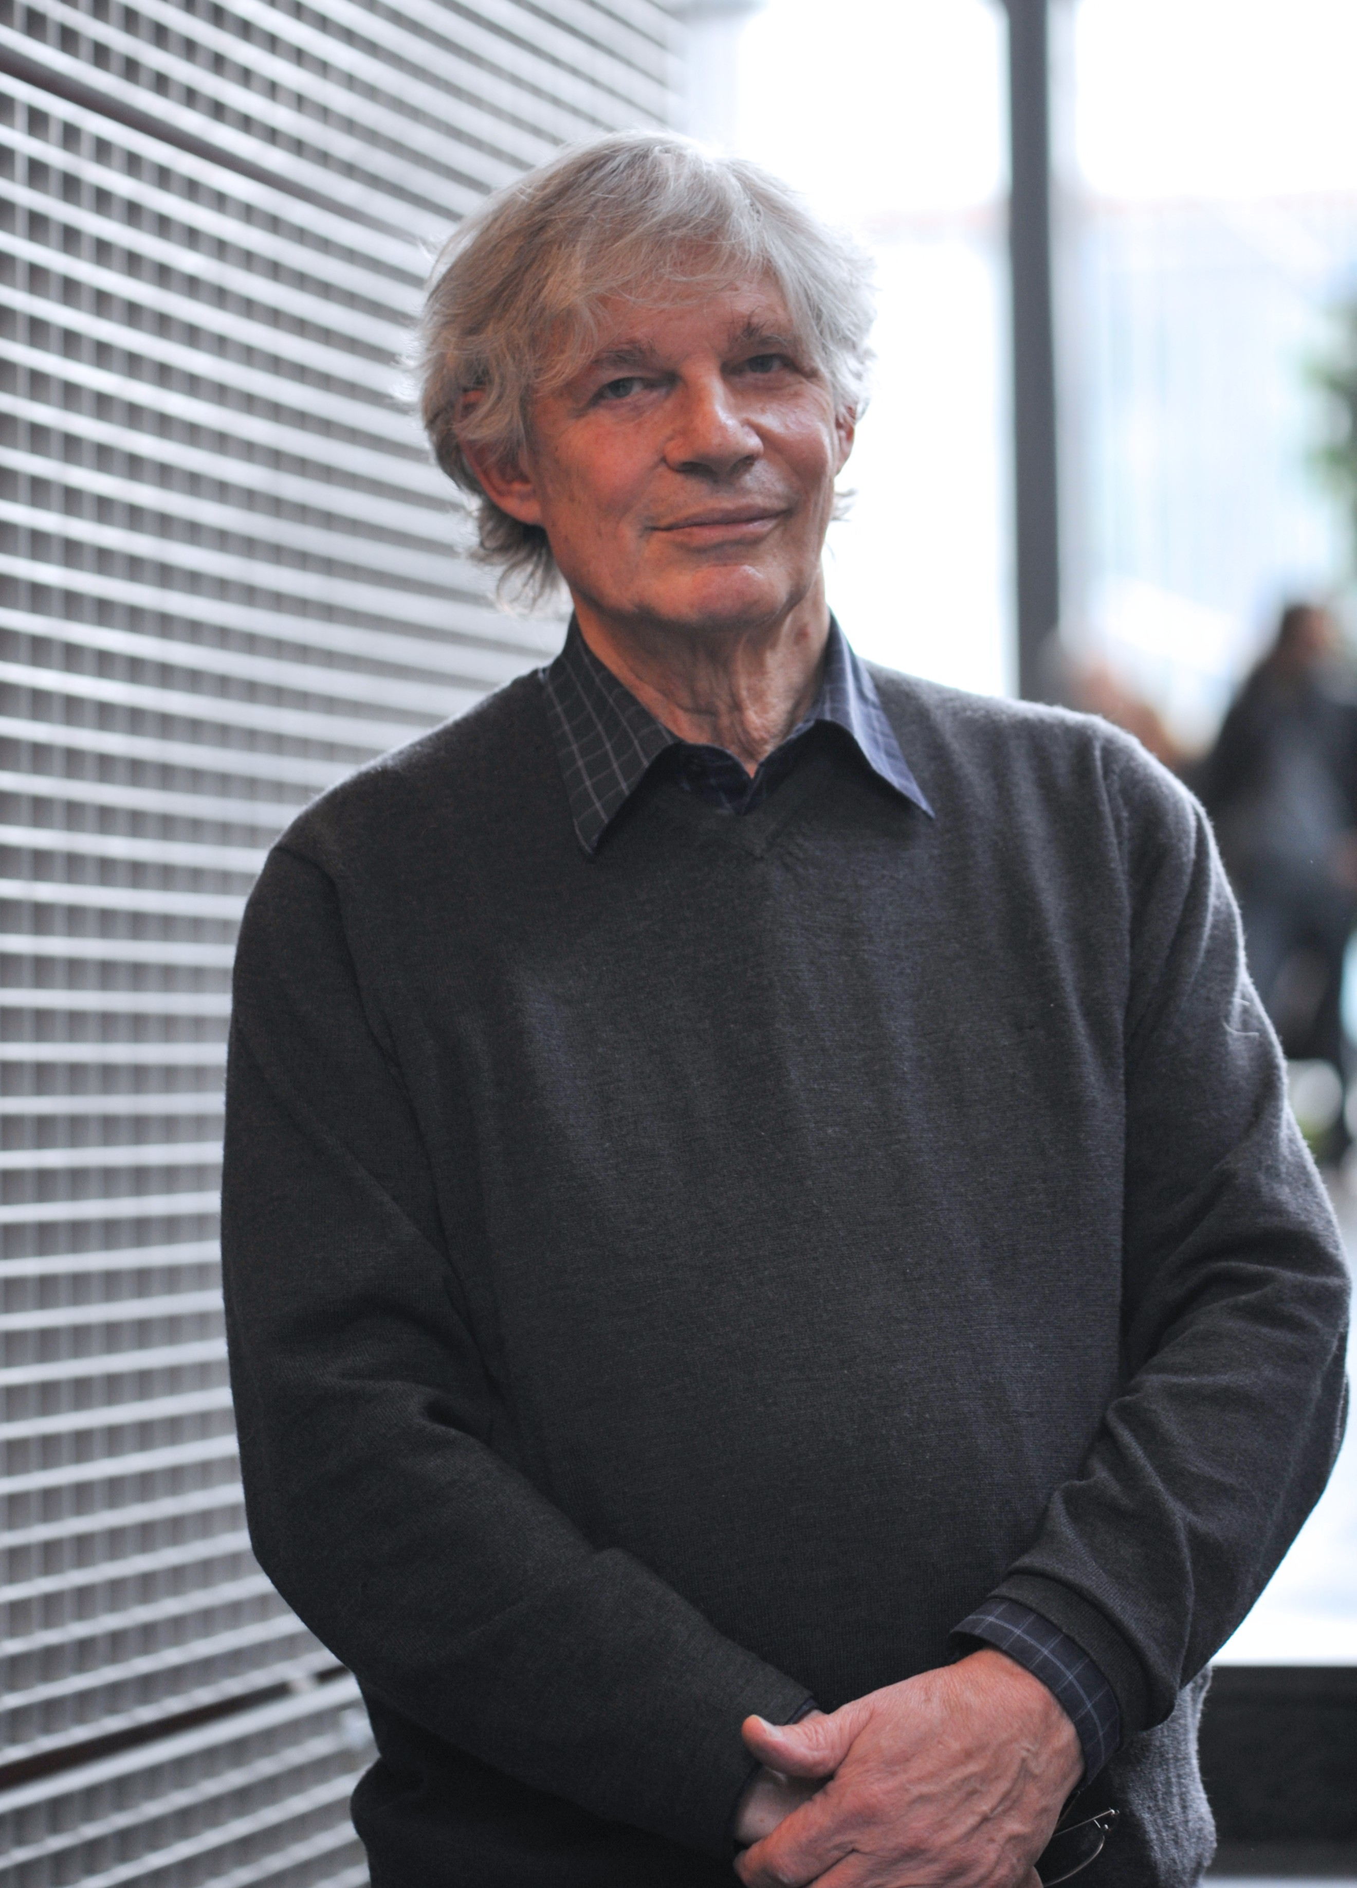
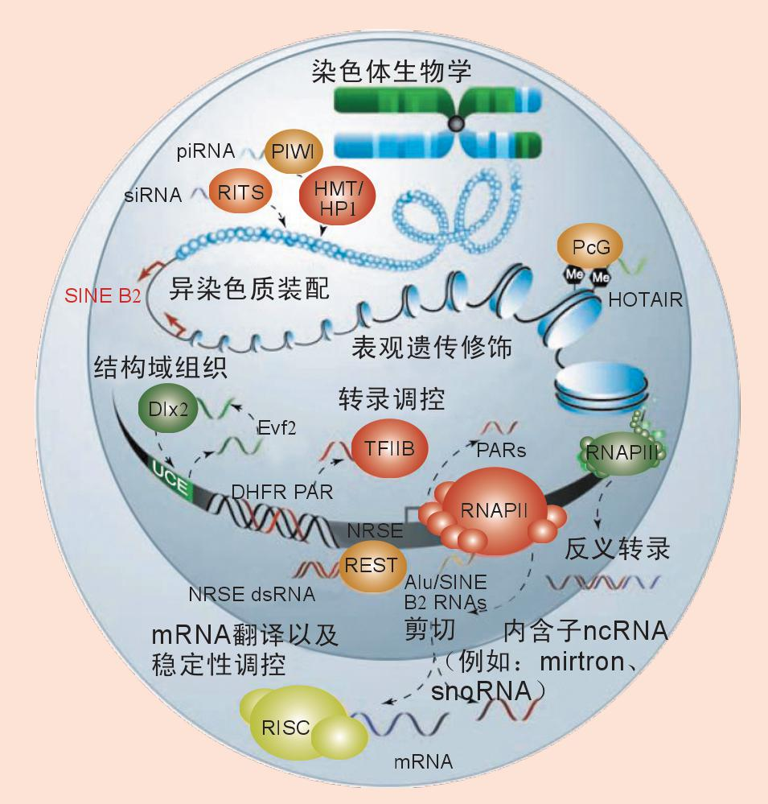
研究背景
布尔网络的提出
布尔网络
建 模
Stuart Alan Kauffman
(理论生物学家)
基因调控网络
S. A. Kauffman, Homeostasis and differentiation in random genetic control networks, Nature, vol. 224, no. 5215. pp. 177-178, 1969. (IF: 40.137)
研究背景

Slide 8
研究背景
布尔网络的应用
噬菌体侵染过程
细胞周期表达
p53信号通路
生化震子
果蝇体节极性网络
胚胎发育
细胞凋亡网络
乳糖操纵子
研究背景
Notes:
布尔网络模型自提出以来一直受到人们的关注，并广泛运用于包括细胞分化、免疫反应、生物进化、神经网络以及基因调控等在内的众多领域。

Slide 9
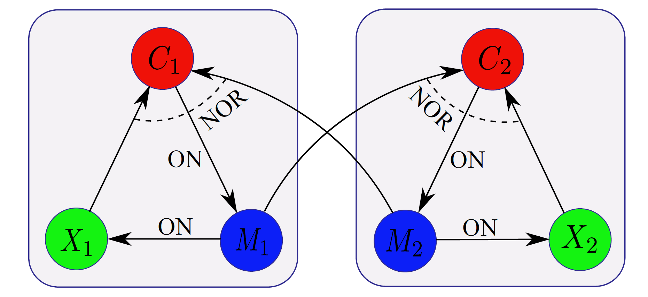
研究背景
图1. 耦合生化震子的网络结构图
研究背景
Notes:
布尔网络缺点：一方面，布尔网络是离散时间系统，它将每个基因的状态二值化，布尔网络只能给出生物系统中状态的离散化描述。然而在实际中，基因表达水平是一个连续值，所以利用布尔网络建模时要将基因表达的数据离散化、二值化，但是这样会造成信息的损失。另一方面，当布尔网络的规模增大时，网络的状态会随着节点数的增加呈指数级增长，给后续的分析带来很大的困难。所以布尔网络适合对系统进行宏观的描述，在对准确性要求不高的情况下有较好的效果。

Slide 10
研究背景
Semi-tensor product of matrices
Definition of STP
The semi-tensor product (STP) of two matrices $A∈M_{m×n}$ and $B∈M_{p×q}$ is defined as
$A⋉B≜(A⨂I_{α/n})$ $(B⨂I_{α/p})$
where $α=l.c.m.(n,p)$ is the least common multiple of $n$ and $p$, and $⨂$ is the tensor (or Kronecker) product.
Remark 1
When $n=p$, $A⋉B=AB$. So it is a generalization of the conventional matrix product that provides a way to multiply two matrices with arbitrary dimensions.
Hereafter, the STP is simply called “product” and the symbol “$⋉$” is omitted if no confusion arises.
研究背景

Slide 11
研究背景
Example 1
Let $A=\left[\begin{matrix}\begin{matrix}1 & 1 \\ 3 & 3\end{matrix} & \begin{matrix}2 & 2 \\ 4 & 4\end{matrix}\end{matrix}\right]$ and $B=\left[\begin{matrix}1 & 2 \\ 3 & 4\end{matrix}\right]$, then we have
$$A⋉B=(A⨂I_{1}) (B⨂I_{2})$$
$$=\left[\begin{matrix}\begin{matrix}1 & 1 \\ 3 & 3\end{matrix} & \begin{matrix}2 & 2 \\ 4 & 4\end{matrix}\end{matrix}\right]\left[\begin{matrix}\begin{matrix}1 & 0 \\ 0 & 1\end{matrix} & \begin{matrix}2 & 0 \\ 0 & 2\end{matrix} \\ \begin{matrix}3 & 0 \\ 0 & 3\end{matrix} & \begin{matrix}4 & 0 \\ 0 & 4\end{matrix}\end{matrix}\right]$$
$$=\left[\begin{matrix}\begin{matrix}7 & 7 \\ 15 & 15\end{matrix} & \begin{matrix}9 & 9 \\ 22 & 22\end{matrix}\end{matrix}\right]$$
$A⋉B=$ $\left[\begin{matrix}\begin{matrix}1 & 1 \\ 3 & 3\end{matrix} & \begin{matrix}2 & 2 \\ 4 & 4\end{matrix}\end{matrix}\right]\left[\begin{matrix}1 & 2 \\ 3 & 4\end{matrix}\right]$
$$=\left[\begin{matrix}\left[\begin{matrix}1 & 1\end{matrix}\right]×1+\left[\begin{matrix}2 & 2\end{matrix}\right]×3 & \left[\begin{matrix}1 & 1\end{matrix}\right]×2+\left[\begin{matrix}2 & 2\end{matrix}\right]×4 \\ \left[\begin{matrix}3 & 3\end{matrix}\right]×1+\left[\begin{matrix}4 & 4\end{matrix}\right]×3 & \left[\begin{matrix}3 & 3\end{matrix}\right]×2+\left[\begin{matrix}4 & 4\end{matrix}\right]×4\end{matrix}\right]$$
研究背景

Slide 12
研究背景
Swap matrix
Definition of swap matrix
An $mn×mn$ swap matrix, denoted by $W_{[m,n]}$, is defined as
$$W_{[m,n]}≜\left[I_{n}⨂δ_{m}^{1},…,I_{n}⨂δ_{m}^{m}\right].$$
If $m=n$, we denote $W_{[m,n]}$ by $W_{[n]}$ for convenience.
Basic property
Let $X∈R^{m}$ and $Y∈R^{n}$ be two column vectors, then
$${Y⋉X=W}_{[m,n]}⋉X⋉Y$$
D. Cheng and H. Qi, A linear representation of dynamics of Boolean networks, IEEE Transactions on Automatic Control, vol. 55, no. 10, pp. 2251-2258, Oct. 2010.
研究背景

Slide 13
研究背景
Matrix expression of logical function
Let $D=\left\{1,0\right\}$ and $1∼δ_{2}^{1}$ and $0∼δ_{2}^{2}$, than $D∼Δ_{2}$.
Lemma 1
Any logical function $f\left(x_{1},…,x_{n}\right):D^{n}→D$ with logical arguments $x_{1}, …,x_{n}∈Δ_{2}$ can be expressed in a multi-linear form as
$f\left(x_{1},…,x_{n}\right)=M_{f}$ $⋉x_{1}⋉x_{1}∙∙∙⋉x_{n}$,
where $M_{f}∈ℒ_{2×2^{n}}$ is unique, called the structure matrix of $f$.
D. Cheng, H. Qi and Z. Li, Analysis and Control of Boolean Network: A Semi-tensor Product Approach. Springer, 2011.
研究背景

Slide 14
研究背景
Some related applications:
Game theory [1]
Finite automata [2]
Nonlinear shift register [3]
Graph minimum stable set and core [4]
Petri nets [5]
……
[1] Cheng, D. Z., et. al. Evolutionarily stable strategy of networked evolutionary games. Automatica, vol. 25, no. 7, pp. 1335-1345, 2014.
[2] X. Xu and Y. Hong, Matrix expression and reachability analysis of finite automata, Journal of Control Theory and Applications, vol. 10, no. 2, pp. 210-215, 2012.
[3] Zhong, J., et. Al, Stability of nonlinear feedback shift registers, Science China-Information Sciences, 59: 012204, 2016.
[4] Zhong, J., Lu J. Q. et. al. Finding graph minimum stable set and core via semi-tensor product approach. Neurocomputing, 174: 588-596, 2016.
[5] Han, X. G., et. al. Calculation of siphons and minimal siphons in Petri nets based on semi-tensor product of matrices. IEEE Transactions on Systems, Man, and Cybernetics: Systems, vol. 47, no. 3, pp. 531-536, 2016.
研究背景

Slide 15
研究背景
Stochastic Boolean networks
The simplest yet basic modeling method for the real regulatory networks is to rely on the discrete logic-based system, which facilitates our study by using the following canonical stochastic, time-invariant Boolean dynamics:
Model
The SBN under consideration consist of a stochastic Boolean state model and a noisy measurement model as follows:
(1a)
(1b)
where
,
,
,
.
* H. Chen, Z. Wang, B. Shen and J. Liang, Model Evaluation of the Stochastic Boolean Control Networks, IEEE Transactions on Automatic Control, doi: 10.1109/TAC.2021.3115473.
研究背景

Slide 16
研究背景
Algebraic representation of SBNs
For each Boolean function $f_{i}$ (respectively, $h_{j}$), one can find its structure matrix $F_{i}$ (respectively, $H_{j}$), thereby giving the following component-wise algebraic form of system (1):
Model
By resorting to the STP technique, the algebraic state space representation of SBNs is obtained as follows
(2a)
(2b)
where
, and
.
研究背景

Slide 17
研究背景
Motivation
Reverse engineering of finite dynamical systems was studied in [1], and the author state that “Due to the limited information and data for some regulatory networks, one often encounters the problem of wanting to choose one model (or a few models) from a large family of models”.
Examples of finite dynamical systems are logical models, Boolean networks and polynomial dynamical systems.
[1] A. Veliz Cuba, An algebraic approach to reverse engineering finite dynamical systems arising from biology, SIAM Journal on Applied Dynamical Systems, vol. 11, no. 1, pp. 31-48, 2012.
研究背景

Slide 18
研究背景
Problem Formulation
For convenience, the complete parameter set of a SBN is denoted by
where $ρ$ is the noise parameter set and $π$ describes the initial distribution of the state.
The maximum-likelihood estimation of $θ$ can be obtained by
$$\hat{θ}=arg\max_{θ∈Θ}{Pr⁡\{y_{0:K}|θ,u_{0:K−1}\}}$$
where $Θ=\{θ_{1},θ_{2},…,θ_{l}\}$ and $θ_{i} (i=1,2,…,l)$ stands for the parameter of the $i$-th candidate model; $y_{0:K}=\left(y\left(0\right),y\left(1\right),…,y\left(K\right)\right)=(δ_{Q}^{j_{0}},δ_{Q}^{j_{1}},…,δ_{Q}^{j_{K}})$ represents the observed output sequence, and $u_{0:K−1}=\left(u\left(0\right),…,u\left(K−1\right)\right)=(δ_{M}^{μ_{0}}, …,δ_{M}^{μ_{K−1}})$ indicates the given control input sequence.
Now, we are in a position to calculate the probability of the observation sequence $y_{0:K}$ for the given parameter $θ$ and the control input sequence $u_{0:K−1}$, i.e.
$$Pr⁡\{y_{0:K}|θ,u_{0:K−1}\}$$
研究背景

Slide 19
研究背景
Problem Formulation
The model evaluation problem
Given the observation sequence $y_{0:K}$, the model parameter $θ$ and the corresponding control sequence $u_{0:K−1}$, this problem asks for computing the exact probability that the observed sequence is produced just by that model, i.e.
$$Pr⁡\{y_{0:K}|θ,u_{0:K−1}\}$$
Given $u_{0:K−1}$ and $θ$, due to the randomness characteristic of the system noises as well as the stochastic initial state, the corresponding output sequence cannot be uniquely determined which, of course, includes the known observation sequence $y_{0:K}$ as a special case.
From the models’ point of view, this problem can also be regarded as the scoring problem as how suitable a given model matches an observed output sequence, which is extremely useful in the process of the system modeling.
研究背景

Slide 20
汇报提纲
研究背景
01
主要结果
02
数值模拟
03
结论
04
Notes:
下面是我将分基本情况，研究背景，学术成果和工作计划四个部分进行汇报。

Slide 21
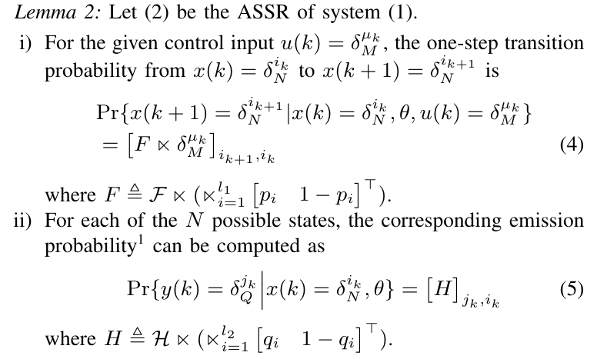
主要结果
1. A straight forward algorithm
主要结果

Slide 22
主要结果
$$u(0)$$
$$u(1)$$
$$⋯$$
$$u(K−1)$$
$$x(0)$$
$$x(1)$$
$$x(2)$$
$$x(K)$$
$$y(0)$$
$$y(1)$$
$$y(2)$$
$$y(K)$$
图2. 随机布尔网络的动态演化过程
隐马尔可夫模型的两个基本假设
齐次马尔可夫性：任意时刻的状态只依赖于其前一时刻的状态，与其他时刻的状态及观测无关，也与时刻无关
观测独立性假设：任意时刻的观测只依赖于该时刻的状态，与其它观测及状态无关。
主要结果

Slide 23
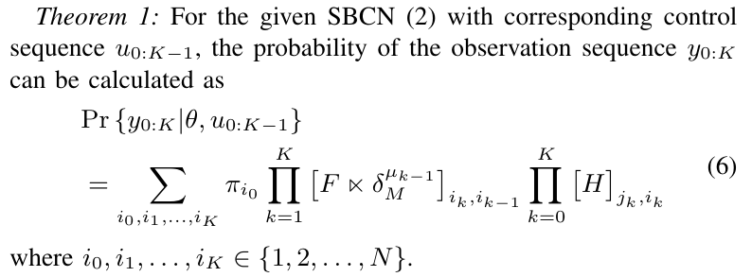
主要结果
$$δ_{M}^{μ_{0}}$$
$$δ_{M}^{μ_{1}}$$
$$δ_{M}^{μ_{K−1}}$$
$$δ_{N}^{i_{0}}$$
$$δ_{N}^{i_{1}}$$
$$δ_{N}^{i_{2}}$$
$$⋯$$
$$δ_{N}^{i_{K}}$$
$${\left[F⋉δ_{M}^{μ_{0}}\right]}_{i_{1},i_{0}}$$
$${\left[F⋉δ_{M}^{μ_{0}}\right]}_{i_{2},i_{1}}$$
$${\left[F⋉δ_{M}^{μ_{K−1}}\right]}_{i_{K},i_{K−1}}$$
$$π_{i_{0}}$$
$${\left[H\right]}_{i_{0},i_{0}}$$
$${\left[H\right]}_{i_{1},i_{1}}$$
$${\left[H\right]}_{i_{K},i_{K}}$$
$$δ_{Q}^{j_{0}}$$
$$δ_{Q}^{j_{1}}$$
$$δ_{Q}^{j_{2}}$$
$$δ_{Q}^{j_{K}}$$
主要结果

Slide 24
主要结果
The number of calculations required by Theorem 1
For the STP of $F$ and $u\left(k\right)$, one need $N^{2}×M$ times of multiplications and $N^{2}(M−1)$ times of additions.
Each term in the sum of (6) can be obtained after $N^{2}\left(2M−1\right)+2K+1$ times of calculations.
Note that there are $N$ possible state at every time instant. Therefore, there are totally $N^{K+1}$ possible choice for the state sequence $x_{0:K}$.
主要结果

Slide 25
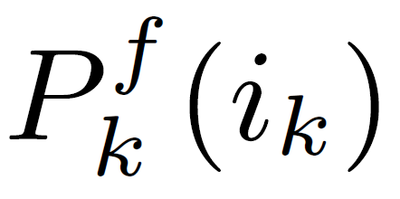
主要结果
2. The forward-backward algorithm
$$u(0)$$
$$u(1)$$
$$x(0)$$
$$x(1)$$
$$⋯$$
$$δ_{N}^{i_{K}}$$
$$⋯$$
$$x(K)$$
$$y(0)$$
$$y(1)$$
$$y(k)$$
$$y(K)$$
主要结果

Slide 26
主要结果
The number of calculations required by Theorem 2
To find $P_{k+1}^{f}(i_{k+1})$ from $P_{k}^{f}(i_{k})$, one needs $N^{2}\left(2M−1\right)+2N$ calculations. To compute all the $N$ entries requires $N[N^{2}\left(2M−1\right)+2N]$ calculations.
The total number of calculations is $KN\left[N^{2}\left(2M−1\right)+2N\right]+N$, which is in the order of $O(MKN^{3})$ rather than the $O(MN^{K+3})$ as required by the direct calculation.
主要结果

Slide 27
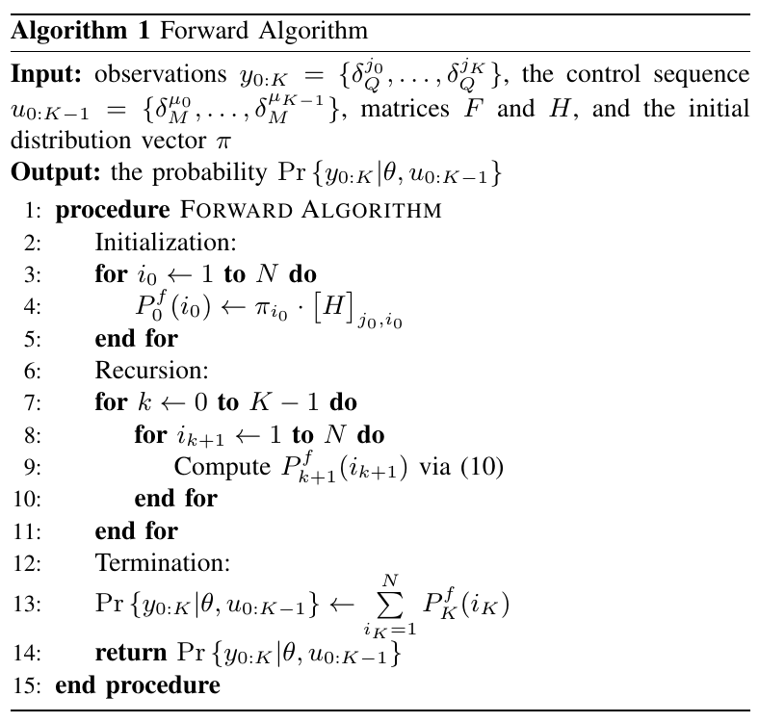
主要结果
主要结果

Slide 28
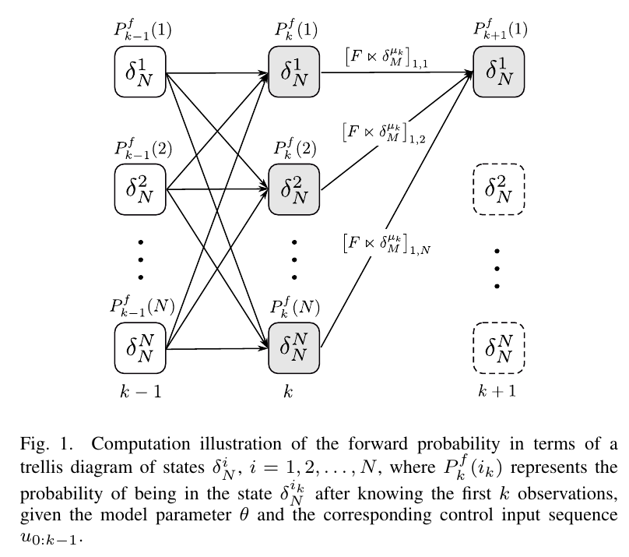
主要结果
主要结果

Slide 29
主要结果
$$u(0)$$
$$⋯$$
$$δ_{N}^{i_{k}}$$
$$u(k)$$
$$x(0)$$
$$x(k+1)$$
$$⋯$$
$$x(K)$$
$$y(0)$$
$$y(k)$$
$$y(k+1)$$
$$y(K)$$
主要结果

Slide 30
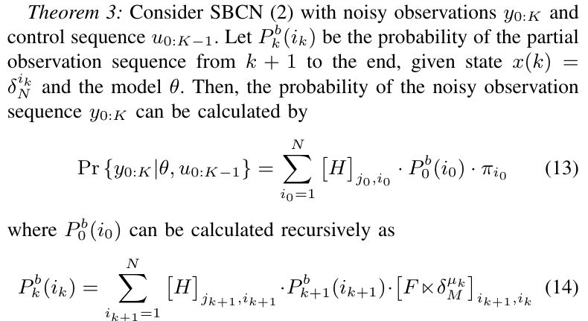
主要结果
主要结果

Slide 31
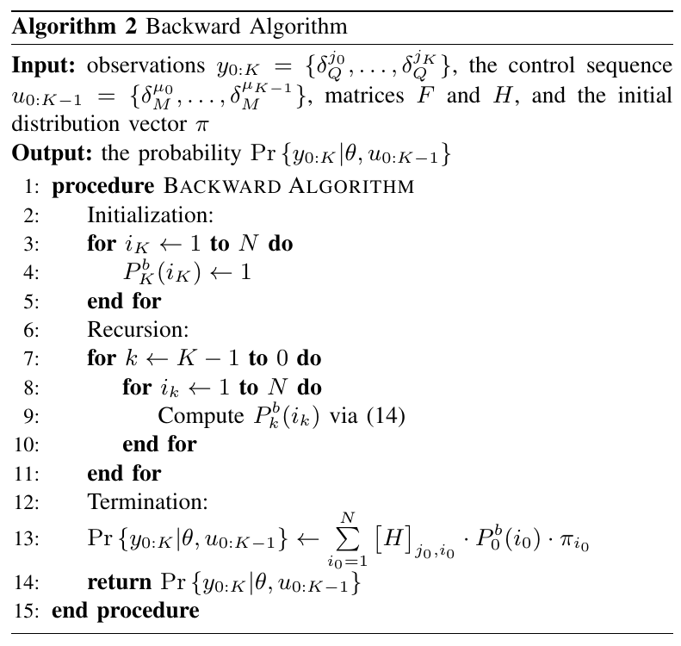
主要结果
主要结果

Slide 32
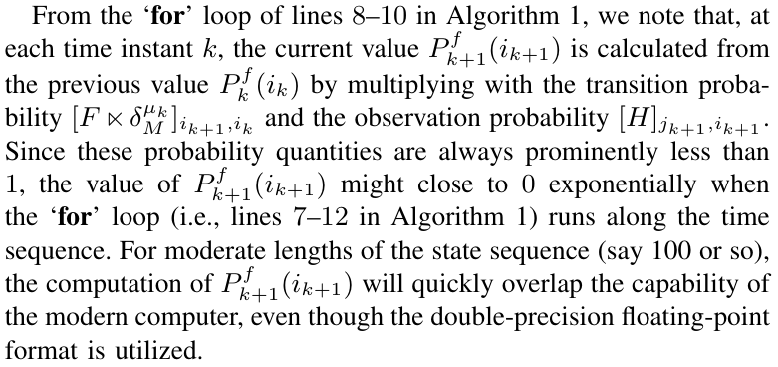
主要结果
主要结果

Slide 33
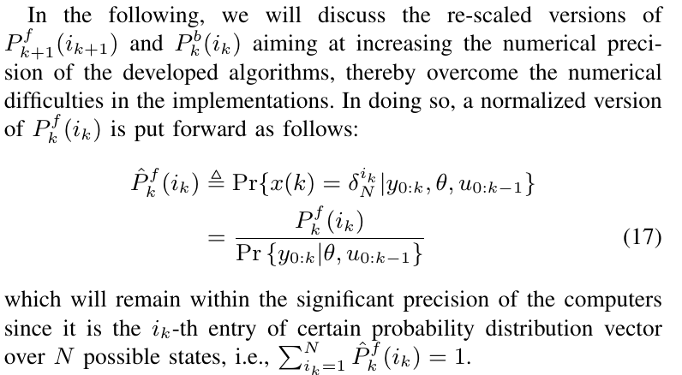
主要结果
3. Scaling factors （缩放因子）
主要结果

Slide 34
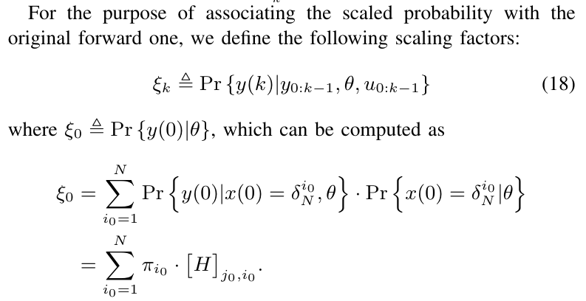
主要结果
主要结果

Slide 35
主要结果
主要结果

Slide 36
汇报提纲
研究背景
01
主要结果
02
数值模拟
03
结论
04
Notes:
下面是我将分基本情况，研究背景，学术成果和工作计划四个部分进行汇报。

Slide 37
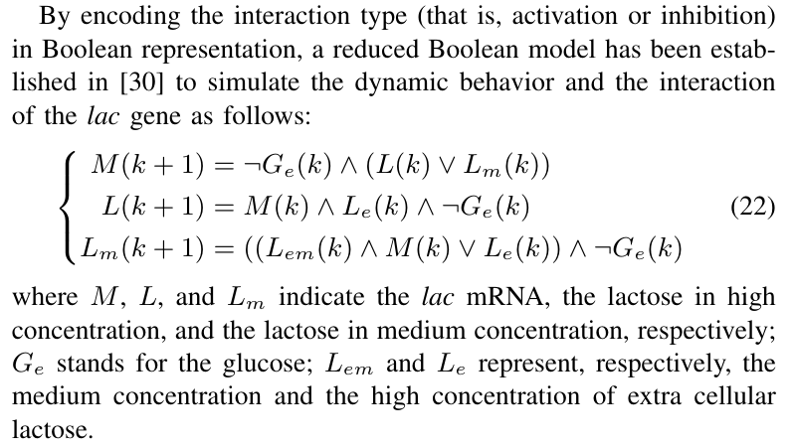
数值模拟
生物实例

Slide 38
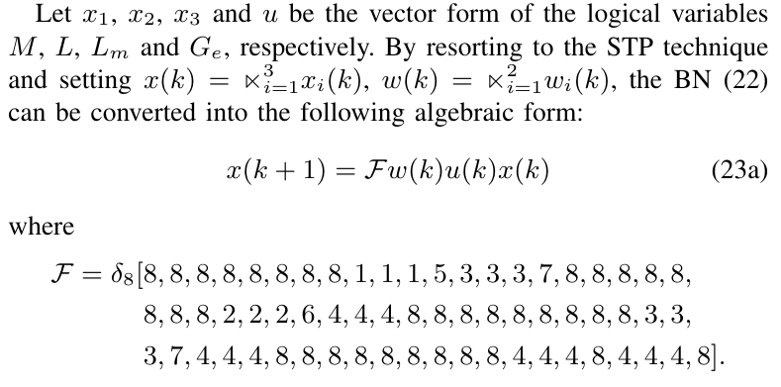
数值模拟
生物实例

Slide 39
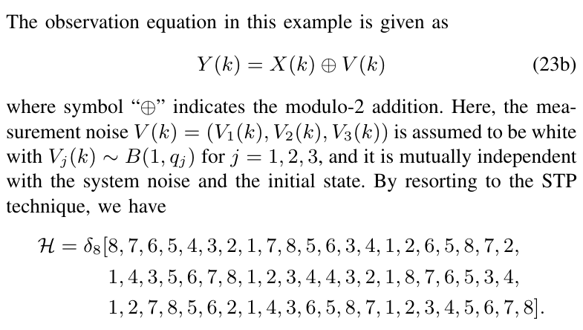
数值模拟
生物实例

Slide 40
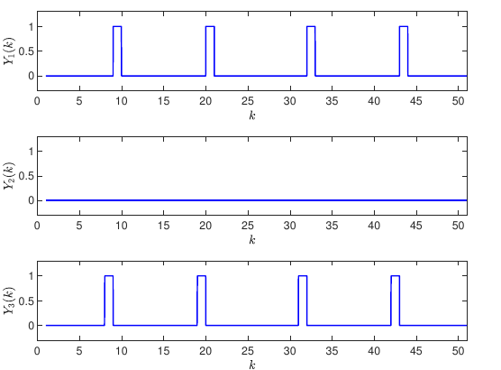
数值模拟
生物实例

Slide 41
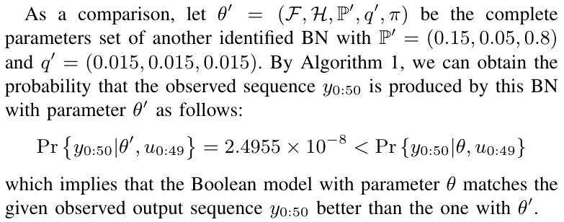
数值模拟
生物实例

Slide 42
汇报提纲
研究背景
01
主要结果
02
数值模拟
03
结论
04
Notes:
下面是我将分基本情况，研究背景，学术成果和工作计划四个部分进行汇报。

Slide 43
结论
Conclusion
By converting the SBCN into an algebraic form with the dynamics similar to that of a hidden Markov model
a straightforward approach has been proposed to compute the probability that the given $y_{0:K}$is produced by the model.
two recursive STP-based algorithms have been designed for model evaluation by resorting to the forward-backward technique.
scaling factors have also been introduced to deal with the numerical issues arising in the implementation of the developed algorithms.
Further the future research direction based on the proposed results
state estimation: smoothing, filtering and prediction …
observed sequence: missing data, time delays in measurements …
结论

Slide 44
Thank you for your attention
Hongwei Chen, Donghua University
hongwei@dhu.edu.cn

