Slide 1


Research on payoff control strategies in multiplayer repeated games
矩阵半张量积及其应用研讨会
汇报人：王元华

Slide 2
目录
CONTENTS
01
Background
02
Main Results
03
Conclusion
目 录

Slide 3
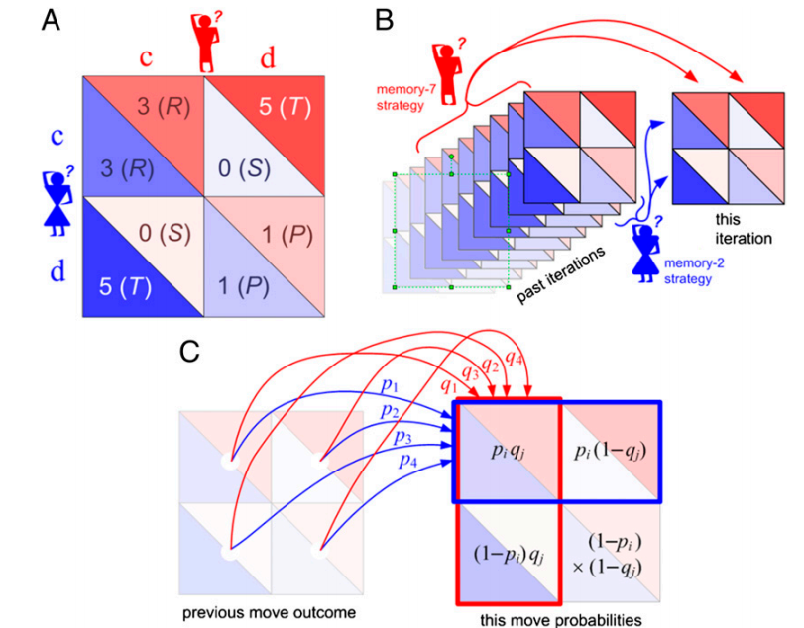
01丨Background
请输入您的标题
请在这里粘贴或者输入你的文字内容
请输入内容
Zero-Determinant (ZD) strategies
Repeated games have provided a general and formal framework to describe the long term behaviors and reciprocity of rational individuals.
ZD strategies can allow one player to unilaterally establish a linear relationship between his own payoff and that of the opponent, regardless of the opponent’s strategy ^{[1]} .
[1] W. Press, F.J. Dyson, Iterated prosoner’s dilemma containes strategies that dominate any evolutionary opponent, Proc. Natl.Acad. Sci., 109(26): 10409-10413, 2012.
Notes:
重复博弈研究的对象是人与人之间的长期交互关系。在重复博弈的理论框架下，传统的博弈论认为，每个玩家的期望收益是由所有玩家的策略和收益函数共同决定的，不可能存在某种简单的策略能够摆脱对手策略的影响而能够单方面控制其他个体的收益。然而，在2012年，Press教授和Dyson教授合作发表在PNAS的一篇文章，文章中指出在两人重复博弈中存在这样一种策略，它强大到无论对方如何对抗，它都能单方面将对手的收益控制在一个固定的数值上，并称这种策略为零行列式策略。这一科学发现彻底改变了人们的传统认知，得到了广泛的关注。在这篇文章发表后的短短一年之内，就有40多篇相关文章发表在PNAS和Nature Communication等顶级学术期刊上。

Slide 4
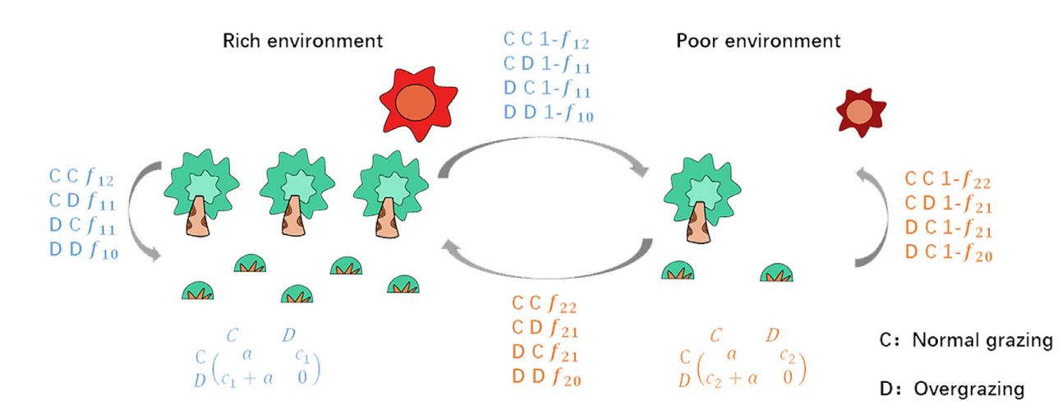
01丨Background
Time-variant game environment
In traditional models, human interactions take place in a constant game environment. Neither human society nor natural environment is fixed in the real world.
Environmental change and human behavior are co-depended. It leads to a feedback model between the dynamics of human behavior and that of the environment.
请输入内容
Notes:
传统的博弈模型中，博弈的收益函数在重复博弈过程中是恒定不变的. 也就说，玩家的交互行为所处的社会或者自然环境是固定不变的。然而，在实际中，无论是人类所处的社会环境还是自然环境都不可能是恒定不变的。近几年, 环境和个体行为的相互影响引起了广泛的关注。环境质量影响着人类的福利，而人类的行为反过来又改变了环境，它们之间的相互作用可建模为反馈模型。举个简单的例子，公共地悲剧中，假设有两个环境，分别是资源丰富的环境和资源匮乏的环境，假设有两个玩家，他们进行重复的囚徒困境博弈，策略C表示正常放牧，策略D表示过度放牧，那么在资源丰富的环境下，背叛获得的诱惑为c1，资源匮乏的环境下背叛获得的诱惑为c2，显然，c1大于c2，因此，不同的博弈环境对应的收益函数是不同的。通过研究发现，过度放牧通常会导致牧场的退化，环境质量变差，并使得可利用的资源减少。

Slide 5
01丨Background
Stochastic games
The feedback between behavior and environment can be studied with the framework of stochastic games ^{[2]} .
The state of environment can change from one period to the next, depending on the current state and the players’ actions. It thus leads to a Markovian eco-evolutionary model between individual behaviors and the undergoing environment.
Motivation I
Algebraic model of Markovian eco-evolutionary dynamics
[2] F. Liu, B. Wu, Environmental quality and population welfare in Markovian eco-evolutionary dynamics, Applied Mathematics and Computation, 431: 127309, 2022.
Notes:
人类行为和环境之间的这种反馈可以用随机博弈框架来研究。在随机博弈中，将玩家所处的博弈环境刻画为状态，并且假设下一时刻所处的状态只与当前状态和局势有关，因此，它导致了个体行为与所处环境之间的马尔可夫共演化模型。因此，我们的第一个研究目标是为时变环境下的重复博弈建立马尔科夫共演化动态的代数模型。

Slide 6
01丨Background
Payoff control strategies
In stochastic game model, is there control strategies that enable one player unilaterally to set a linear relationship between collective welfare and environmental quality?
The control strategies in repeated games with time-variant environment, called generalized zero-determinant (GZD) strategies.
Motivation II
How to provide the algebraic formula of GZD strategies ?
Notes:
在随机博弈中是否存在收益控制策略能够设定集体福利和环境质量之间的线性关系呢？我们将固定收益函数下重复博弈的零行列式策略研究推广到时变环境，并将时变环境下的收益控制策略，称之为广义零行列式策略。

Slide 7
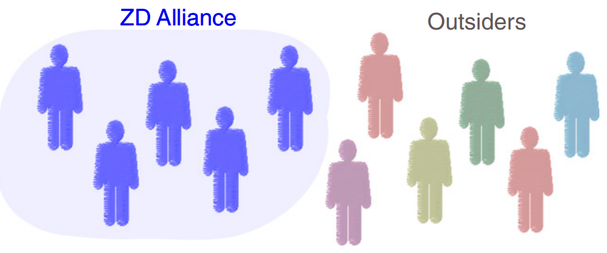
01丨Background
Zero-Determinant alliances
The previous studies are based on the assumption that individuals act independently. However, as the number of players increases, the ability of a single player to control the payoffs of other players decreases dramatically.
We are interested in the question whether individuals can gain a higher amount of control by coordinating their play with other group members ^{[3]}.
Motivation III
How to design zero-determinant alliances in large groups？
[3] Hilbe C, Wu B, Traulsen A, Nowak M A, Cooperation and control in multiplayer social dilemmas, Proc Natl Acad Sci USA, 111(46), 16425-16430, 2014.
Notes:
在零行列式策略的先前研究中，都是假设博弈个体独立选择策略。但是，随着博弈人数增多, 单个策略的控制能力不断下降. 因此，我们感兴趣的是，个体是否可以通过与其他成员协调合作来获得更高的控制权。文献3中引入了零行列式联盟的概念，文献指出玩家通过与其他人组成联盟可以提高零行列式策略的控制能力，并以公共品博弈为例说明，在大规模群体中，单个玩家不能实现任意敲诈，但是，足够大的零行列式联盟可以实现任意敲诈。

Slide 8
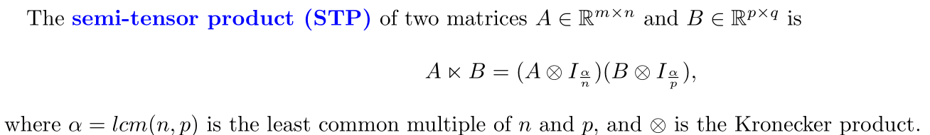
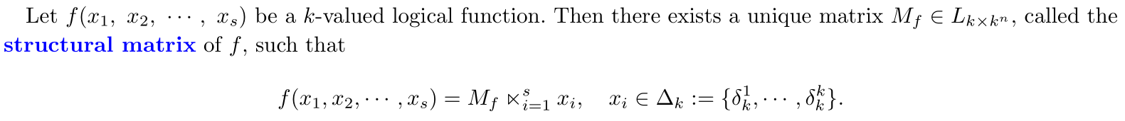
01丨Background
Preliminaries
Semi-tensor product of matrices
Definition of STP:
The main advantage of STP: Convert a logical expression into a vector form.

Slide 9
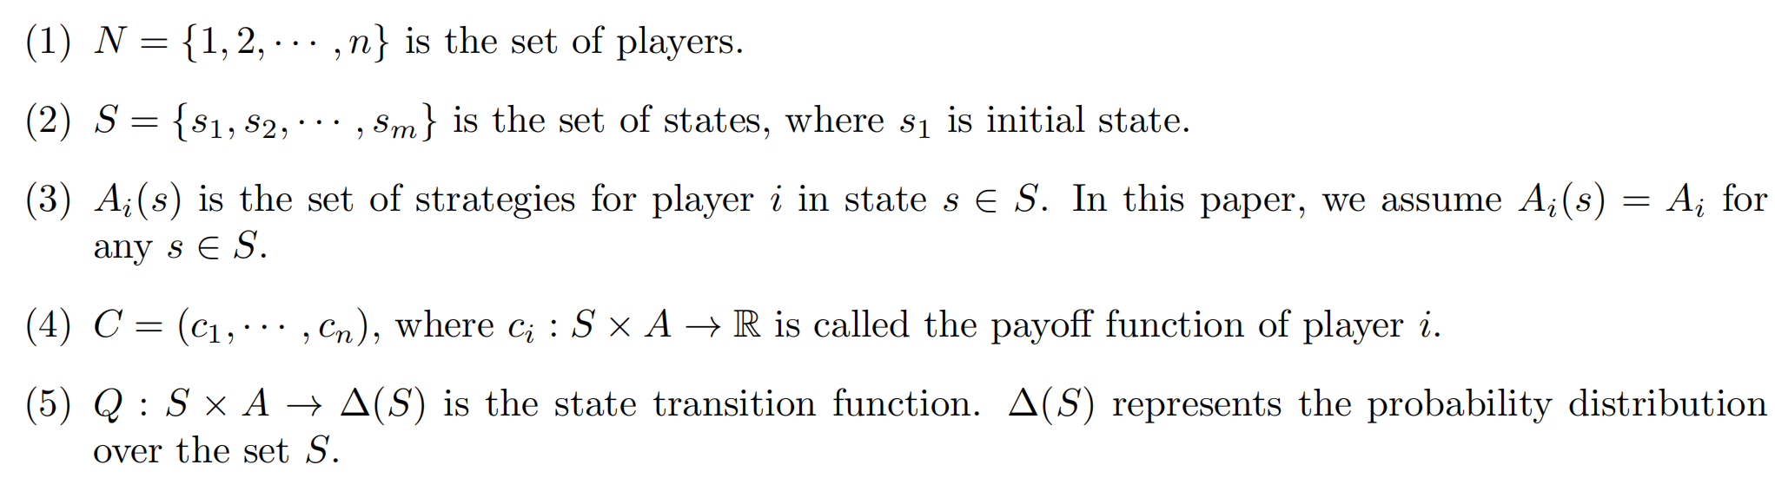
01丨Background
Preliminaries
Definition of stochastic games
Definition 1: A stochastic game can be denoted by G = (N, S, A, C, Q), where

Slide 10
02丨Main Results
Algebraic model for repeated games with time-variant environment
Design of generalized zero-determinant (GZD) strategies
Design of zero-determinant (ZD) alliances

Slide 11
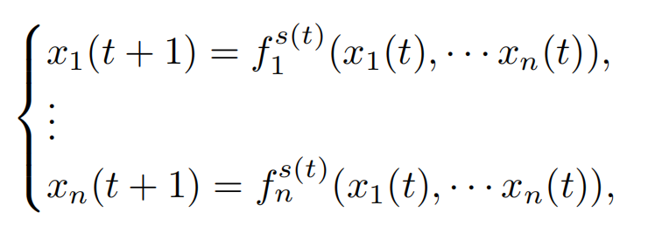


02丨Main Results
Algebraic model
Strategy evolutionary dynamics of multi-player repeated game with time-variant environment
Matrix expression of Markovian profile dynamics
Matrix expression of Markovian state
dynamics
1
03
04
(1)
(2)

Slide 12
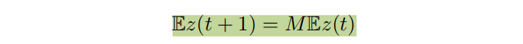

02丨Main Results
Algebraic model
Set z(t) = s(t)x(t), then we get the Markovian eco-evolutionary system,
its equivalent algebraic model is
03
04
(3)

Slide 13
02丨Main Results
Algebraic model
Example 1: Dissemination of online public opinion
Online media platforms can adopt both active and passive control measures.
Netizens have two different choices: spreading and not spreading.
The finite game is three-player Prisoner’s Dilemma
two environmental states (i.e. games 1 and game 2)
1
03
04
1
03
04
“not spreading” means “cooperate” (C) “spreading” means “defect”(D)
N = {1, 2, 3} and A₁=A₂={C,D}
Notes:
以网络舆论传播为例。网络媒体平台可以采取主动和被动控制措施，其中主动控制是指网络媒体平台对信息内容进行实时控制和审查，而被动控制是指在面对突发公共事件时，允许舆论信息的传播，从而获得流量和人气。对于某个话题，网民通常有两种不同的选择：传播和不传播。网民的收益与网络媒体平台的控制行为密切相关，因此两个博弈状态下，玩家的收益是不一样的。

Slide 14
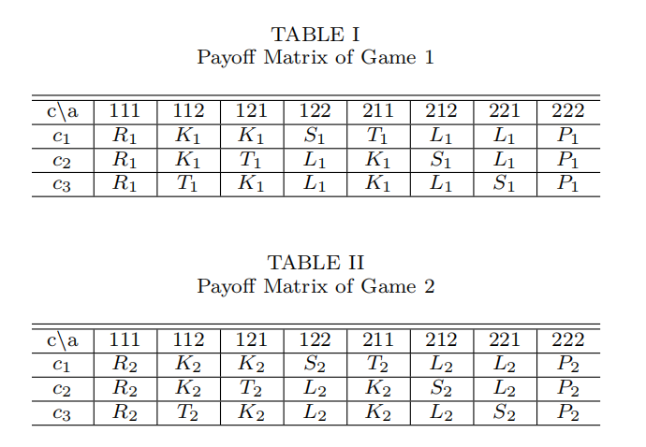
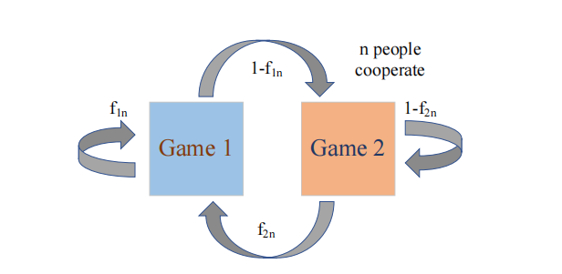
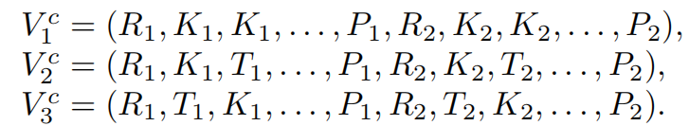
02丨Main Results
Algebraic model
1
03
04
Fig.1 : Game Transition
f_{mn} is the probability of the three players being in game 1 in the next step, if there are n (n = 0, 1 , 2, 3) cooperators in Game m (m = 1, 2) at current time.
Notes:
其中fmn是玩家在下一时刻进入游戏1的概率，m表示当前状态（m=1,2），n（n=0,1,2,3）是合作者的数量。

Slide 15
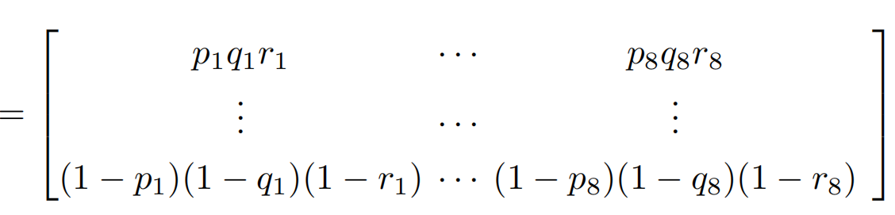

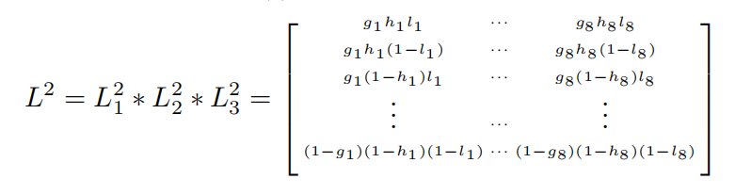

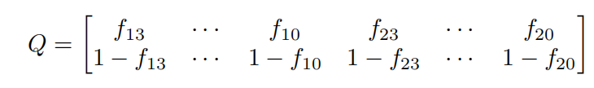


02丨Main Results
Algebraic model
when s(t)=1
when s(t)=2
请在这里粘贴或者输入你的文字内容
请在这里粘贴或者输入你的文字内容
01
0
(4)
Notes:
利用矩阵半张量积，我们可以分别得到状态1和状态2下的局势演化方程的代数形式，以及代数化的状态演化方程，将这两个方程整合在一起，就得到了马尔科夫型共演化方程的代数形式，其中马尔科夫转移矩阵M计算如下，这是一个16乘以16的概率转移矩阵

Slide 16
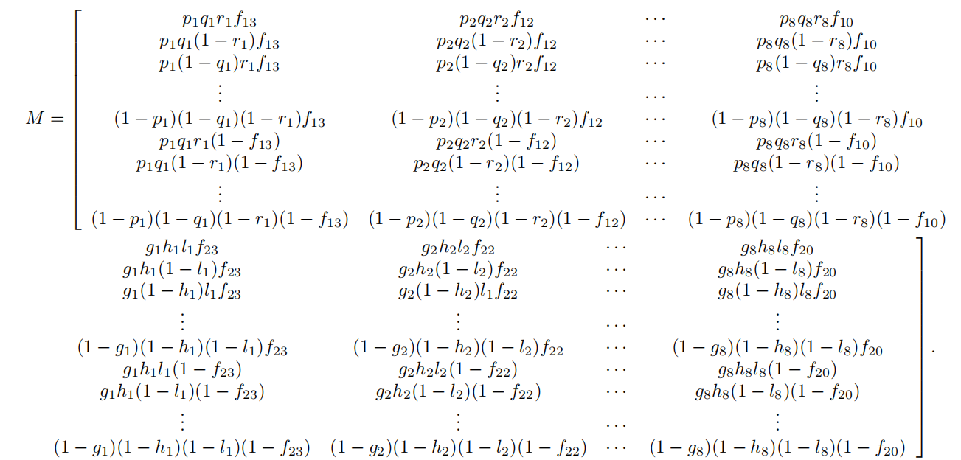

02丨Main Results
Algebraic model
Markov transition matrix
Notes:
博弈的演化动力学完全是由其马尔可夫转移矩阵来确定的

Slide 17


02丨Main Results
Design of GZD strategies
Assume the transition matrix M has a unique stationary distribution
(5)
Set
Notes:
假设矩阵M具有唯一的平稳分布，记为λ，其中表示平稳状态下博弈m中处于局势j的概率。

Slide 18
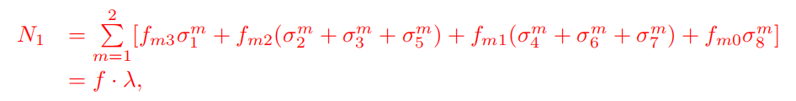

02丨Main Results
Design of GZD strategies
Definition of environmental quality
Definition 2: Denote N_{m} as the proportion of the time in game m (m = 1, 2), then N_{m} is called environmental quality of game m.
请在这里粘贴或者输入你的文字内容
请在这里粘贴或者输入你的文字内容
请在这里粘贴或者输入你的文字内容
请在这里粘贴或者输入你的文字内容
01
Notes:
环境m的环境质量定义为环境m的时间占比，也就是平稳状态下处于博弈m的概率，用Nm表示，仍然以刚才的例子为例，那么N1定义如下，

Slide 19


02丨Main Results
Design of GZD strategies
Definition of collective welfare
Definition 3: The sum of expect payoffs for all players are expressed as the collective welfare as
请在这里粘贴或者输入你的文字内容
请在这里粘贴或者输入你的文字内容
请在这里粘贴或者输入你的文字内容
请在这里粘贴或者输入你的文字内容
  Explore the linear relationship between the collective welfare and environmental quality.

Slide 20

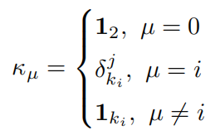
02丨Main Results
Design of GZD strategies
Lemma 1 ^{[4]} : Consider a finite game G ∈ G_{[3;2,2,2]} played repetitively in two environments. The strategy extraction vector for player i with strategy j is
where
.
Then we have
请在这里粘贴或者输入你的文字内容
请在这里粘贴或者输入你的文字内容
请在这里粘贴或者输入你的文字内容
01
0其中2
[4] Cheng D, Li C. Design of zero-determinant strategies and its application to networked repeated games. Sci. China Inf. Sci., 2024, doi: 10.1007/s11432-023-4022-6

Slide 21
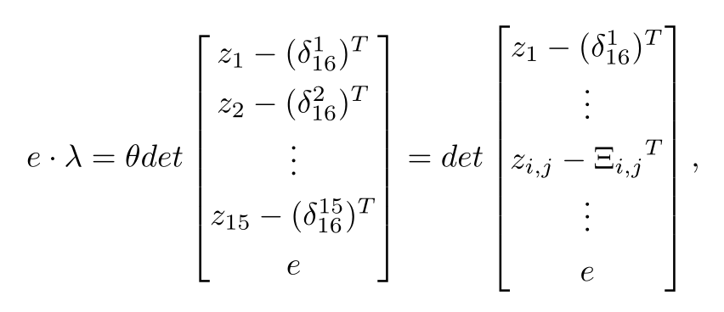


02丨Main Results
Design of GZD strategies
According to equation (5) and basic knowledge of linear algebra, for an arbitrary vector e ∈ R¹⁶,
it is easy to calculate
(6)
请在这里粘贴或者输入你的文字内容
请在这里粘贴或者输入你的文字内容
请在这里粘贴或者输入你的文字内容
where θ is a non-zero constant.

Slide 22


02丨Main Results
Design of GZD strategies
Formula of GZD strategies
Theorem 1 : Consider an infinitely repeated game G ∈ G_{[3;2,2,2]} with two environmental states. Assume player i aims to set the linear relationship between N₁ and W as
Then the GZD strategies can be designed as
请在这里粘贴或者输入你的文字内容
请在这里粘贴或者输入你的文字内容
请在这里粘贴或者输入你的文字内容
请在这里粘贴或者输入你的文字内容
请在这里粘贴或者输入你的文字内容
请在这里粘贴或者输入你的文字内容
(7)

Slide 23
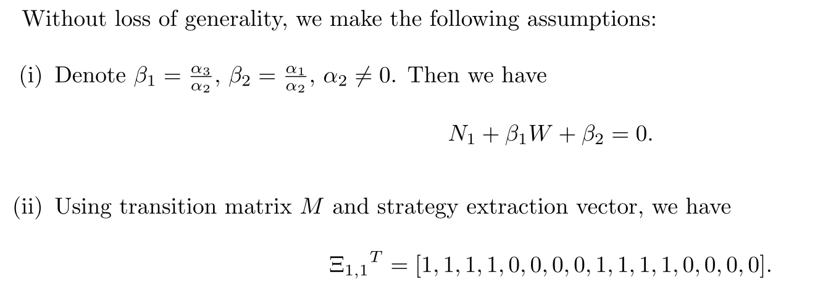
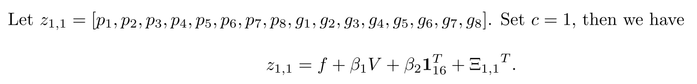
02丨Main Results
Properties of GZD strategies
请在这里粘贴或者输入你的文字内容
请在这里粘贴或者输入你的文字内容
请在这里粘贴或者输入你的文字内容
请在这里粘贴或者输入你的文字内容
(8)
(iii) R_{m} = a > 0, K_{m} = a − b_{m}, S_{m} = a − 2c_{m}, T_{m} = 2b_{m} > 0, L_{m} = c_{m} > 0, P_{m} = 0 (m = 1, 2).

Slide 24
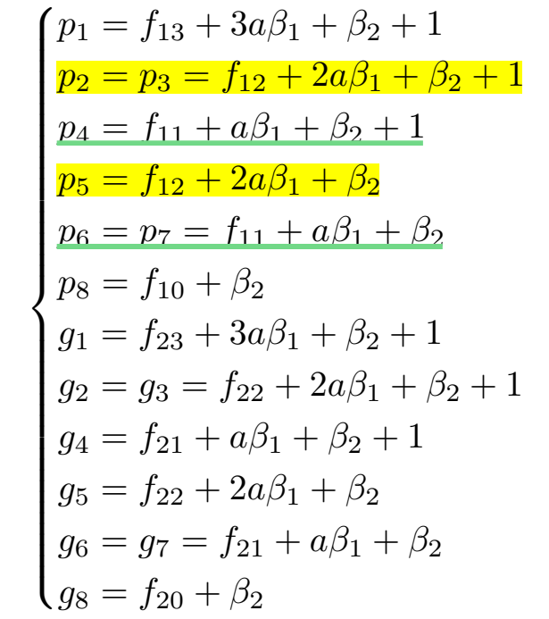
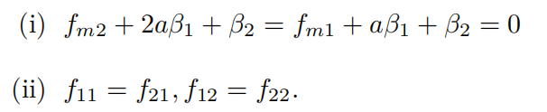
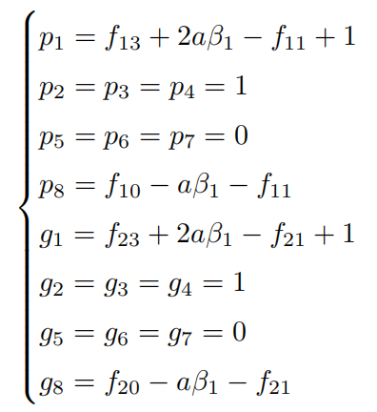

02丨Main Results
Properties of GZD strategies
The GZD strategies in (8) can be rewritten as
请在这里粘贴或者输入你的文字内容
请在这里粘贴或者输入你的文字内容
(9)
Notes:
where both β1and β2are solely determined by player 1.

Slide 25


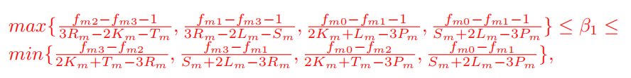
02丨Main Results
Properties of GZD strategies
Proposition 1: Consider an infinitely repeated game G ∈ G_{[3;2,2,2]} with two environments.
请在这里粘贴或者输入你的文字内容
(10)
请在这里粘贴或者输入你的文字内容
请在这里粘贴或者输入你的文字内容
请在这里粘贴或者输入你的文字内容
请在这里粘贴或者输入你的文字内容
请在这里粘贴或者输入你的文字内容
(11)

Slide 26

02丨Main Results
Properties of GZD strategies
Remrk 1:
    The
(11)
It is shown that the linear relationship can be set to be either positive or negative, which is completely determined by the focal individual. And if more people don’t spread rumour, then transforming into an environment with stricter regulation is possible.
请在这里粘贴或者输入你的文字内容
If the two environments are identical, then the GZD strategies will degenerate into the traditional ZD strategies.
Notes:
也就是说，如果更多的人不散布谣言，那么就有可能转变为环境质量更好、监管更严格的环境。线性关系可以设置为正相关或负相关的，这完全由焦点玩家决定的。这意味着即使在恶劣的环境中需要更长的时间，集体福利也可以更高。

Slide 27
02丨Main Results
Design of zero-determinant (ZD) alliances
Types of alliances
  Strategic alliances
When players form a strategy alliance, they only agree on the set of alliance members, and on a common ZD strategy that each alliance member independently applies during the repeated game.
  Synchronous alliances
All alliance members synchronize their decisions in each round, such that all allies play the same action.
Notes:
第三个主要结果是我们正在做的研究内容，称为零行列式联盟，目前只得到比较简单的结论，还需要进一步修改完善，今天只是把主要思想向老师们汇报一下。联盟的类型有两种：策略联盟和同步联盟，如果玩家形成一个策略联盟的话，联盟中有一个核心玩家，其他联盟成员在重复博弈过程中采用与核心玩家相同的零行列式策略。同步联盟中的成员会选择相同的策略，比如多人囚徒困境博弈的话，他们要么都选择合作，要么都选择背叛，因此，同步联盟就可以看做是一个整体玩家参与博弈，这与单个人进行博弈没有太大区别。我们主要研究策略联盟的情况。

Slide 28
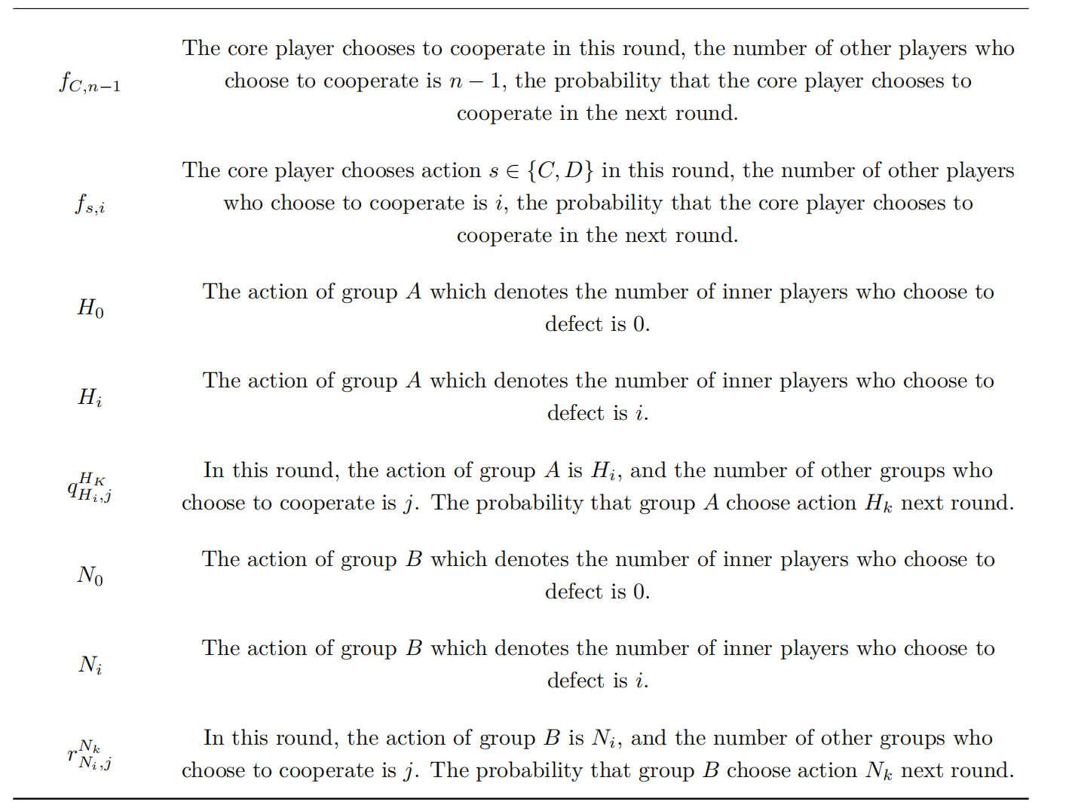
02丨Main Results
Notations

Slide 29


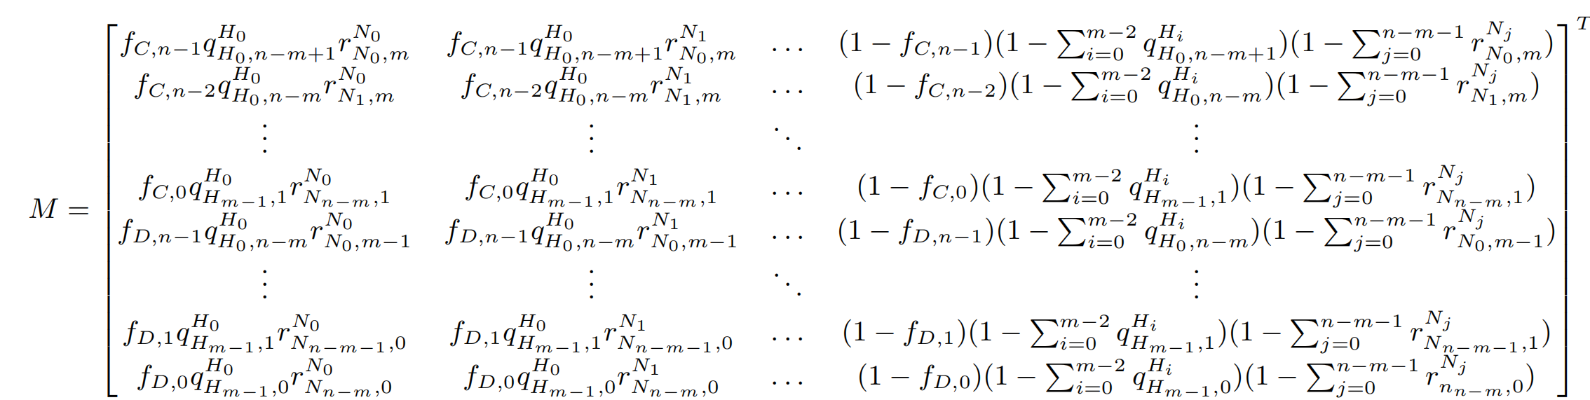


02丨Main Results
Profile evolutionary equation
(12)
where the Markov transition matrix is

Slide 30

02丨Main Results
Design of zero-determinant (ZD) alliances
Theorem 2 :
s in the alliance.
Consider an infinitely repeated game. Assume the core player i* aims to set the linear relationship between the expect payoff of alliance and outsiders to satisfy
Then the ZD strategies for core player i* can be designed as
请在这里粘贴或者输入你的文字内容
请在这里粘贴或者输入你的文字内容
请在这里粘贴或者输入你的文字内容
请在这里粘贴或者输入你的文字内容
请在这里粘贴或者输入你的文字内容
请在这里粘贴或者输入你的文字内容
(13)
(14)
Notes:
为了让核心玩家区分其他盟友和局外人，引入权重来刻画不同玩家对他的重要性。

Slide 31
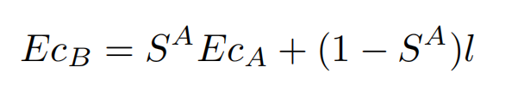
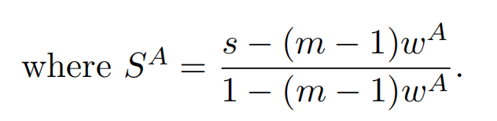
02丨Main Results
Design of zero-determinant (ZD) alliances
denotes the core player’s zero determinant strategy, which is also shared by
other players in the alliance.
Remark 2:
denotes the core player’s ZD strategy, which is also shared by other players in the alliance.
When the alliance uses this ZD strategy, it can enforces the relationship between the alliance’s payoff and the payoff of the outsiders to satisfy
请在这里粘贴或者输入你的文字内容
请在这里粘贴或者输入你的文字内容
请在这里粘贴或者输入你的文字内容
请在这里粘贴或者输入你的文字内容
(15)
is the extortion factor.

Slide 32
02丨Main Results
Design of zero-determinant (ZD) alliances
m
Proposition 2 ^{[3]}:
The ZD alliance can enforce exactly the payoff relationships (15), if and only if
S^{A} <1 and
(16)
m
请在这里粘贴或者输入你的文字内容
m
m-1
m
请在这里粘贴或者输入你的文字内容
请在这里粘贴或者输入你的文字内容
请在这里粘贴或者输入你的文字内容
Interestingly, as the alliance size m increases, condition (16) becomes easier to satisfy. That is, larger alliances can therefore enforce more extreme payoff relationships.
[3] Hilbe C, Wu B, Traulsen A, Nowak MA, Cooperation and control in multiplayer social dilemmas, Proc Natl Acad Sci USA, 111(46), 16425-16430, 2014.
Notes:
因此，更大的联盟可以施加更极端的收益关系。在文献3中，作者以公共物品博弈为例，当博弈人数大于某个数值时，单个玩家不能进行任意敲诈。但是，联盟只需要足够大，就可以实现任意敲诈。

Slide 33
02丨Main Results
Design of zero-determinant (ZD) alliances
Example 2: four-player Prisoner’s Dilemma
Assume that player 1 is the core player and form an alliance with player 2.
Table 3 payoff matrix
T > R > Z > K > M > L > P > N

Slide 34
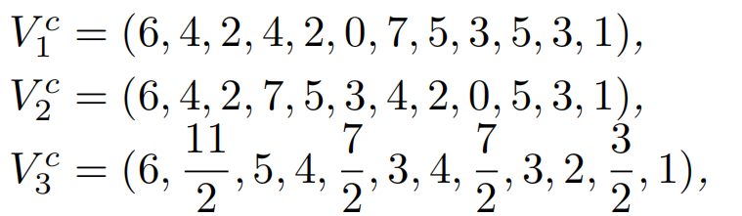
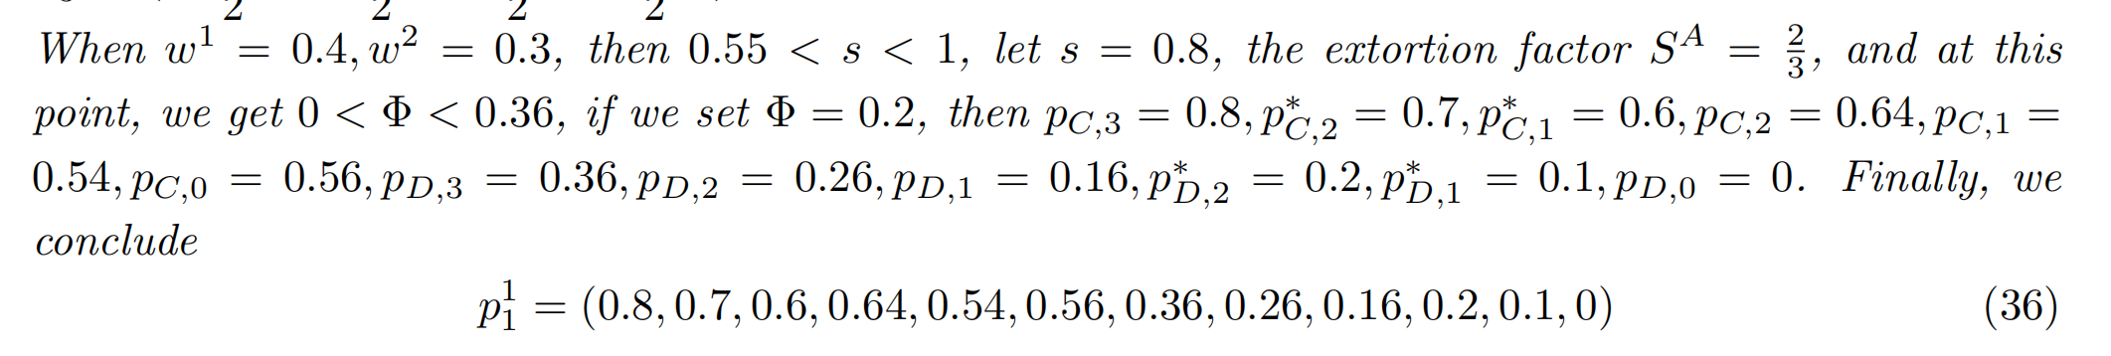
02丨Main Results
Example 2: four-player Prisoner’s Dilemma
The ZD strategy for the core player can be given as
Set T = 7, R = 6, Z = 5, K = 4, M = 3, L = 2, P = 1, N = 0. Then we get

Slide 35
03丨Conclusion
Matrix expression of Markovian eco-evolutionary dynamics is provided for multi-player repeated games with time-variant environment.
GZD strategies : we explore the linear relationship between collective welfare and environment quality.
ZD alliances : provide new perspectives for controlling payoffs in a large-scale game with numerous involved players.

Slide 36
Evaluation of dynamic model
恳请各位老师批评指正

