Slide 1
Service Chain Composition in NFV Systems: A Game-Theoretic Perspective based on STP theory
2025 Seminar on Semi-tensor Product
of Matrices and Its Applications, Kunming
Shuting Le
Suzhou University of Science and Technology

Slide 2
1
Introduction
1
2
Preliminaries
3
NFV games with complete information
NFV games with incomplete information
4
5
Prospect

Slide 3
1
Intoduction

Slide 4
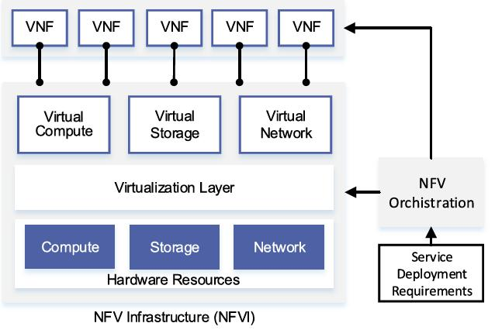
1.1
NFV Infrastructure
Network Functions Visualization (NFV) [1] , consists of virtualization network
layer, NFV Infrastructure (NFVI), and Management and Orchestration (MANO)
system.
From NFV White Paper
2014 by ETSI
Fig 1.1 NFV System Architecture
[1] M.S.Bonm, K. L. Dias,and S. F. L. Fernandes, Integrated NFV/SDN architectures: A systematic literature review, IEEE ACM Comput. Surv, vol. 51, pp. 114, 2019.
Notes:
欧洲电信标准组织（ETSI）定义的 NFV 架构如图 3.1 所示，在网络功能虚拟化基础设施（NFVI）上部署和执行虚拟网络功能（VNF），NFVI 是由软件层包装的商品服务器组成，并抽象地、逻辑地区分他们在管理层的上面，一个 VNF 通常映射一个虚拟机到 NFVI。通过管理和编排系统（M&O）
的控制，VNFs 在NFVI 上部署、执行和操作，这些都是由一组描述网络服务和其 VNFs 特征的元数据驱动。M&O 系统包括：一个用于主管网络服务生命周期的 NFV 编排器；一套用于主管 VNFs 生命周期的管理器；一个管理虚拟化基础设施的管理器，这可以被看作是一个扩展的云管理系统，负责控制和管理 NFVI 资源
。

Slide 5
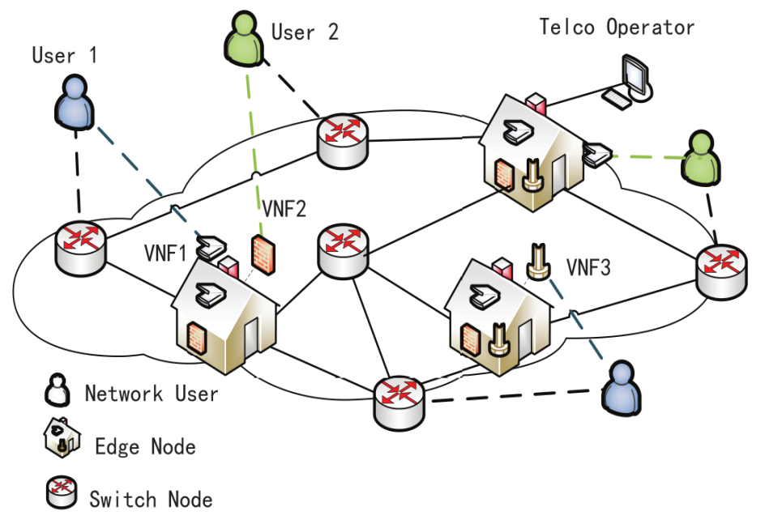
1.2
Service Chain Composition
Service chain composition (SCC) determines the required network functions and paths between them for the network service requests
in the NFV network[1].
Main roles :
Network users generate traffic flows.
Virtual network function (VNF) servers,
provide VNFs as a service.
Telco Operator is responsible for the management and orchestration.
Fig 1.2 A service chain composition scenario
[1] M.S.Bonm, K. L. Dias,and S. F. L. Fernandes, Integrated NFV/SDN architectures: A systematic literature review, IEEE ACM Comput. Surv, vol. 51, pp. 114, 2019.
Notes:
NFV 技术虽然为网络服务商建立灵活高效的服务模式提供了支撑，但在用户需求动态变化的情况下，虚拟网络功能的编排仍然具有挑战性。为了使分
布在多个云数据中心的网络功能进行合理链接，网络中流量数据包得到有效响应，服务功能链技术应运而生。根据互联网工程任务组对 SFC 的标准化定义可知，广义的服务功能链是一组有序的网络功能集合，业务按顺序依次经过网络功能的处理。网络功能作为一个逻辑构件，既可以通过嵌入物理网络元素实现，也可以通过虚拟网络功能实现。在 NFV 架构中，SFC 请求由一组 VNFs 和 VNF 之间的链接(Virtual Network Function Link，VNFL)组成。NFV 通过管理和编排机制将一个端到端的网络服务变为由 VNFL 连接的 VNFs 集合，其中的 VNF 对应着一个或若干个虚拟机资源，每条 VNFL 对应着一组物理链路集合，需要占用一定的网络资源。如图 2-4 所示，这是 NFV 网络中一条服务功能链，其中，终端 A 和 B 分别
是服务起始点和终止点，虚拟网络功能运行于底层硬件资源上，可以与单个或多个基础设施相关联。

Slide 6
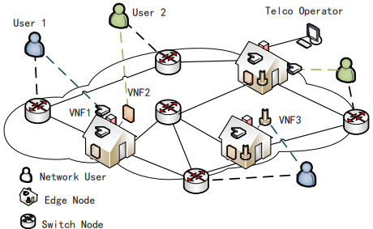
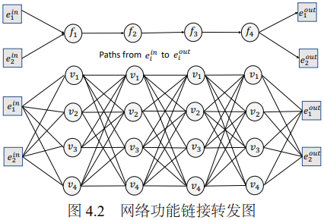
1.3
NFV service chain model
Preliminaries：
Function layers:
VNF Servers set:
NS configuration of user :
Fig 1.3 Network function forwarding diagram[1].
Each user selfishly aims to maximize their own benefits or minimize costs，
characterized by its data synchronization rate and the ingress and the egress node pair .

Slide 7
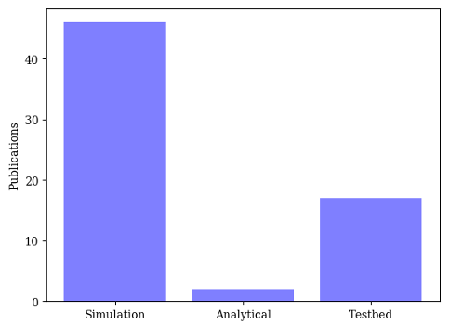
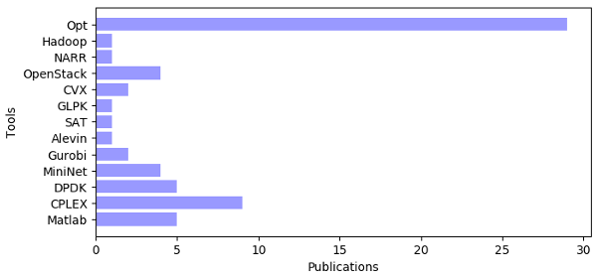
1.4
Techniques and tools for NFV approaches
Fig 1.4 List of techniques [2].
Fig 1.5 List of tools [2].
Both industrial researchers and academics have concurrently been researching the architectural components of networks. All this raises the question of how a virtual network function can be developed and deployed for use in a data center scenario.
[2] R Souza, K Dias, S Fernandes, NFV Data Centers: A Systematic Review, IEEE Access, vol. 8, pp. 51713 - 51735, 2022.

Slide 8
1.5
Problems and Main Works
The existing methods （centralized algorithm）mainly optimize cost from the perspective of telecom operators, although the system optimization is achieved, but the individual utility of network users is not considered。
The need to know the network status and system parameters means that continuous monitoring of the network is difficult to achieve in practice.
Considering the behavior of users competing for resources, the function chain configuration problem is transformed into the Nash equilibrium solution problem of the corresponding model.
When it comes to the practical implementation in numerical computation, the proposed expression of the potential function by STP is preferred since it can store the whole game framework and derives the Nash equilibrium systematically.

Slide 9
2
Preliminaries

Slide 10
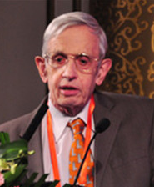
2.1
Normal Game
A game is characterized by a tuple
Coin game |  | player 2
 |  | head | tail
Player 1 | head | -1,1 | 1,-1
 | tail | 1,-1 | --1,1
John Nash
Def 2.1 [3] If for each player , action profile satisifies
then it is called the pure Nash equilibrium.
[3] R.Gibbons,“A primer in game theory,”Harvester Wheatsheaf,1992.
Notes:
重复严格优势法，即每名参与者都考虑所有可能发生的情况，并从中作出最优选择

Slide 11
2.2
(Weighted) potential game
Def 2.2 [3] A game is a weighted potential game if it admits a function satisfies :
P
is called the weighted potential function.
Example: Prisoner dilemma
utility function |  | Player 2
 |  | Confess | Deny
Player 1 | Confess | -3,-3 | 0,-4
 | Deny | -4,0 | -1,-1
potential function | Confess | Deny
Confess | -3 | -4
Deny | -4 | -5
[3] R.Gibbons,“A primer in game theory,”Harvester Wheatsheaf,1992..

Slide 12
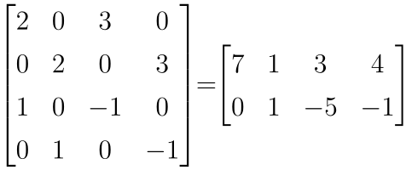
2.4
Semi-tensor Product
Def 2.3 [4] The semi-tensor product (STP) of A and B is defined as
Example：
The algebraic representation of the utility function in
[5]
Utility matrix：
[4] D.Cheng, H.Qi, Z.Li,“Analysis and Control of Boolean Networks: A Semi-tensor Product Approach,”London,U.K.:Springer,2011.
[5] D.Cheng,“On finite potential games, Automatica,vol.50,no.7,pp.1793–1801, 2014

Slide 13
A variation of congestion game
2.5
Def 2.4 [6] A congestion game is a tuple
:
Player set:
Facilities set:
Action set :
Utility functions：
Fig 2.1 A player-specific utilities congestion situation.
Def 2.5 [7]Congestion games with player-specific utility (CGPS) is a tuple
I
,where
III
V
Thm 2.1 [7] Let be a CGPS game. Then CGPS game admits a weighted potential function given by
[6] R.W. Rosenthal, “A class of games possessing pure-strategy nash equilibria,” International Journal of Game Theory, vol. 2, pp. 65–67,1973.
[7] S. Le, Y. Wu, and X. Sun, “Congestion games with player-specific utility functions and its application to NFV networks,” IEEE Transactions on Automation Science and Engineering, vol. 16, no. 4, pp. 1870–1881, 2019.
Notes:
原拥塞博弈刻画的是局中人受拥塞影响程度相同，效用一致。无法刻画局中人的效用
受拥塞的影响程度不同的情形。

Slide 14
3
NFV games with complete information

Slide 15
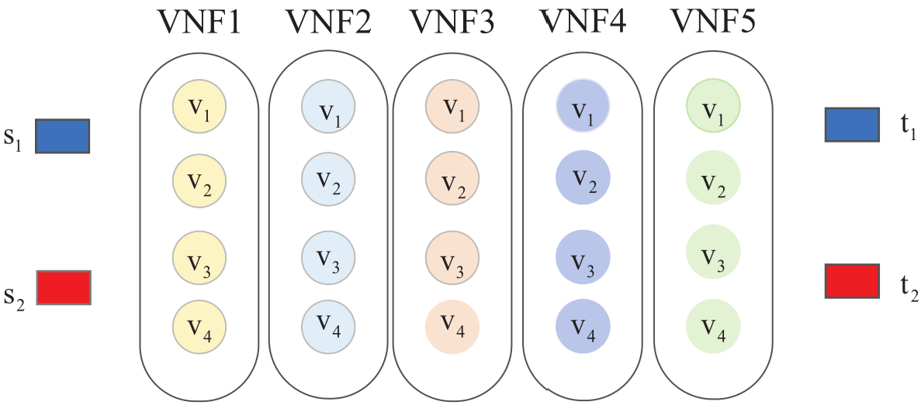
3.1
NFV game formulation
The purposed NFV game :
Player set:
Facilities set:
Action set :
Utility functions：
Fig 3.1 Service Chain Model with F = 5,
V = 4 and N = 2.
that depend on the actual network status and demand.

Slide 16
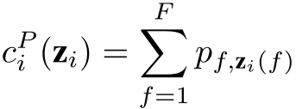
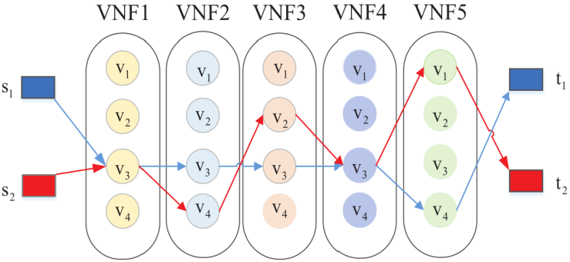
3. 2.1
Service function chaining games for user overhead
Server prices:
Communication latencies:
Congestion costs:
Construction of utility function
Fig 3.2 Illustrative example of a possible
service chain configuration.
.
The utility function：
Potential Function
Thm 3.1 [7]The resulted NFV game admits a weighted potential function given by
[7] S. Le, Y. Wu, and X. Sun, “Congestion games with player-specific utility functions and its application to NFV networks,” IEEE Transactions on Automation Science and Engineering, vol. 16, no. 4, pp. 1870–1881, 2019.

Slide 17
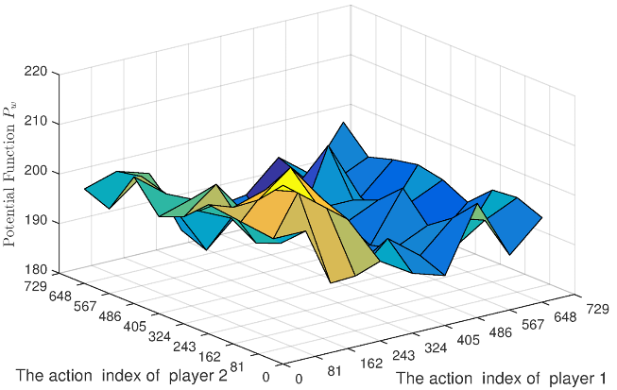
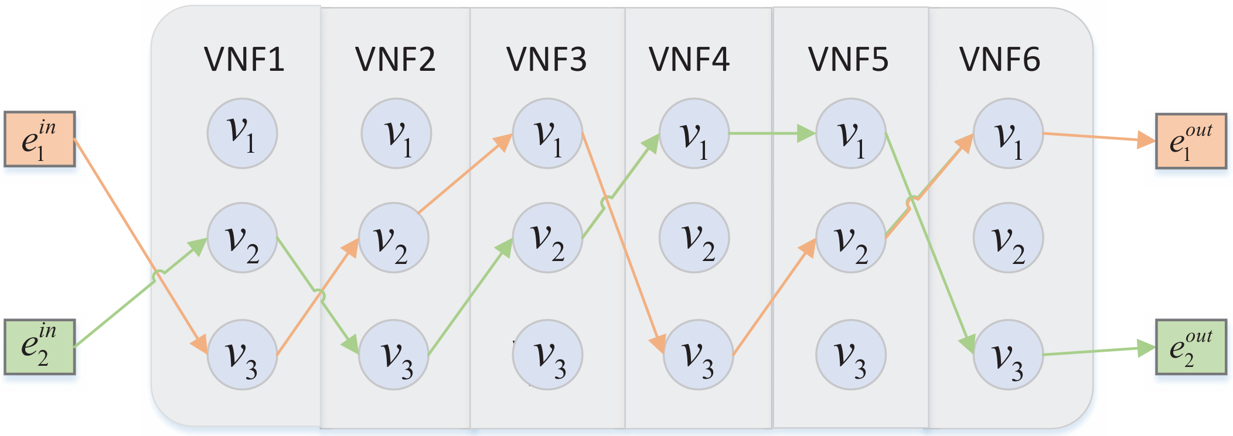
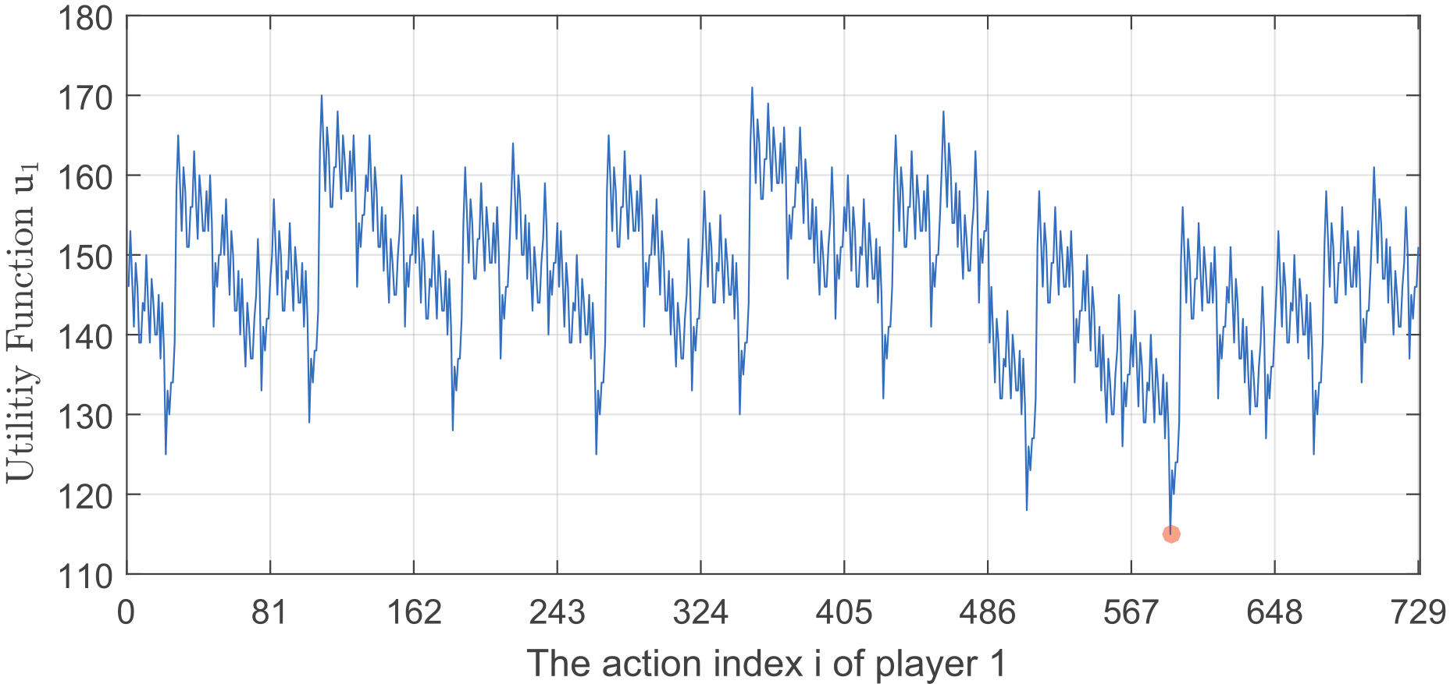
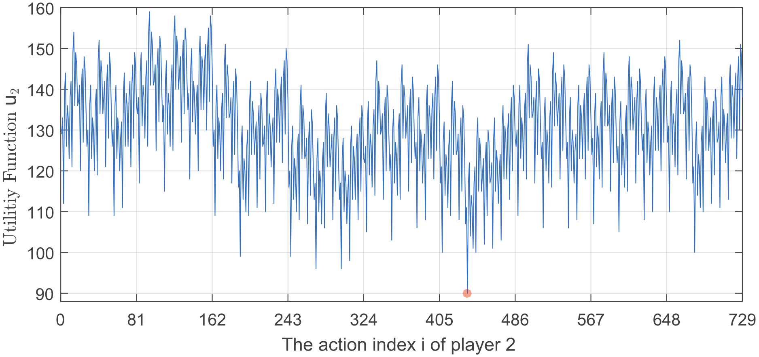
3.2.2
Numerical Example
Fig 3.3 Network function forwarding diagram.
Fig 3.4 The potential function in Eg3.1.
Fig 3.5 The utility function .
Fig 3.6 The utility function .
Notes:
=

Slide 18
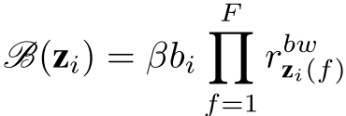
3. 3.1
Service function chaining games with function benefit
The utility of each user is calculated using the function benefit and the total costs for choosing the desired functions.
Function benefit :
Server prices:
Communication latencies:
Congestion costs:
Fig 3.7 A service function chain request
under bandwidth loss.
The utility function：

Slide 19
3.3.2
Algebraic representation and calculation by STP
The algebraic representation of the NFV game
Specific utility structure vector:
Congestion cost vector:
Congestion cost matrix:
Potential Function
Thm 3.2 [78]The resulted NFV game admits a weighted potential function given by
where , is the data synchronization rate of player .
[8] S. Le, Y. Wu, and M. Toyoda, “A congestion game framework for service chain composition in NFV with function benefit,” Information Sciences, vol. 514, pp. 512–522, 2020..
Notes:
=

Slide 20
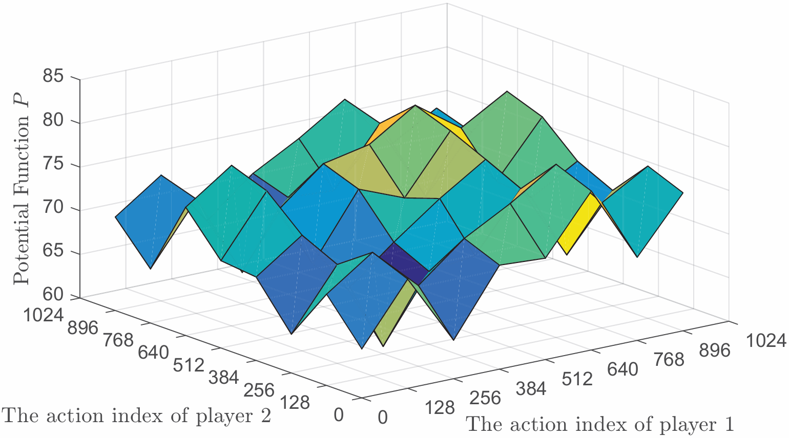
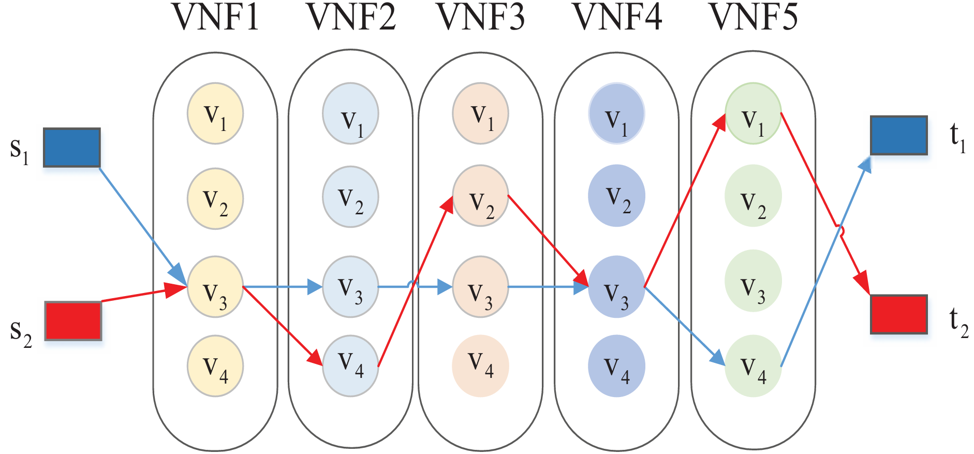
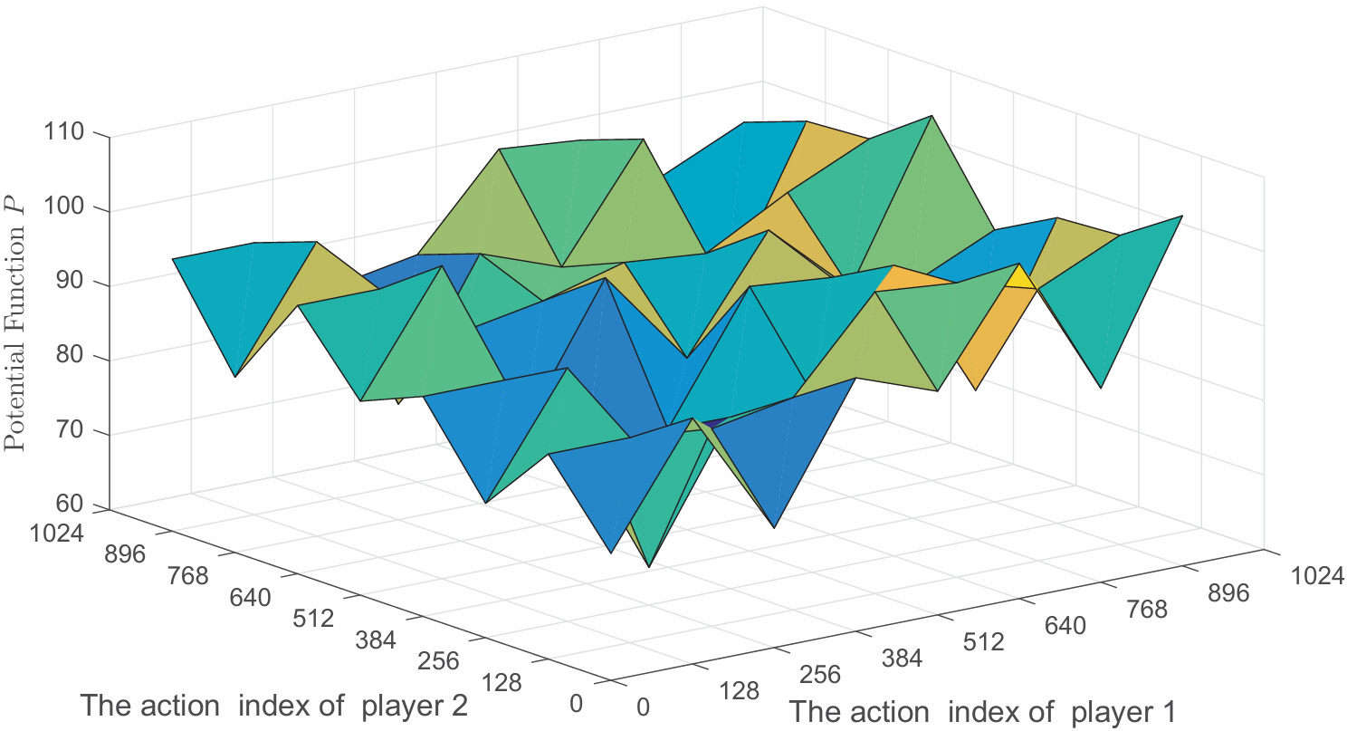
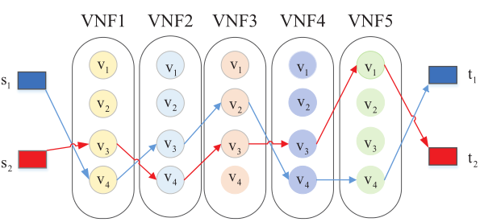
3.3.3
Numerical Example
Fig 3.8 Potential function .
Fig 3.9 Service chain configuration at NE.
Fig 3.10 Potential function
Fig 3.11 Service chain configuration at NE.
The sizes of parameters quantify the impacts of the different cost factors on the utility function, which ultimately affect the behaviors of network users.

Slide 21
3. 4
Service function chaining games with coupled constraints
Construction of utility function
server capacity constraint
minimum target constraint
The utility function：
Potential Function
Thm 3.3 [9]The resulted NFV game is a weighted potential game with a potential function given by
[9] S. Le, Y. Wu, Y. Guo, and C. Vecchio, Game Theoretic Approach for a service function chain routing in NFV with coupled constraints , IEEE Transac tions on Circuits and Systems II: Express Briefs, 2021, 68(12): 3557-3561.

Slide 22
4
NFV games with incomplete information

Slide 23
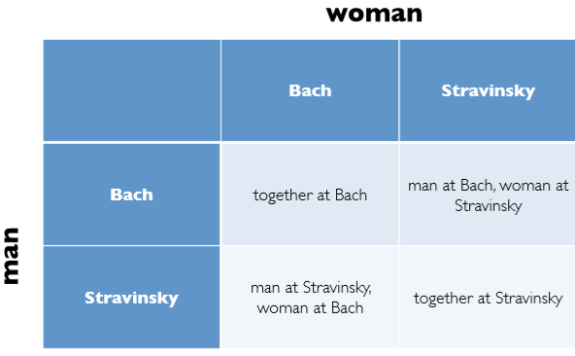
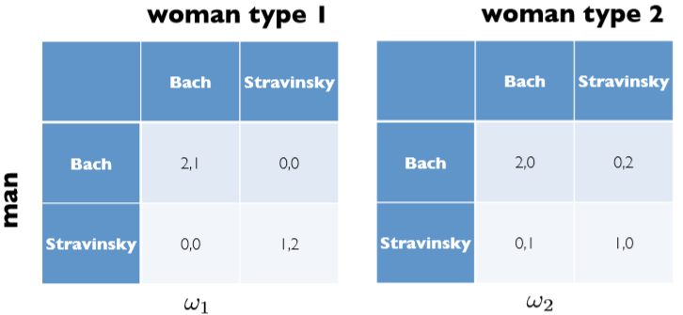
4.1
Incomplete information
Battle of Sexes
•Players: –a man and a woman
•Actions: –attending a concert of either Bach or Stravinsky
•Preferences: –each players prefers to attend a concert with the other rather than alone,
Uncertainty
The man is not certain about the intentions of the woman:
How the situation can be modeled? ——Bayesian games

Slide 24
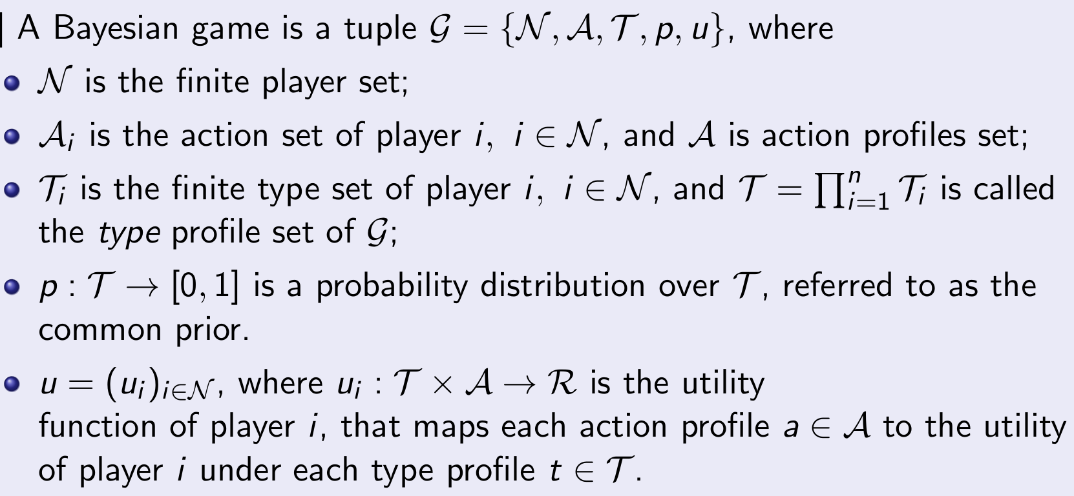
4.2
Bayesian Game
Def 4.1 [10]
[10] J. C Harsanyi, Games with incomplete information played by Bayesian players part I. The basic model, Management Science, vol. 14, no. 3, pp.159-182, 1967.
.

Slide 25
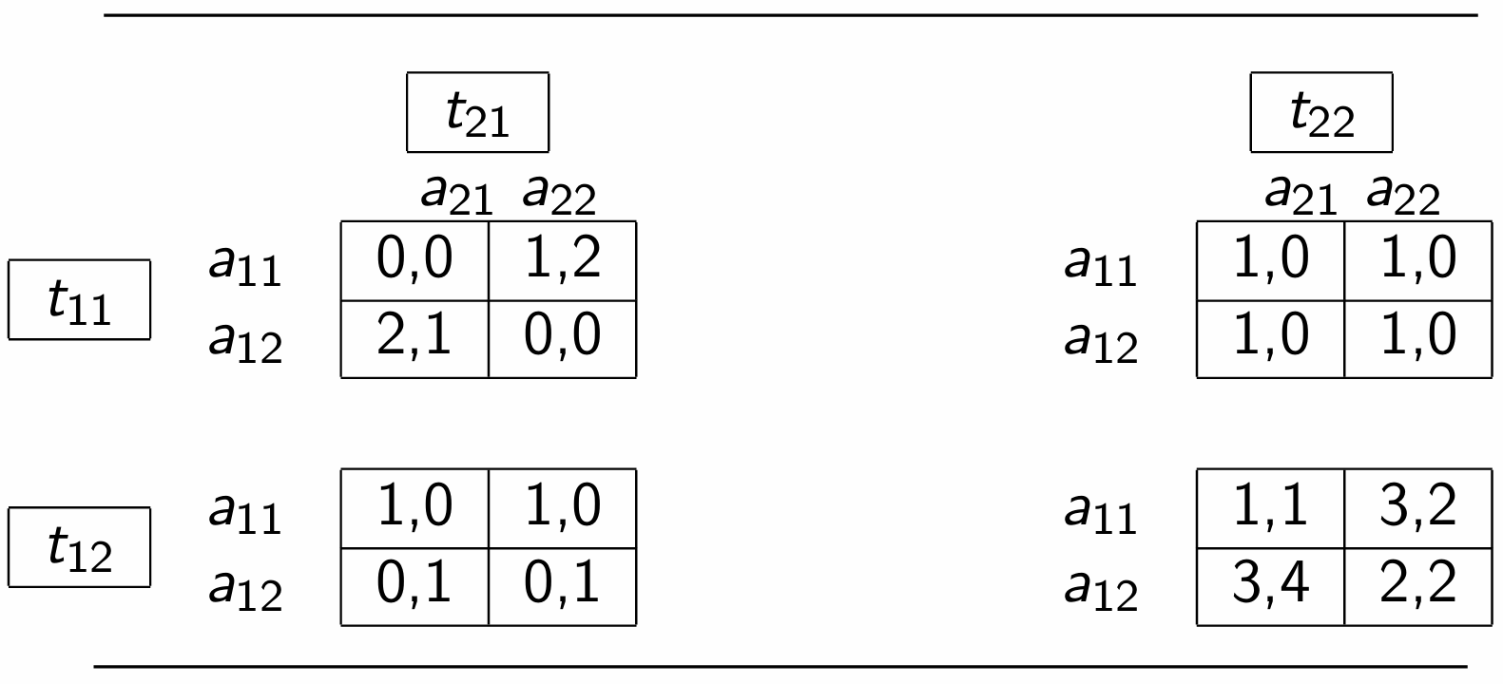
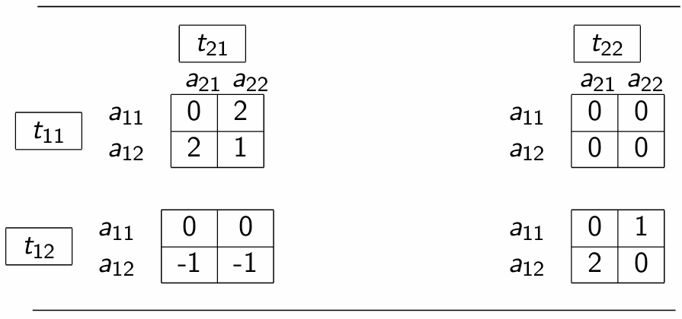
4.2
Bayesian Game
Bayesian Nash equilibrium
Def 4.2 [3] If for each type of each player in Bayesian game, strategy profile satisfies
then it is a pure Bayesian Nash equilibrium (BNE).
Fig 4.1 A Bayesian potential game.
Bayesian Potential Games
Def 4.3 [3] A Bayesian game G is a Bayesian potential game (BPG) if there exists a function , satisfies
And F is a Bayesian potential function for G.
Fig 4.2 A Bayesian potential function.
[3] R.Gibbons,“A primer in game theory,”Harvester Wheatsheaf,1992..

Slide 26
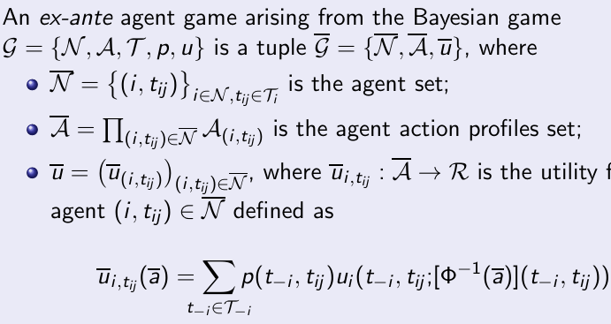
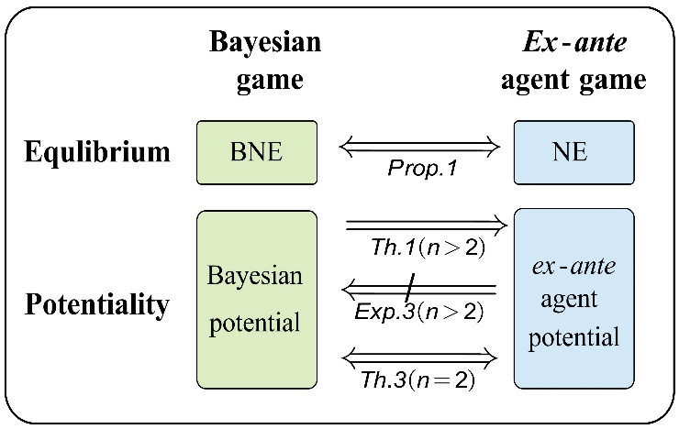
4.3
Ex-ante Agent Game
Conversions in Bayesian games
The key idea to dealing with a Bayesian game is to convert it into a normal game, which is also called a complete information game[11].
Def 4.4 [12]
The proposed game expands the scope of using the potential function method to seek the Bayesian Nash equilibrium.
[11] C Li, D. Cheng, Modeling, analysis, and dynamics of Bayesian games via matrix-based method, Journal of the Franklin Institute，vol. 14, no. 3, pp.6162-6193, 2023.
[12] Y. Wu, S. Le, K. Zhang, X. Sun, Ex-ante agent transformation of Bayesian games, IEEE Trans. Autom. Control , vol. 67, no. 11, pp. 5793 - 5808, 2022.
.

Slide 27
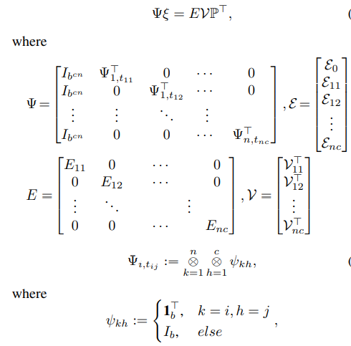
4.3
Ex-ante Agent Game
Potential equations of ex-ante agent games
Inspired by the equation of the deterministic potential game in [5] , develop a potential equation stores the probability information of the original Bayesian games.
Thm 4.1 The ex-ante agent game of the Bayesian game G = {N,A,T,p,u} is a potential game, if and only if the ex-ante agent potential game equation
has a solution,
[5] D.Cheng,“On finite potential games, Automatica,vol.50,no.7,pp.1793–1801, 2014

Slide 28
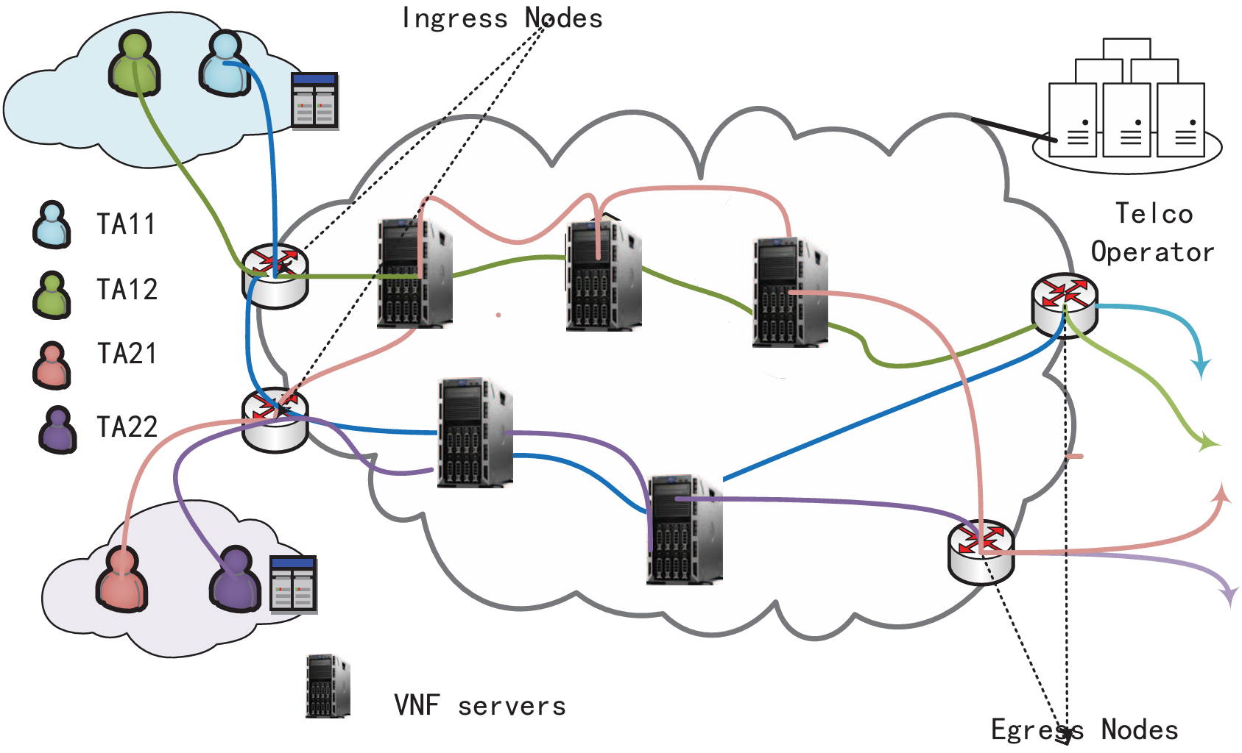
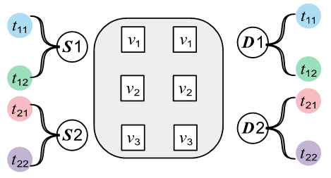
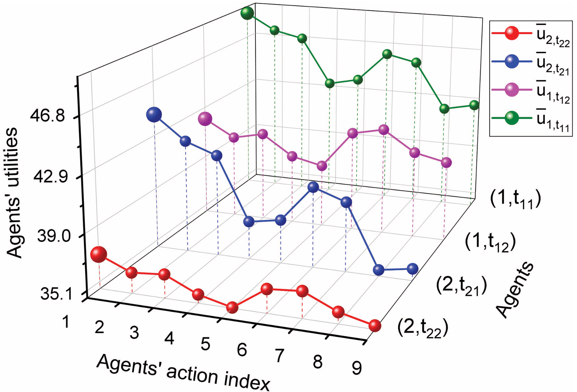
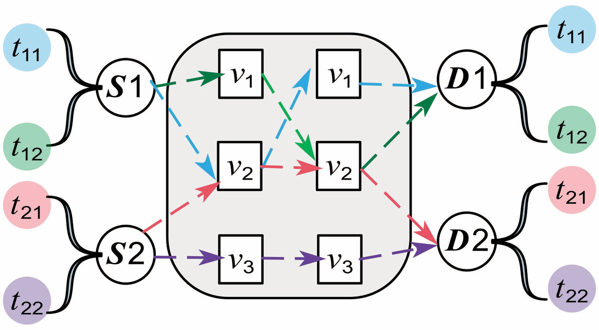
4.4
NFV game with incomplete information
In a real deployment though, the user traffic load and link demands include significant uncertainty
e.g., The traffic load that each user is expecting can vary according to their target applications.
Fig 4.3 A Network scenario with
incomplete information.
Fig 4.4 An illustrative example.
Fig 4.6 The paths of players at BNE.
Fig 4.5 Values of agents’ utilities.
Notes:
NFV 技术虽然为网络服务商建立灵活高效的服务模式提供了支撑，但在用户需求动态变化的情况下，虚拟网络功能的编排仍然具有挑战性。为了使分
布在多个云数据中心的网络功能进行合理链接，网络中流量数据包得到有效响应，服务功能链技术应运而生。根据互联网工程任务组对 SFC 的标准化定义可知，广义的服务功能链是一组有序的网络功能集合，业务按顺序依次经过网络功能的处理。网络功能作为一个逻辑构件，既可以通过嵌入物理网络元素实现，也可以通过虚拟网络功能实现。在 NFV 架构中，SFC 请求由一组 VNFs 和 VNF 之间的链接(Virtual Network Function Link，VNFL)组成。NFV 通过管理和编排机制将一个端到端的网络服务变为由 VNFL 连接的 VNFs 集合，其中的 VNF 对应着一个或若干个虚拟机资源，每条 VNFL 对应着一组物理链路集合，需要占用一定的网络资源。如图 2-4 所示，这是 NFV 网络中一条服务功能链，其中，终端 A 和 B 分别
是服务起始点和终止点，虚拟网络功能运行于底层硬件资源上，可以与单个或多个基础设施相关联。

Slide 29
5
Prospect

Slide 30
5
Future investigation
Equilibrium Algorithm: the lower computational complexity method for checking BPG and calculating BNE.
Performance Evaluation: the price of anarchy of the resulted NFV games.
DUT

Slide 31
Thanks for listening!
DUT

